Slide 1

Why is my solar suddenly worth nothing?
2026
Injection rates, and why self-consumption is the answer
Notes:
When solar PV first took off in Europe, homeowners were paid generously for every kilowatt-hour they injected back to the grid — sometimes more than they paid to buy electricity. That world is gone. In many countries today, the compensation for injected solar energy hovers around zero, or in some cases is even negative. This deck explains why that has happened and, more importantly, what it means for how we should size, operate and think about our solar systems going forward. The short version: the value of solar has shifted from injection to self-consumption.

Slide 2
How to use this slide deck
This Slide deck is meant as a guide and easy starting point for a person that will explain the topic to an audience that isn't familiar with the topic yet.
Feel free to adapt and expand to your own need.
  The material is licensed under CC4.0 SA BY
You can find guidance text in the notes of each slide

Slide 3
Agenda
Yesterday's deal
Today: ~0 €/kWh
Once upon a time, every solar kWh you produced was worth the same as one you bought.
Oversupply at noon, the merit-order effect, and fixed grid fees all pull the price down.
Self-consumption first
Shifting loads, batteries and energy communities turn every produced kWh into a saved kWh.
Notes:
We will walk through three questions in turn. First, why solar used to feel like such a good deal — net metering and feed-in tariffs made every kWh equally valuable. Second, what changed and why injection rates collapsed to near-zero. Third, what this means in practice: the value of your solar system today comes from the energy you use yourself, not the energy you send to the grid.

Slide 4
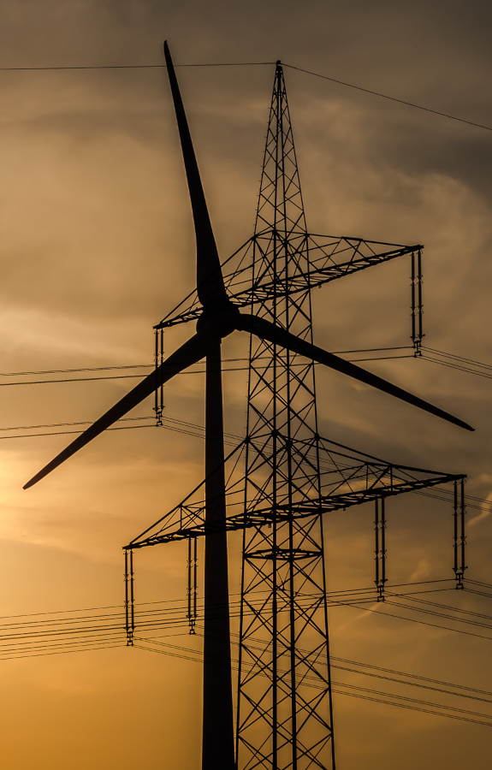
Yesterday's deal
Net metering: 1 kWh in cancels 1 kWh out
Feed-in tariffs guaranteed per injected kWh
More panels = more revenue, regardless of timing
Notes:
For roughly fifteen years, residential solar in Europe ran on one of two simple deals. Under net metering, your meter literally counted backwards when you injected energy — every kWh you produced cancelled out a kWh you imported later, at the same retail price. Under feed-in tariffs, you were paid a fixed per-kWh price for everything you injected, often above the wholesale market rate, and guaranteed for 10–20 years. In both cases the message to the homeowner was identical: produce as much as you can, whenever you can, and you'll be rewarded. The size and orientation of your panels didn't really matter — only the total annual output did.

Slide 5
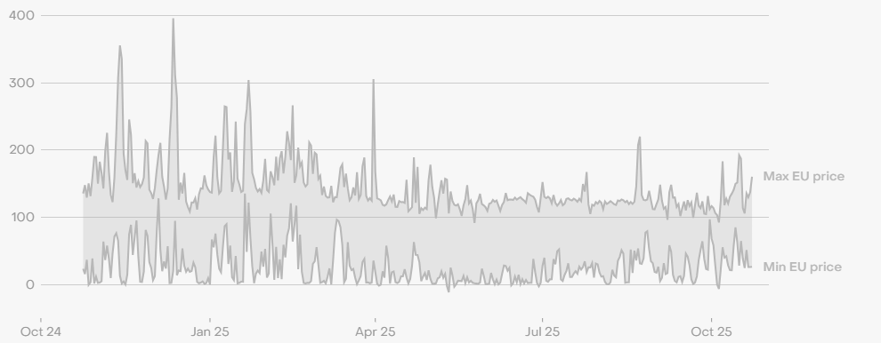
Why is injection worth so little today?
Notes:
Both of the old deals were policy choices, not market realities. They worked when rooftop solar was rare and the marginal kWh of clean energy was genuinely valuable. As solar capacity grew across Europe — by a factor of more than ten over a decade — that calculus changed completely. Three things pulled the value of an injected kWh toward zero, and we will look at each of them in turn.

Slide 6
Why injection is worth ~0 €
Everyone produces at the same time
On a sunny day, half the country's roofs export at once. The grid suddenly has far more solar power than anyone needs locally, and prices on the wholesale market collapse — sometimes all the way to zero, or even below.
Notes:
The first reason is the simplest: solar production peaks at exactly the same moment for everyone in the same region. When the sun is high on a clear day in May, every PV system within a few hundred kilometres of you is exporting at the same time. Local demand doesn't change that much through the day, so the grid ends up with a massive surplus of cheap solar electricity. Wholesale prices on the day-ahead market fall sharply during these hours — in Germany, the Netherlands, Belgium and Spain we now routinely see midday prices below 10 €/MWh in spring, and sometimes negative prices when there's also wind.

Slide 7
Why injection is worth ~0 €
Everyone produces at the same time
Half the country's roofs export at once. Wholesale prices on a sunny day regularly collapse to near-zero — or even turn negative.
The merit-order effect
Electricity markets price every kWh at the cost of the most expensive plant needed. When solar covers the load at noon, the cheapest source — solar itself — sets the price. Result: near-zero clearing price.
Notes:
The second reason sits inside the design of the European wholesale market. Electricity is priced by the merit-order principle: bids are stacked from cheapest to most expensive, and the price everyone receives is set by the most expensive plant needed to meet demand. In the old days that was usually a gas plant — so even renewable producers were paid a gas-derived price. But on a sunny afternoon, with solar covering the entire load, the most expensive plant needed is solar itself, with a marginal cost of zero. So the market price falls to zero, and any retail injection rate that tracks the wholesale market falls with it.

Slide 8
Why injection is worth ~0 €
Everyone produces at the same time
Half the country's roofs export at once. Wholesale prices on a sunny day regularly collapse to near-zero — or even turn negative.
The merit-order effect
Markets price every kWh at the most expensive plant needed. With solar covering the load at noon, solar itself sets the price — at zero fuel cost.
Grid fees and taxes are not refunded
Most of your bill is grid tariffs, levies and VAT, paid on every imported kWh but never returned on what you inject. Net metering hid this; smart meters expose it.
Notes:
The third reason is the policy shift that comes with smart meters. Under the old net-metering scheme, a kWh in and a kWh out were treated as equivalent — which quietly meant you weren't paying grid tariffs, levies or VAT on the electricity you self-produced. That was always an implicit subsidy worth ten to twenty cents per kWh. With smart meters and separate metering of import and export, regulators in Belgium, the Netherlands and elsewhere have switched to settlement on the actual flows. You still pay the full retail price (including all fees) on every imported kWh, but you only receive the bare wholesale price on every exported kWh. The two are no longer symmetric, and the gap is huge.

Slide 9
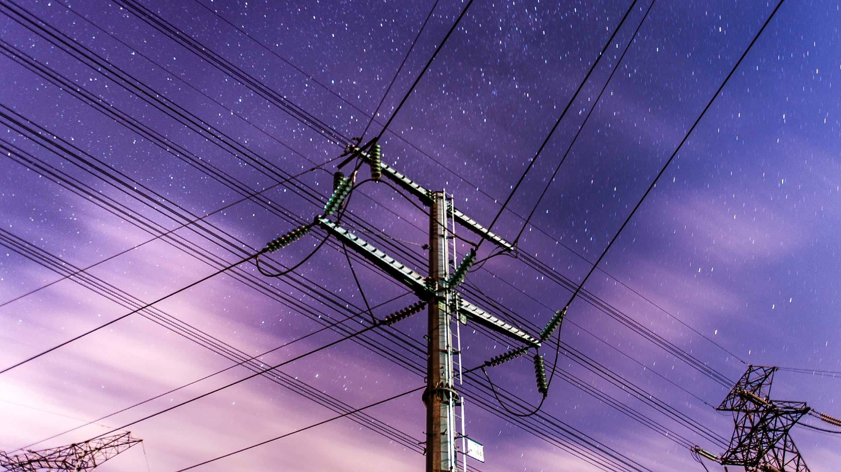
Self-consumption is the answer
Self-
consume
Every kWh you use yourself avoids the full retail price.
Every kWh you inject earns only the wholesale price.
Notes:
If injection is worth almost nothing and import costs the full retail price, the value of any PV system today is measured by how much of its output you consume yourself. A self-consumed kWh saves you the full retail price — typically around thirty euro cents in most EU markets. An injected kWh earns you the wholesale price — typically two to five cents. The ratio can be six or ten to one. That ratio is what makes self-consumption strategies the single biggest lever for the economics of residential solar today.

Slide 10
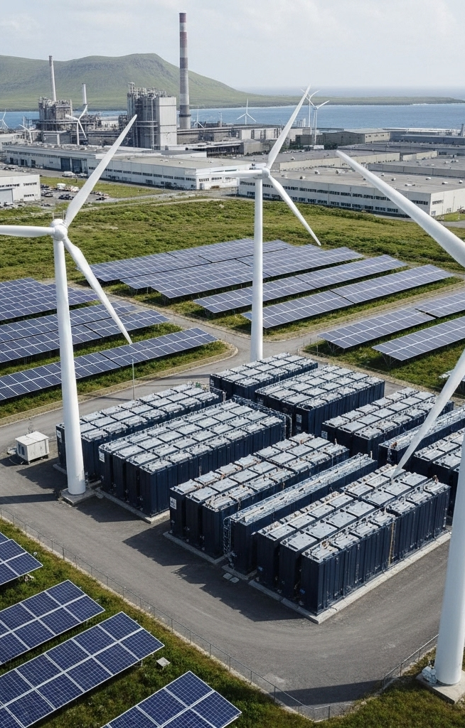
Shift your loads to daytime
When the sun shines, run the loads:
Charge the EV at midday, not overnight
Heat-pump boost cycles around solar noon
Run the dishwasher and washing machine on solar hours
Notes:
The cheapest way to lift self-consumption is to move flexible loads into the sunny hours. EV charging is the single biggest opportunity — a typical 7 kW home charger can absorb everything a 4–5 kWp roof produces. If you currently charge overnight on a cheap night tariff, switching to midday charging now almost always wins, because you avoid both the grid-fee component and the near-zero injection price. The same logic applies to heat-pump boilers, electric water heaters, dishwashers, washing machines and tumble driers — most modern appliances can be scheduled to start during a specific window.

Slide 11
Add a home battery (maybe)
Soak up midday surplus, discharge in the evening:
A 5–10 kWh battery covers most of an evening
Inverter must charge from PV first, never from the grid
Size to your evening profile, not to your roof
Notes:
A home battery stores midday surplus until the evening peak, when you would otherwise import at the retail rate. A 5–10 kWh battery is plenty for most households — it is sized to evening load, not to PV output. The break-even depends heavily on the spread between import and injection prices: at a twenty-five-cent retail and three-cent injection, every cycled kWh saves about twenty-two cents, which gives a payback in the seven-to-ten-year range with current battery prices. Importantly, the smart inverter should be configured to charge from PV first, never from the grid, otherwise you destroy the economics.

Slide 12
Join (or start) an energy community
Self-consumption at neighbourhood scale:
Share PV output with neighbours who can use it now
A daycare, bakery or office absorbs your noon peak
EU regulation lets members settle at a reduced grid tariff
Notes:
If you can't self-consume more inside your own meter, the next best thing is to share the surplus with neighbours who can use it right now. EU regulation (the Renewable Energy Directive and the Electricity Market Directive) created two legal forms for this — Renewable Energy Communities and Citizen Energy Communities — and most member states have transposed them. Inside such a community, your midday surplus can be settled against the consumption of a daycare, a bakery, a small office or a neighbour with an EV, often at a reduced grid tariff. The Every1 deck 'An energy community is more than just energy sharing' goes deeper on this — it is a natural follow-up to this deck.

Slide 13

The takeaway
Solar is still a great investment — the rules have changed:
Design for self-consumption, not for maximum annual output
Combine PV with flexibility: smart loads, batteries, EV, community
The meter is a tool, not the value of your kWh
Notes:
The headline is not that solar is over. It isn't — the LCOE of rooftop PV is still below the retail electricity price almost everywhere in Europe, which means the technology pays itself back. What has changed is where the value comes from. Yesterday, value came from injection: bigger roofs, more annual kWh, better returns. Today, value comes from self-consumption: matching your production to your consumption, in the same building or the same community. Practically, that means designing PV systems differently — east-west orientations to spread production, smaller arrays paired with batteries, and integration with EVs, heat pumps and smart appliances. The goal is no longer to make the meter spin backwards; it is to keep the meter still.

Slide 14
acknowledgements
This slide deck “Why is my solar suddenly worth nothing?” was produced by Th!nk E for the Every1 project and is licensed CC BY-SA 4.0.
Every1 has received funding from the European Union’s Horizon Europe research and innovation programme under grant agreement No. 101075596.

Slide 15
Thank you!
Notes:
Any questions? Useful follow-up Every1 materials on the knowledge hub: 'An energy community is more than just energy sharing', 'How does flexibility help the grid', 'Why do we need interoperability between household appliances', and the 'Flexibility, can you beat the market?' Excel game.

