Slide 1

Why do we need interoperability between household appliances
date
Lorem
Notes:
We live in a time when energy must be used more intelligently than ever before.
Our electricity increasingly comes from renewable sources such as solar and wind power. This is good for the climate, but it also presents new challenges: the sun does not always shine, and the wind does not always blow. As a result, the supply of energy
Fluctuates, and in order to maintain balance in the electricity grid, we also need to organize our energy demand more intelligently.
An important part of that solution lies in our homes. Household appliances such as washing machines, heat pumps and dishwashers consume a large proportion of the electricity. Imagine if these appliances could communicate with each other and
automatically decide to run at the most suitable time, when there is a lot of solar energy available or when the price of electricity is low. That is precisely the idea behind Energy Smart Appliances.
These smart appliances can communicate with each other and with the energy system via standardized digital languages and protocols. This creates a network of devices that work together to use energy more efficiently, cheaply and sustainably.

Slide 2
How to use this slide deck
This Slide deck is meant as a guide and easy starting point for a person that will explain the topic to an audience that isn't familiar with the topic yet.
Feel free to adapt and expand to your own need.
  The material is licensed under CC4.0 SA BY
You can find guidance text in the notes of each slide

Slide 3
Agenda
Why devices need to communicate
How devices work together to save energy
Smart communication helps to make better use of renewable energy and keep the electricity grid balanced.
Smart devices adjust their consumption to energy supply, prices and each other via open standards.
Benefits of interoperability
Smart communication between devices will make energy consumption more sustainable, efficient and user-friendly in the future.

Slide 4
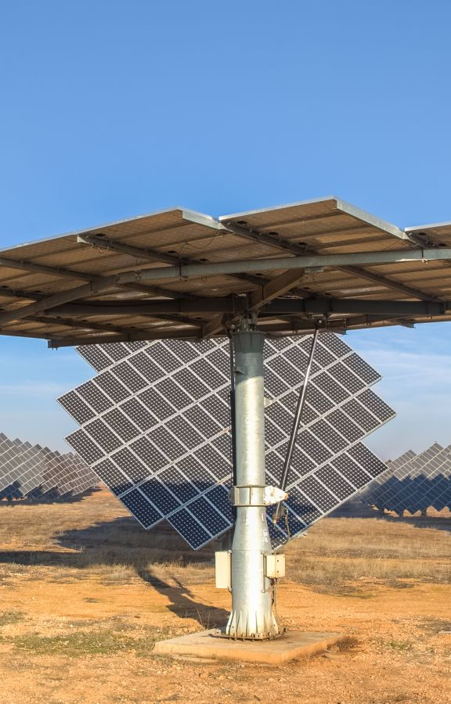
Why devices need to communicate
Energy transition: sun and wind are variable supply
We want to optimize for profit and CO2 reductions
We want to do more with the same grid
Notes:
We are in the midst of a major energy transition. More electricity is being produced from renewable sources such as solar and wind. This is good for the climate, but it also brings new challenges. Solar panels mainly produce energy during the day,
while wind energy fluctuates greatly depending on the weather. As a result, the supply of electricity is not constant, while demand often peaks at times when less green energy is available. In the past, the electricity grid was controlled by a few large power
stations that could easily adjust supply to demand. Today, that balance is shifting we have thousands of small energy sources spread across homes, businesses and local grids. Think of solar panels, home batteries, electric cars and heat pumps. This makes the system more decentralized and complex to manage. At the same time, electricity consumption is rising due to the electrification of heating, mobility and household appliances. When everyone cooks, turns on the washing machine or charges their car at the
same time, peak moments occur that place a heavy load on the grid. Conversely, on sunny afternoons, sometimes more energy is lost than we can use. That is why smart control is needed: appliances that do not simply consume energy but do so at the right
time. Only in this way can we keep the electricity grid in balance, avoid energy waste and get the most out of renewable sources.
But this will not work if each appliance continues to operate independently. Household appliances must be able to communicate with each other and with the energy system. A washing machine that knows when the solar panels are producing a lot of energy, or a heat pump that temporarily consumes less when the grid load is high, that is the kind of cooperation we need. Without that communication, the potential of smart energy remains untapped. We lose flexibility, pay higher prices during peak times and risk overloading the grid. So, the challenge is clear: how do we enable appliances to communicate efficiently with each other so that they can contribute to a stable, affordable and sustainable energy system?

Slide 5
Local Control
On the device itself
Own measurements
Example:
  Curtailment of PV installations
V
253
t
Notes:
Before we go into interoperability lets first have a look at the simplest form of control that we include in our devices. Local Control.
In local control we will do all the regulation at the relevant device itself, using it’s own measurements.
A typical example of this is the control of PV Inverters. Although modern PV invertors do talk to other devices all of them contain at least a form of local control to limit the voltage range. This sets both a minimum and a maximum voltage outside of which the PV invertor will shut off. Typically the situation that is most well now is where the voltage at the output of the invertor rises to high. (What the exact limit is will depend on national rules, for this example we will work with 253V (i.e. 230V +10%)) This is better know as curtailment and is implemented to protect other devices connected to the grid. To this end of protection this local control loop works very well. By disabling the invertor we do protect these devices. The downside is that we are losing potential production of solar energy. Also this local loop doesn’t allow for optimal usage of energy locally.

Slide 6
Local Control with external measurements
Car Chargers
Electric Boilers
Heat pumps
Batteries
…
Notes:
How could we improve the local usage of energy. It is clear that this is not something your solar installation will be able to optimise. We just want the panels to produce as much energy as possible, and then other devices will try to steer themselves to use this energy optimally. Typical examples for this are car chargers, boilers, heat pumps and batteries, but this isn’t an exhaustive list. So how do they use this energy optimally?

Slide 7
Local Control with external measurements
Local Control on the device itself
Measurements through other devices
  E.g.: Digital meter, PV Invertors
Example a car charger could look at the readings from the digital meter and set its charging current to ensure all produced solar energy is put into the car.
Notes:
These devices still typically work through local control, but instead of using only their own measurements they will connect to another device to get measurements. The most typical measurement source is the digital meter (it does vary across Europe how much data you can really get from this meter) it can give the grid consumption/injection to the car charger.
With just this information you could already make a simple control algorithm where the car charger will set its charging current in such a way that the house is neither injecting or drawing energy from the grid. In such a scenario all produced energy stays local.
Of course in reality we use more data than just these measurements, these devices will also try to predict solar production throughout the day, and should know how much energy is needed at least to, for example, drive to work the next day.
Next to car chargers an electric boiler could heat the water with excess energy, a heat pump could change its setpoints to run more when there is more production, etc.

Slide 8
Local Control with external measurements
Local Control on the device itself
Measurements through other devices
  E.g.: Digital meter, PV Invertors
Example a car charger could look at the readings from the digital meter and set its charging current to ensure all produced solar energy is put into the car.
Works very well for 1 device
Tricky for multiple devices.
Notes:
Now when we start combining more and more of these devices in a house these different control loops might start working against each other. Although they are all trying to do the same thing they can make it more difficult for each other.

Slide 9
Local Control with external measurements
Notes:
You could compare it with balancing a see-saw.
If you are doing this by yourself, it’s relatively easy to do.
Now imagine you are doing this not just with a second person, but there is a screen between you, so you don’t know what the other person is doing. This becomes borderline impossible. This is basically the same as two control loops working at the same time.

Slide 10
Interoperability
Decentralised control
  Devices are aware of each others' goals and behaviour and can predict each other.
Centralised control
  A central hub/service will decide who gets/has to use energy at which point.
Also less controllable devices can be involved
  Dishwashers
  Washing machine/dryer
Notes:
This is where interoperability comes in, it allows for communication and coordination between the different control loops. This can happen either decentralised where the devices just know from each other what they are going to do/ doing and adapting to this. Or this can happen through a centralised hub or service that will run a control loop of it’s own and use the other devices to implement this.
In interoperability not only devices that are controllable can be involved, but also devices also that have no to low controllability can make their data available, with this data other devices can pre-empt for example the energy usage of a heating cycle of the washing machine.

Slide 11
Beyond Local Interoperability
Communication can also go beyond the home
  Within an energy community to share energy
  Sell flexibility
    Directly to an aggregator
    Via an energy community to an aggregator
Notes:
Interoperability can go further than the house. If you are part of an energy community (or other energy sharing scheme) you could also optimise your devices to use the energy produced by others in your community.
Aside from this you could also sell the flexibility of your devices. What is this flexibility? In short: Based on the current state of the grid there might be financial incentives offered to either increase or reduce your energy consumption. You can use your smart interoperable devices to react to these incentives. Going into flexibility would lead us to far here, but an important point there is that in general you will need an aggregator that combines the flexibility of many households into one bundle to participate. For more information on flexibility take a look at the learning materials available on the Every1 website.

Slide 12
Benefits in short
Reduce costs
By using more self-produced electricity
Reduce CO2 emissions
By ensuring you tailor your consumption to production
Stabilize the grid
Smart devices adjust their consumption to avoid peaks in the grid.
Notes:
By optimizing the match between consumption and production you need to draw less energy from the grid, this helps avoiding grid costs reducing your overall electricity bill
By using your devices as much as possible when your PV installation is working you get to use cleaner energy
Local usage of energy and matching consumption to production help reduce the load on the grid.

Slide 13
Thank you!

Slide 14
acknowledgements
This slide deck was produced for by the Every1 project.
The images used in this presentation are as follows:
Slide 3: Spain’s new government commits to massive clean energy build-out by energytransition.org
CC BY-SA 4.0 license

Slide 15
Licencing
CC 4.0 SA BY
  You can use it commercially
  Attribute the Every1 project
  Make slide deck available

Slide 16
Other Topics
Energy Digitalisation for SMEs
An energy community is more than just energy sharing
How does flexibility help the grid
Do renewables make the grid unstable
Avoiding the Mattheus effect
The changing role of citizens in the energy transition
Is going off grid a good idea
What is bidirectional charging (French)
What can we learn from the Spanish and Portuguese Black-out? (Portuguese)
What is a digital twin of the grid (Spanish)
Why cybersecurity matters
How to make our grid cheaper
The energy market explained (Dutch)
Why is my solar energy worth nothing anymore

