Slide 1

Why cybersecurity matters
date
Lorem
Notes:
We live in an age where almost everything is digitally connected. Businesses, governments and individuals rely on technology every day to share information, make payments and collaborate. This digitalization brings enormous benefits, but it also makes us
more vulnerable than ever. Cyber attacks are no longer exceptional, but a reality that everyone must take into account. Cyber security, protecting computer systems, networks and data from attacks or unauthorized access, has therefore become an
indispensable part of our society. It is not just about technical measures, but also about policy, human behavior and constant vigilance.
When a cyberattack occurs, the consequences can be significant: loss of sensitive information, financial damage, reputational damage and even disruption of vital infrastructure. Yet it appears that many organizations and individuals still underestimate their
digital resilience. With this presentation, we want to show what cybersecurity entails, why it is so important, and how we can ensure that it is applied effectively, both technologically and humanly. Because in an increasingly digital world, cybersecurity is no
longer a luxury, but an absolute necessity.

Slide 2
How to use this slide deck
This Slide deck is meant as a guide and easy starting point for a person that will explain the topic to an audience that isn't familiar with the topic yet.
Feel free to adapt and expand to your own need.
  The material is licensed under CC4.0 SA BY
You can find guidance text in the notes of each slide

Slide 3
Agenda
What is cybersecurity?
Why is cybersecurity essential?
Cybersecurity: the digital wall of trust.
Digital security is not a luxury, but a necessity.
The future of cybersecurity.
The future is digital, and therefore it must be secure.

Slide 4
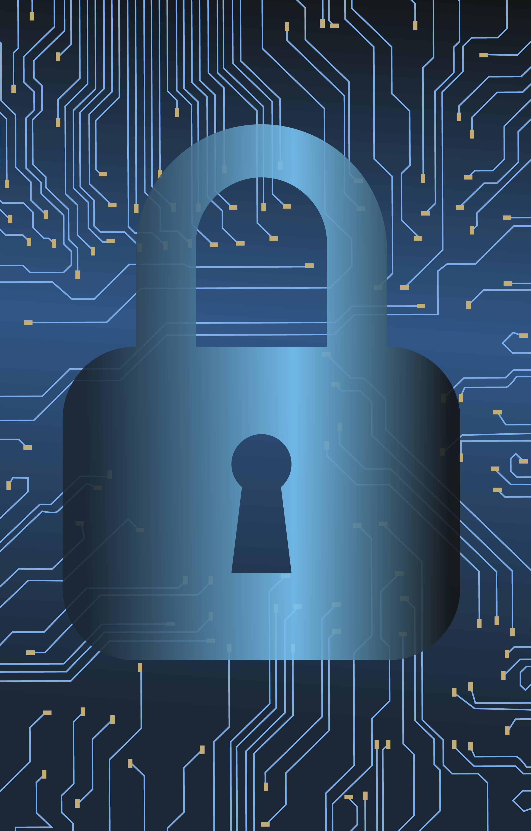
What is cybersecurity?
Protection of systems and data
Confidentiality, integrity and availability
Technology, policy and human behavior
Notes:
Cybersecurity is the set of measures and strategies designed to protect computer systems, networks and data from digital attacks. In our highly connected world, where almost everything happens online, from banking to healthcare and communication,
cybersecurity has become indispensable. The goal of cybersecurity is to keep our digital information safe and ensure that it cannot be stolen, altered or destroyed by unauthorized persons. This revolves around three basic principles: confidentiality, integrity
and availability. Confidentiality means that only people with the right permissions can access certain data. Integrity means that this data remains accurate and reliable. Availability guarantees that systems and information are always accessible when needed.
Cybersecurity encompasses not only technology, such as firewalls and antivirus programs, but also human behavior and organizational policy. A sound password policy, regular software updates, and employee awareness are at least as important as technical
protection. Digital threats such as phishing, ransomware, or data breaches can have serious consequences, from financial damage to loss of trust. That is why cybersecurity is no longer an option, but a necessity. It helps individuals, businesses, and
governments protect themselves against the growing risks of our digital society and continue to function safely in an ever-changing online world.

Slide 5
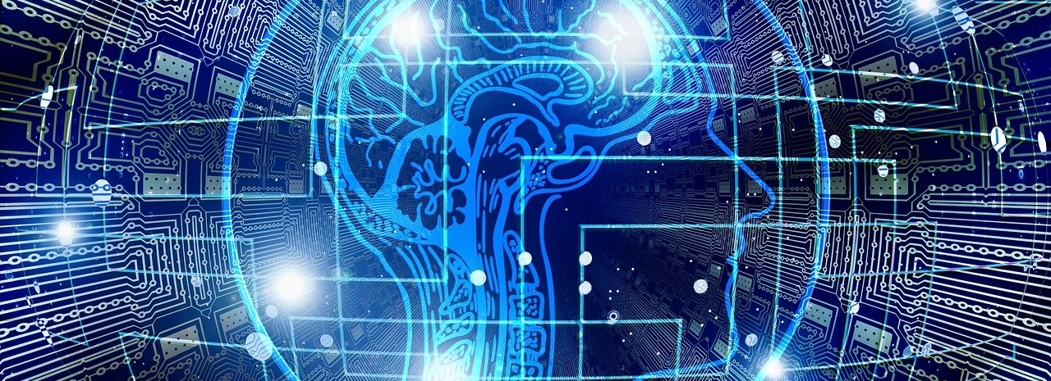
Why is cybersecurity essential?
Notes:
In the 21st century, we have become heavily dependent on digital technology. Businesses, governments and individuals use online services every day to communicate, exchange information, carry out financial transactions and manage vital processes.
This digital dependence makes our lives more efficient and connected, but it also entails significant risks. Cybersecurity is therefore a core component of a secure, reliable and resilient society. It is not only about protecting systems, but also about ensuring
trust, continuity and social stability.

Slide 6
Why is cybersecurity essential?
Protection of sensitive information
Cybersecurity ensures that personal, financial and confidential data remains secure.
Notes:
Protection of sensitive information
Information is one of the most valuable assets today. Think of personal data such as national insurance numbers, medical records, financial information and intellectual property of companies. Without effective security, this data can be stolen, manipulated or made public. The consequences are often far-reaching: identity fraud, financial damage, loss of reputation and legal sanctions, such as fines under European GDPR legislation.
Cybersecurity encompasses multiple layers of protection:
Technology such as encryption, firewalls and access systems.
Process-based policies, such as regular audits and risk assessments.
Human factors, such as training and awareness of phishing and social engineering.
It is important to emphasize that even an organization with the best technology can be vulnerable if employees unknowingly violate security rules. Cybersecurity is therefore both technical and social in nature.

Slide 7
Why is cybersecurity essential?
Protection of sensitive information
Cybersecurity ensures that personal, financial and confidential data remains secure.
Continuity of services and critical infrastructure
Cybersecurity keeps vital systems operational and prevents societal disruptions.
Notes:
Continuity of services and critical infrastructure
Many vital systems in our society are entirely digital. Energy supply, water distribution, transport, healthcare and communications depend on networks and software. A cyberattack can shut down or seriously disrupt these systems, with direct consequences for millions of people. For example, an attack on a hospital can be life-threatening, while an attack on a fuel pipeline can lead to shortages and social panic.
Cyber security ensures that these infrastructures remain reliable and continuously available through a combination of:
Prevention, such as network segmentation, monitoring and access management.
Detection, whereby abnormal behavior is identified and reported.
Incident response, whereby systems are quickly restored, and damage is limited.
Critical infrastructure requires a high degree of resilience, as a single incident can have enormous social and economic consequences. Cybersecurity is therefore not only a matter of corporate security, but also of national and social security.

Slide 8
Why is cybersecurity essential?
Protection of sensitive information
Cybersecurity ensures that personal, financial and confidential data remains secure.
Continuity of services and critical infrastructure
Cybersecurity keeps vital systems operational and prevents societal disruptions.
Economic and social stability
Cybersecurity protects the economy and the trust of individuals and organizations against digital threats.
Notes:
Economic and social stability
Cyber attacks have significant economic implications. Worldwide, the costs of cybercrime run into hundreds of billions of dollars per year. These costs arise from:
Loss of productivity due to system downtime
Financial damage due to theft of money or intellectual property
Reputational damage and loss of customer confidence
Legal sanctions and compliance costs
In addition, a major cyberattack can threaten the stability of entire sectors. Banks, energy companies and logistics networks are essential to the functioning of society; an attack can lead to far-reaching disruptions. Cybersecurity provides organizations and
governments with the means to manage risks, build resilience and ensure continuity.

Slide 9
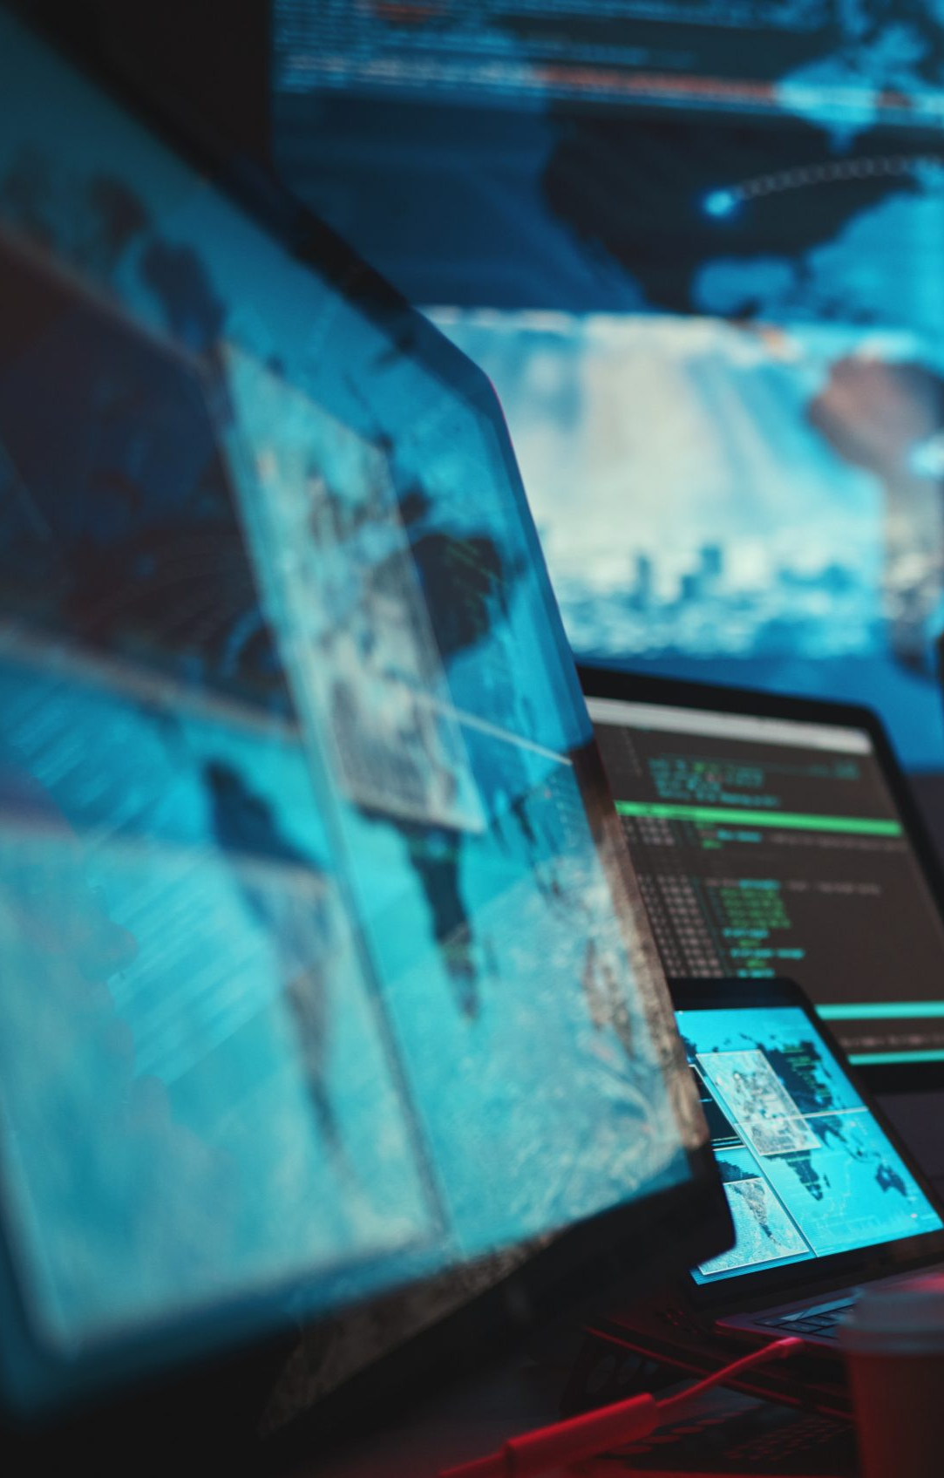
Why is cybersecurity essential?
Cyber attacks in the past:
Wannacry 2017
Solarwinds 2020
Colonial pipeline 2021
Notes:
Several major incidents in recent years clearly demonstrate that cybersecurity is vitally important. These examples show how digital attacks not only affect computers, but also disrupt people, businesses and entire societies.
One of the most well-known cases is the WannaCry attack of 2017. This ransomware spread rapidly across more than 150 countries by exploiting a vulnerability in older Windows systems. Once a computer was infected, all files were encrypted, and a ransom
was demanded to get them back. Hospitals in the United Kingdom were particularly hard hit: operations had to be cancelled, and patient records were temporarily inaccessible. The attack caused hundreds of millions of dollars in damage worldwide and
painfully demonstrated how vulnerable essential services can be when systems are not updated in a timely manner.
Three years later, in 2020, the world was once again confronted with one of the most sophisticated cyber attacks ever: the SolarWinds hack. Attackers infiltrated the software of the American company SolarWinds, which supplies IT management systems to
thousands of organizations. Through a compromised software update, hackers gained access to countless networks, including those of American government agencies. The attack went undetected for months, allowing sensitive information to be stolen.
This event made it clear that cybersecurity does not stop at one's own organization: suppliers and partners must also be secure, because a single weak link in the chain can have global consequences.
A last and recent example occurred in 2021 with the Colonial Pipeline attack in the United States. Ransomware temporarily shut down the country's largest fuel pipeline, leaving millions of Americans without fuel. The attack caused panic, long queues at petrol stations and even temporary shortages. Colonial Pipeline ultimately paid millions of dollars in ransom to restore the system. This incident showed that a cyberattack not only causes economic damage but can also have a direct social and even physical impact.
Together, these examples show that cyber attacks are not isolated incidents, but real threats with far-reaching consequences. They affect all levels of society: individuals, businesses and governments. Each attack emphasizes once again that investing in cyber
security is not only a technical necessity, but a social duty to maintain trust, security and stability in our digital world.

Slide 10
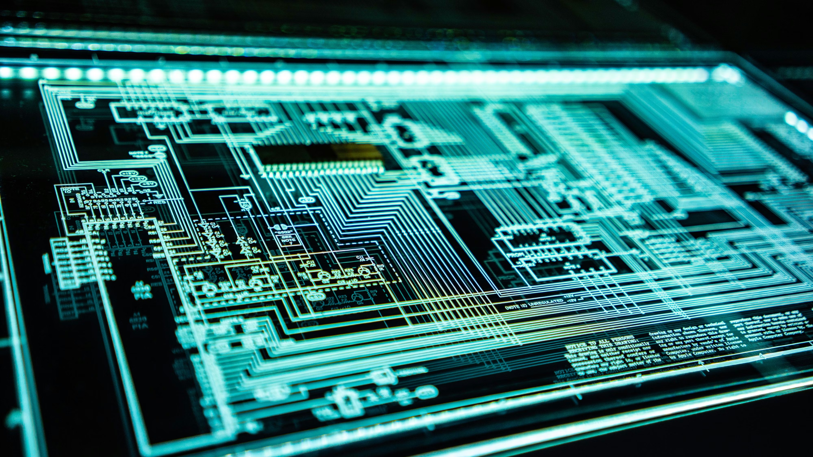
The future of
cybersecurity
Notes:
In the future, we will arm ourselves against cyber threats by combining resilience building, increased vigilance and strengthened cooperation. We will focus on systems that not only prevent attacks from succeeding but can also quickly detect and recover
when something goes wrong. This means that organizations and countries will invest in strengthening their infrastructure, training staff, and building resilience, the capacity to continue functioning under attack or disruption. It also means that we no longer
consider disruptions to be “exceptional” but assume that incidents will happen and that it is important to be prepared for recovery and continuity.

Slide 11
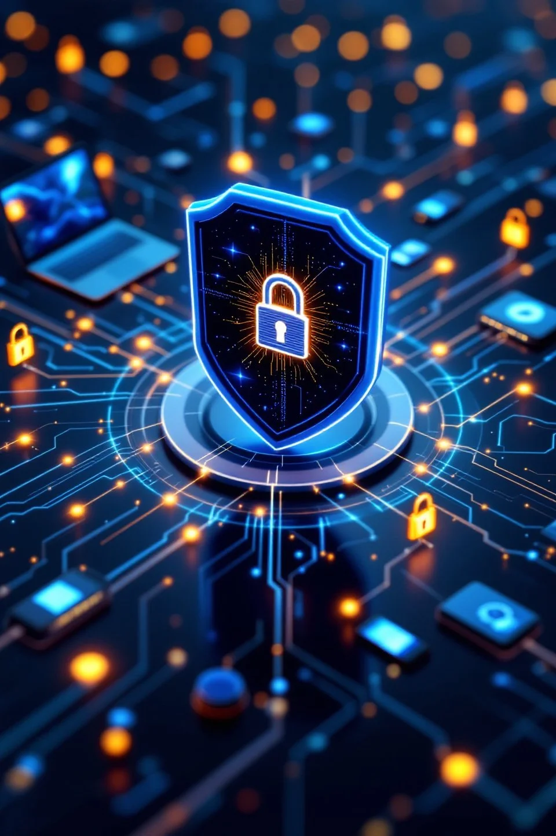
The future of cybersecurity
Focus on resilience and cooperation
Security built into technology
AI and zero trust strengthen protection
Everyone plays a role in digital security
EU strengthens policy
Notes:
How can we arm ourselves against future threats?
The future of cybersecurity revolves around resilience, vigilance and cooperation. It is no longer a question of whether an organization will ever be attacked, but when. That is why the focus is on building resilience: systems must not only be able to prevent
attacks, but also recover quickly if something goes wrong. Governments, businesses and citizens must remain constantly alert, invest in security and work together to share knowledge and information. Incidents are no longer seen as exceptions, but as
situations for which one must be prepared.
Technological developments and solutions
Technology plays a crucial role in defending against cyber threats. In the coming years, security will become increasingly automated and integrated. New systems will be “secure by design”, meaning that security is built in from the design process onwards,
rather than added as an afterthought. The European Union's Cyber Resilience Act stipulates that all digital products must meet strict security requirements and receive regular updates. The principle of zero trust is also gaining importance: no one inside or
outside a network is automatically trusted, and every access must be continuously monitored. In addition, artificial intelligence (AI) is increasingly being used to detect abnormal behavior in networks more quickly and stop attacks at an early stage. As our
society becomes increasingly dependent on digital infrastructure, think of 5G networks, smart cities and Internet of Things devices, these new technologies must also be robustly secured. The European Union is therefore strongly committed to protecting
critical infrastructure, such as energy supply, healthcare and transport, through joint European initiatives such as the Joint Cyber Unit.
What can I do myself?
Although many measures are taken at a technical and policy level, cybersecurity also starts with the user. Everyone can contribute to a safer digital environment. It starts with simple habits: use strong, unique passwords and enable multi-factor authentication
where possible. Make sure your devices and software are always up to date and be alert to suspicious emails or links. Phishing and social engineering remain the most popular ways for attackers to gain access to systems. In addition, it is important to make
regular backups and know what to do in the event of a security incident. Awareness and digitally responsible behavior are the first line of defense in cybersecurity, and that applies to everyone, from employees to private individuals.
The role of policy and European cooperation
Cybersecurity is also becoming increasingly important at the political level. Within the European Union, various initiatives have been launched in recent years to strengthen the digital security of member states. The NIS2 Directive (Network and Information
Systems Directive) obliges governments and organizations to improve their digital security and report incidents. The Cyber Resilience Act stipulates that manufacturers are responsible for the security of their products, and the Cyber Solidarity Act (2025)
strengthens European cooperation in the event of major cyber incidents, enabling countries to help each other more quickly in the event of threats or attacks. In addition, the EU is investing in innovation, training and research into new security technologies
through programs such as Digital Europe and Horizon Europe. These initiatives are designed to ensure that Europe not only responds to cyber threats but also plays a leading role in digital security worldwide.

Slide 12
acknowledgements
This slide deck was produced for by the Every1 project.
The images used in this presentation are as follows:
Slide 3: Cybersecurity.png by wikimedia commons
CC0 1.0 license
Slide 4: The Role Of AI In SEO And Cybersecurity by
technologymarketingtoolkit.com CC BY-NC 4.0 license
Slide 8: 5 Red Flags That Your Cyber Insurer Might Not Pay – Know Your Rights by elawfirm.org CC BY-NC 4.0 license
Slide 9: Dell Technologies: Österreichische Unternehmen investieren zunehmend in Cybersecurity. by heate.at
CC BY 4.0 license
Slide 10: Security automation for modern software by
bestdefense.io CC BY-NC 4.0 license

Slide 13
Thank you!
Notes:
The future of cybersecurity is therefore a shared responsibility. Technology alone is not enough: it requires cooperation between citizens, businesses and governments. By investing in knowledge, innovation and policy, but also by remaining alert and aware as individuals, we are building a digital world that is not only smart and connected, but also safe and reliable. Cybersecurity is not a temporary project, but a permanent pillar of our modern society.

