Slide 1

What is a Digital
Twin of the
Electricity grid
fecha
09-12-2025
Notes:
Today I’d like to talk about what a digital twin of the power grid really is, and then go one step further: how we can build a federated digital twin of the EU power system, moving from concept to reality.
In smart grids we often talk about the three Ds: decarbonisation, decentralisation and digitalisation – and increasingly a fourth D, democratisation, because active consumers and prosumers at the grid edge are changing how the system behaves.
The focus of my talk is the third D, digitalisation. We’ll look at how digital twins can help us operate and plan a highly decarbonised, deeply interconnected European power system, and why a federated approach across countries, TSOs, DSOs and market actors is essential for making this work in practice.

Slide 2
How to use this slide deck
This Slide deck is meant as a guide and easy starting point for a person that will explain the topic to an audience that isn't familiar with the topic yet.
Feel free to adapt and expand to your own need.
  The material is licensed under CC4.0 SA BY
You can find guidance text in the notes of each slide

Slide 3
Agenda
DT Basics
Concepts, Applications, and Challenges
Federation
Different Types Of DT Federation For Power Grids
Horizontal, vertical, or Distributed Modular
DT Use cases in power grids and Twin EU project
Interoperability, Standardisation, and
Call for Action
Notes:
Here’s the roadmap for the next 30 minutes.
DT Basics – the concepts, main applications and some very common misconceptions around digital twins in power grids.
Federation – different types of federation: horizontal, vertical, and distributed modular federation for power grids.
DT use cases and the TwinEU project – where digital twins already add value today and how TwinEU is implementing a federated architecture across Europe.
Interoperability, standardisation and call to action – the data models, standards, and concrete steps we all need to take.
Think of it as a journey: first we agree on what we’re talking about, then we look at how to connect many twins, what we can actually do with them, and finally what has to happen next.

Slide 4
Concept of Digital Twins
Misconceptions
Notes:
Let’s start with the basics: what is a digital twin – and what is it not?
Digital twins didn’t appear first in energy; they originated in aerospace and advanced manufacturing, where you can’t afford failures and systems evolve over decades. The core ingredients are always the same:
a physical entity (an asset, a substation, a whole grid),
a virtual model,
data linking both,
a service interface, and
continuous communication between the virtual and physical worlds.
A very common misconception is:
“If I have a simulation model, I have a digital twin.”
That’s not enough. A digital twin is a virtual representation that stays linked to reality through live data and supports decisions throughout the asset’s life cycle. Without that ongoing data connection, we just have a static model, not a twin.

Slide 5
Policy & system context
EU “Digitalising the energy system – EU action plan”
  “sustainable, (cyber)secure, transparent and competitive market for digital energy services”.
ENTSO-E’s RDI Roadmap 2024–2034
Joint task force created between TSOs and DSOs, and the TwinEU project
Notes:
The Commission's action plan addresses:
Opportunities: New ways of facilitating data exchange, promoting investments, bringing consumer benefits
Challenges: Cybersecurity and increased energy consumption
Key Focus: Promoting investments in digital infrastructure
ENTSO-E’s RDI Roadmap 2024–2034 sets missions on DTs for monitoring, control, flexibility and asset optimisation.
Alignment with ENTSO-E RDI Roadmap 2024-2034:
Mission 1: Advanced network reconfiguration, DT for asset maintenance optimization
Mission 4: DT for monitoring, enhanced grid representation, grid control
Mission 5: DT for enhanced grid flexibility
TwinEU aligns with these by demonstrating federated DTs across eight pilots and defining pan-EU scenarios.
Speaker note: connect climate targets, RES growth, electrification, and the need for data-driven operation.

Slide 6
Where?
What?
Why?
How?
Originating in aerospace and
Manufacturing
Physical Entity, Virtual Model, Data, Service interface, Communication
Electricity grids to remain robust while driving energy transition
Continuous monitoring, predictive
analysis, and decision support
Notes:
So, where do digital twins come from, what are they, why do we need them, and how do they work?
Where? They originate in aerospace and manufacturing, where complex, expensive systems are modelled and monitored over decades.
What? In our context, a digital twin is a combination of a physical entity, a virtual model, data, a service interface and communication between them.
Why? Because power grids must stay robust while enabling the energy transition – continuous monitoring, predictive analysis and decision support become essential.
How? By combining physics-based models, measurement data, and operational interfaces in a modular, extensible architecture.
The big idea is that instead of reacting to problems, we can anticipate them and explore “what-if” scenarios before touching the real system.

Slide 7
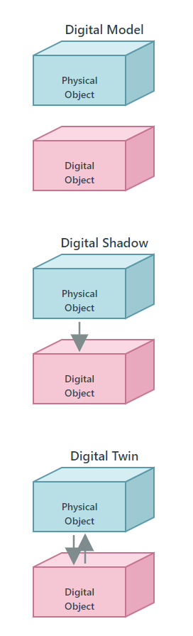
A virtual representation of a physical system
Most common misconception with a basic simulation model: Data connection
It’s all just about the data!
    Data and standards
Notes:
Data connection => DT:live and bi-directional)
The fundamental challenge remains in obtaining, cleaning, understanding, and doing something with data!
A presumed open data approach to data: An unintentionally clever first step to let SMEs open advanced business models and technologies.
What is not open? Prioritising how to share in a more scalable way!
Data and standards: if we are solving to get from A to B, can we also solve for how we describe and format our data? It is about governance, policy, and regulation.

Slide 8
Inconsistent definitions and its minimum functionality requirements
ISO/IEC 30173: “the digital representation of a target entity with data connections that enable convergence between the physical and digital states at an appropriate rate of synchronisation”.
VDE’s DZiNE also adds: “accompanies the real object throughout its life cycles”; tightly coupled via communication infrastructure.
In the current power systems, DTs combine models, live measurements, and control interfaces for assets, substations or whole grids (such as SCADA/EMS).
Notes:
Lack of Consensus on Digital Twin Definition: Working with distribution system operators and transmission system operators, it became very clear that there is a lack of consensus and definition about what is really meant by "digital twin" in the context of electrical grids. What is the minimum set of functionalities to claim that a grid is equipped with a digital twin?

Slide 9
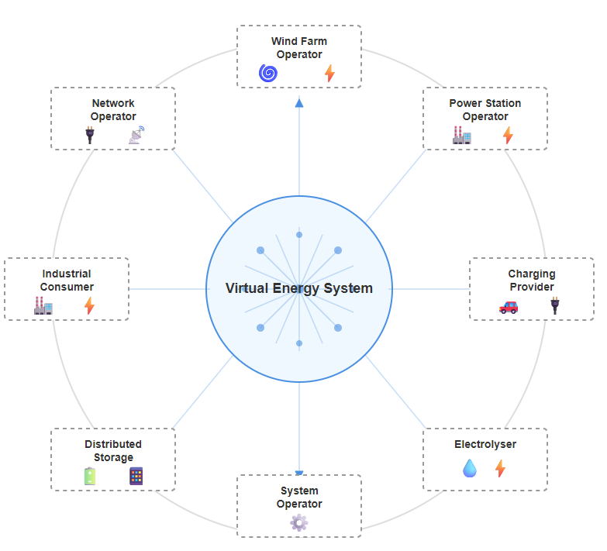
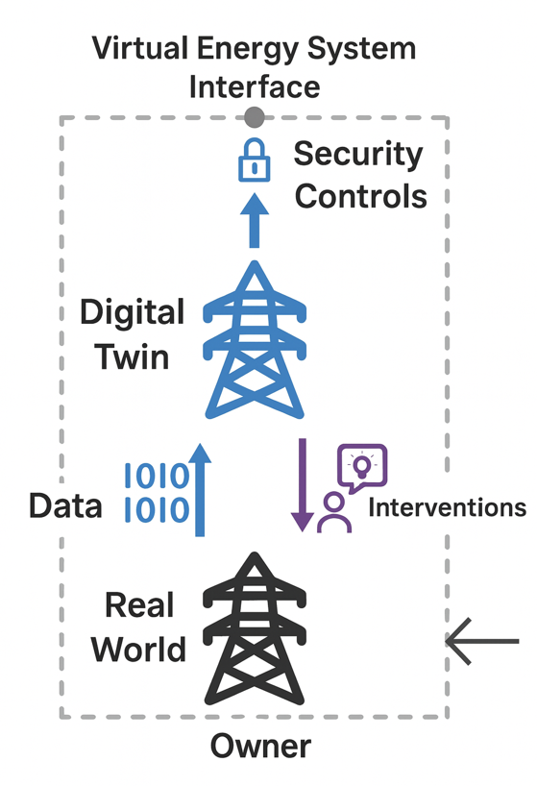
Virtual Energy System
Notes:
The Virtual Energy System is looking at the particular challenge around digital twinning - how can you connect those disparate providers?
This includes:
Network operators
Power station operators
Electrolyzers
System operators
The whole value chain
They're all going to want to build their own digital twins for whatever purpose (whether they be shadows or true twins - kind of doesn't matter).
The key questions are:
How can you ensure that the data passes to them effectively?
How can you ensure that these systems are at least minimally interoperable with each other?
How can you take insight from one and apply it in another context?
How does this all knit together?

Slide 10
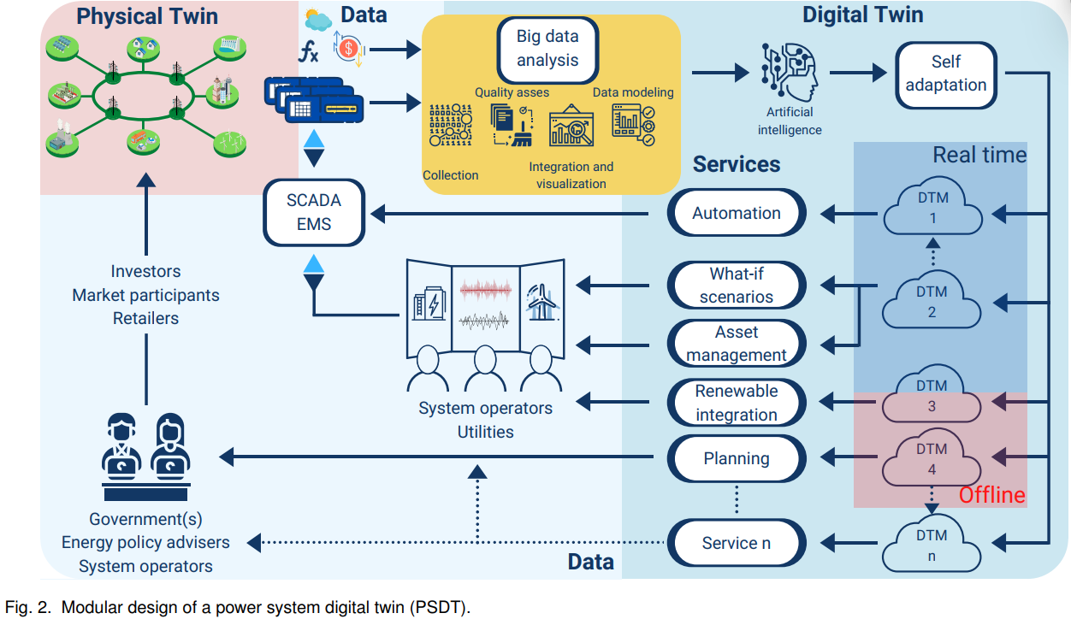
Digital Twins in the Future Utilities and Control Rooms
Multi-timescale analysis (minutes to years)
Physics-based simulation & ML models
Predictive & prescriptive analytics
Modular, extensible platforms
What-if scenario testing
Open APIs and federation support
Lifecycle management
* By F. Arrano-Vargas
Notes:
Now, imagine a control room in 2030.
Operators have a digital twin that performs multi-timescale analysis, from minutes to years. It combines physics-based simulations with machine-learning models, runs predictive and prescriptive analytics, and lets operators test “what-if” scenarios before committing to actions.
Behind this are modular, extensible platforms with open APIs and built-in support for federation. They manage the lifecycle of models, data and configurations. That’s the type of environment sketched here.
This is no longer science fiction. Many utilities already have pieces of this in place – the challenge is to turn islands of innovation into a consistent, interoperable whole.

Slide 11
Seconds before – RES & protection behaviour
Digital Twins Functions
in the 28 April Blackout
After / during – damage limitation & learning
Minutes before – oscillation monitoring
Before the event –
planning & scheduling
* By F. Arrano-Vargas, G. Konstantinou
Notes:
1. Before the event – planning & scheduling (Offline DTMs)
DT runs day-ahead and intraday scenarios and warns that the grid is fragile when Spain exports several GW with low inertia.
2. Minutes before – oscillation monitoring (Real‑time DTMs 1–2)
When the 0.63 Hz ‘wobble’ and later the 0.21 Hz swing appear, the DT turns PMU data into a clear alarm: ‘this is an inter‑area mode that is starting to grow’.
3. Seconds before – RES & protection behaviour (Asset / RES models)
The DT shows which PV and wind plants are likely to trip on over‑voltage or abnormal conditions and how much reactive power and inertia will be lost if they do.
4. After / during – damage limitation & learning (Automation & self‑adaptation)
Once the collapse starts, the DT supports controlled islanding and smarter load shedding, and later it is used to replay the event and improve procedures.

Slide 12
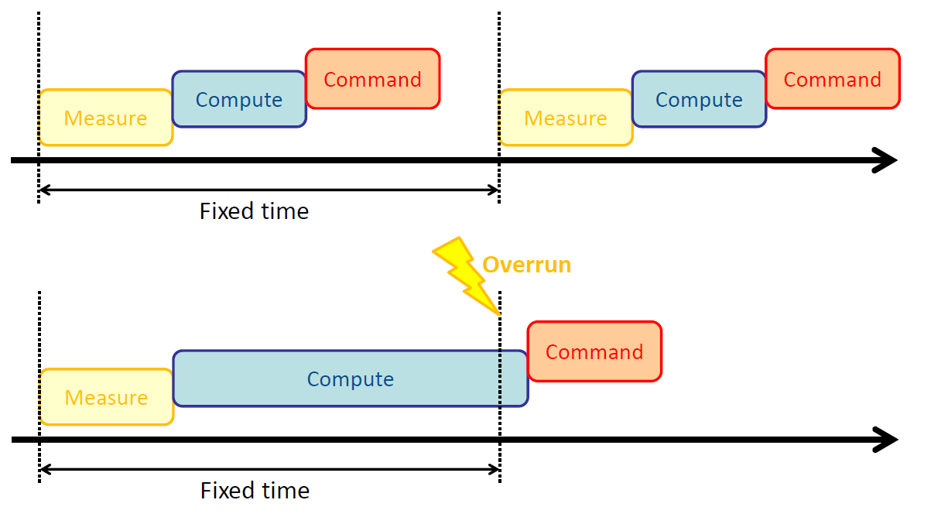
Main Challenges
Real-Time Synchronisation
Interoperability and standardisation
Redundancies in data models
Data and twin silos
Technology limitations
Multi-system dependencies
Investment inventives
Notes:
The pan-European transmission system is a Cyber-Physical System already framed by IEC protocols: 60870-5-101/-104 and now IEC 61850.
TSOs/DSOs operate multi-vendor, heterogeneous OT/IT stacks – SCADA, PMUs, IEDs, GIS, EMS/DMS, customer portals.
Digital Twins must integrate across this CPS: from field sensors up to market platforms.
Solutions not synchronised adequately with reality.
How should this synchronisation process be enabled?
What is the minimum requirement to claim that a twin is really "twinning" reality?
Interoperability is the main challenge, and there is also an opportunity for DT to solve it!
Interoperability gaps: Limited cross-border modelling and data exchange capabilities, with operators working in isolation
Often, there was a lack of awareness that the introduction of digital technologies and software, without sufficient coordination by management, can lead to redundancies in data models.
What we have – and what we need – is an ecosystem of interoperable twins, each owned, governed and operated locally.
There are many digital twins that must learn to communicate with one another.

Slide 13
Federation
Different Types Of DT Federation For Power Grids
Horizontal, vertical, or Distributed Modular
Notes:
This slide is a pivot: from individual twins and their problems to federation.
The key message: there will be no single, monolithic “Digital Twin of the Power Grid”. Instead, we must learn how to federate many digital twins – horizontally across departments, vertically across asset/substation/system levels, and in a distributed modular way across Europe.
The next slides unpack what that actually looks like.

Slide 14
Horizontal Federated Power Grid Digital Twin
Based on Organisational System Operator Departments
There is no single, monolithic “Digital Twin of the Power Grid”
Finance
Enterprise Resource Planning
Asset
Building Information Model
System
Common Information Model, CGMES
Management
System of Systems
Notes:
System Operations: Identifies limitations, decides to build new infrastructure
Asset Department: Plans new substations/power lines using Building Information Model (BIM) digital twin
Finance Department: Uses Enterprise Resource Planning (ERP) digital twin with market information, prices, supplier availability
Management: Decides optimal solution based on scenarios (Scenario Analysis: Calculate different timing/cost scenarios )
Each department has individual systems and digital twins, but connecting them enables management to make best decisions—creating federated digital twin

Slide 15
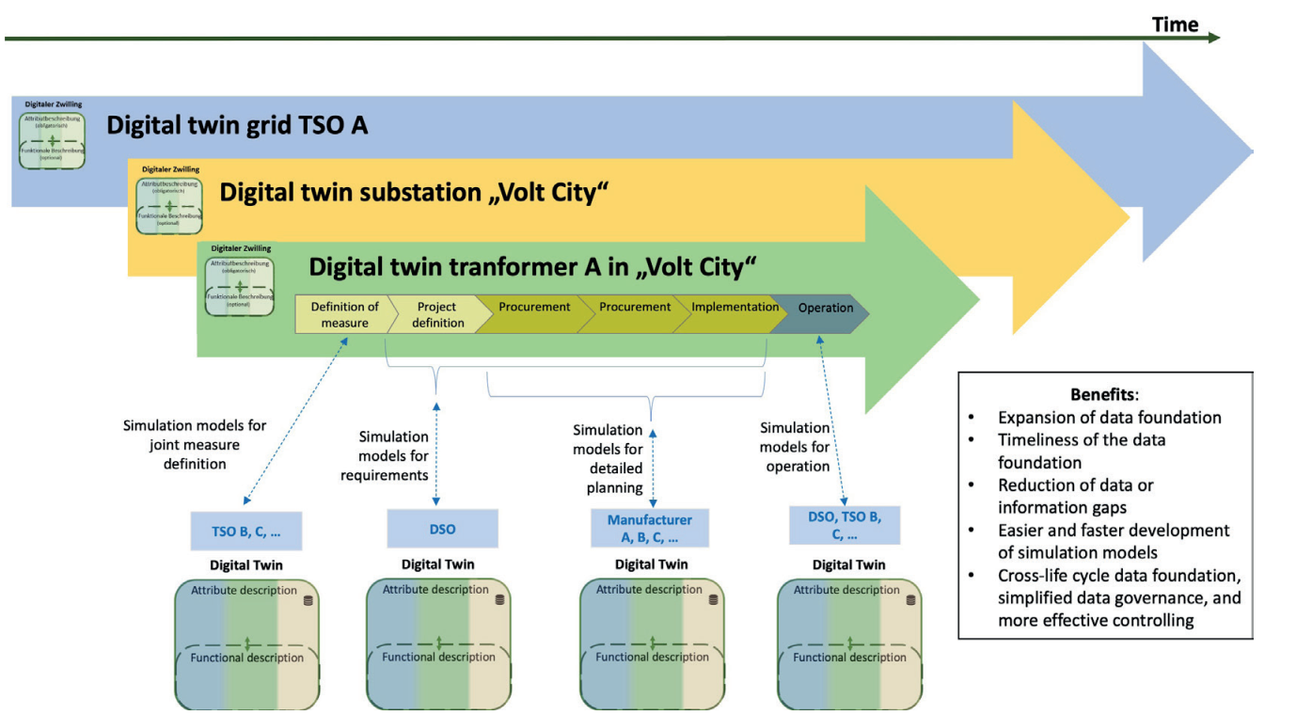
Vertically Federated Power Grid Digital Twin
Networking of Digital
Twins
A top-down organisational perspective :
  Assets
  Substations
  Whole grid
Exemplary interaction of multiple digital twins in the context of establishing a new transformer in a substation (from DZiNE)
Notes:
VDE working group on digital twins in power systems in Germany: Digital Twin in the network and electricity industry (DZiNE)
Individual solutions (bottom-up approaches): Single digital twins for single use cases
Future Direction: End-to-end processes, Federated digital twins (linked individual twins)
A top-down organisational perspective is needed: ;;;
Lets start from the bottom:
illustrates the DZiNE of Transformer A over multiple life cycle phases on a timeline. The horizontal arrows represent the general connection of the transformer’s DZiNE to the DZiNE of the “Volt City” substation and the network twin of TSO A. The life cycle of the substation and the network can be significantly longer than the life cycle of the transformer being planned. The lower part of the image shows the interfaces to other DZiNEs outside of TSO A. In this example, the interfaces are used to create and utilize common simulation models for different purposes

Slide 16
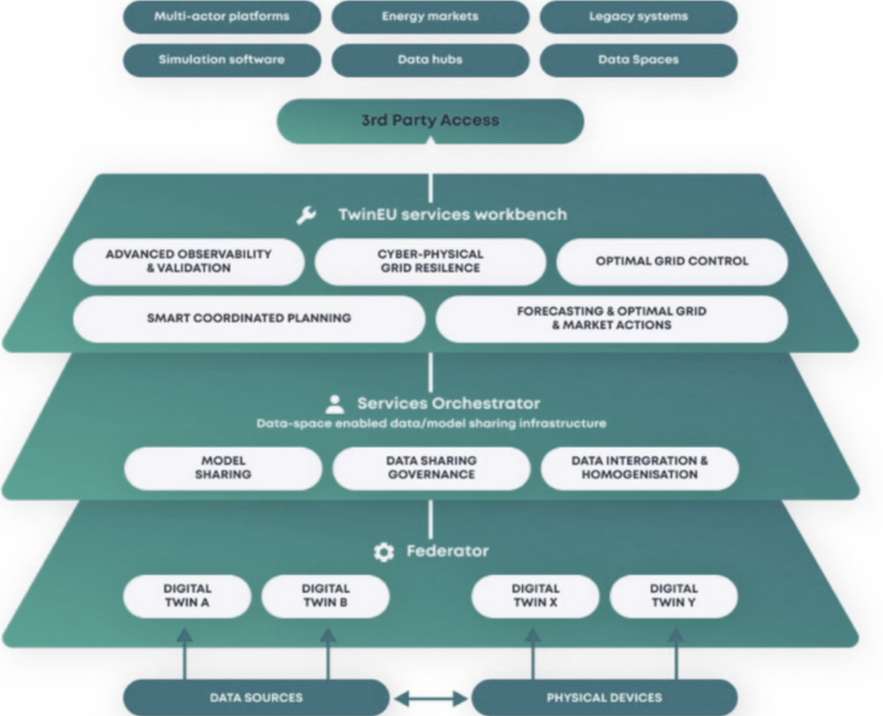
TWIN EU project:
Federated how? Distributed Modular?
A suite of analytical tools
and applications that support grid planning,
market analysis, and operational decision-making.
Secure and interoperable data sharing
Collaboration TSOs, DSOs, and market participants
The OneNet Connector
Builds local digital twins into a common framework
Real-time data acquisition and model synchronisation
The TwinEU architecture
Notes:
TwIN-EU will leverage a unique set of competences coming from grid and market operators, technology providers and research centres to create a concept of pan-European digital twin based on the federation of local twins, so as to enable a reliable, resilient and safe operation of the infrastructure while facilitating new business models that will accelerate the deployment of renewable energy sources in Europe
Integration with the European energy data space
Federator : connecting, synchronising, and coordinating several independent digital twins
Focus areas: grid observability, cyber resilience, forecasting, congestion management, asset management
Multi-Layer Federated Structure
The TwIN-EU architecture consists of several interconnected layers:
Foundation Layer: Local digital twins operated by individual grid operators at both transmission and distribution levels. These represent existing or newly developed digital twin implementations at the national level.
National Federation Layer: Tighter integration between TSOs and DSOs within individual countries, recognizing the existing regulatory and operational connections at the national level.
European Federation Layer: Continental-level coordination enabling cross-border data and model sharing across the EU.
Data and Model Sharing Layer: Infrastructure supporting data integration and homogenization, model sharing and standardization, governance frameworks, and standards implementation (CIM, SAREF, GAIA-X, FIWARE).
Service Layer: Common services offered by the federated infrastructure to all participants.
Third-Party Access Layer: Mechanisms enabling external parties (beyond grid operators) to access digital twin capabilities through proper data connectors, supporting new business models.
Multi-layer presentation but working in a distributed way with the OneNet connectors
TSOs/DSOs sometimes lack incentive due to high development costs

Slide 17
DT Use Cases
Data models and Standardisation
Notes:
This slide signals another gear change: from architecture to use cases.
The message is: architecture and standards only make sense if they support real-world applications. Digital twins bring value when they sit on top of consistent data models and are used for specific operational and planning tasks.
On the next slides, we first look at generic DT use cases in power grids, then at the use cases implemented in TwinEU, and finally at the data and standardisation aspects that underpin them.

Slide 18
Main use cases of the power grid DTs
01
02
03
04
Operational Control and Pattern Recognition
Grid Resilient Planning
Consumer Engagement
Market operations
Notes:
Here we have four generic families of use cases:
Operational control and pattern recognition – situational awareness, anomaly detection, oscillation monitoring, contingency analysis, and early warning for operators.
Grid-resilient planning – long-term network planning, RES integration, hosting-capacity studies and climate-resilience analysis.
Consumer engagement – providing better information and tools to consumers and prosumers, enabling them to offer flexibility and understand their impact.
Market operations – improving capacity allocation, market coupling, reserve sizing and balancing through more accurate, model-based simulations.
These categories set the stage for the more concrete TwinEU use cases that follow.

Slide 19
Main use cases of the power grid DTs in TWIN EU
01
02
03
04
Transmission & distribution operation (TSO/DSO ops)
Transmission & distribution planning and expansion
Distribution + Market integration (prosumer / flexibility layer)
Energy market + Cross-sectoral applications
Notes:
TwinEU organises its work into four similar pillars:
Transmission & distribution operation (TSO/DSO operations) – real-time and near-real-time twins for operating the grid securely.
Transmission & distribution planning and expansion – planning reinforcements and integrating large amounts of renewables.
Distribution + market integration (prosumer / flexibility layer) – enabling local markets, flexibility platforms and prosumer participation.
Energy market + cross-sectoral applications – using digital twins in market design and in interactions with gas, heat, mobility and other sectors.
The key message: the federated twin is not an abstract research toy; it is built around very concrete operational and market needs.

Slide 20
Detailed use cases of the power grid DTs in TWIN EU
01
02
03
04
Control-centre twins using real-time measurements and forecasts
FFR simulations to tune frequency-stability services
Distribution twins for fault location, state estimation, network reconfiguration
LV/MV hosting capacity, siting of new DER, and long-term reinforcement planning
Transmission planning twins simulate RES integration
Prosumer- and DSO-facing services:
Smart-meter twins,
Flexibility offers,
Visibility for consumers & aggregators
Evaluate technical constraints and network reliability
DT-based DAM / balancing market simulators for capacity allocation and reserve sizing
System-wide security impacts of market-driven schedules
Notes:
Now we go one level deeper with some examples:
Control-centre twins using real-time measurements and forecasts to support operators with predictive security analysis.
FFR and stability simulations to tune frequency-stability services and defence plans.
Distribution-level twins for fault location, state estimation and network reconfiguration to improve reliability.
Planning twins to evaluate hosting capacity, congestion, and reinforcement options under different RES and demand scenarios.
Market-oriented twins to simulate day-ahead and balancing markets, capacity allocation and reserve sizing, and to evaluate the system-wide security impact of market-driven schedules.
Together, these use cases show how a federated approach can support the entire chain, from assets to markets.

Slide 21
Interoperability and Call for Action
Data models and Standardisation
Notes:
We’re now in the last chapter: interoperability, standardisation and call to action.
Up to now, we have seen what digital twins are, why policy and system context matter, how federation can be organised, and what use cases exist.
The remaining question is: what do we have to do – practically – to make this real and scalable?
This slide signals that the answer lies in data models, standards, governance and collaboration.

Slide 22
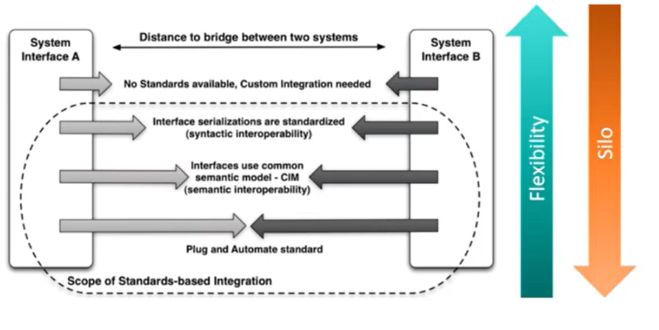
Interoperability and Standardisation
“Connect, don’t collect!”
Notes:
Standardisation reduces distance between systems, but must find the right balance: Too little standardisation: Difficult integration. Too much standardisation: Reduced flexibility, risk of creating silos
The key advantage of a federated approach (rather than centralised) is that each organisation can maintain their own digital twin while ensuring interoperability through shared data standards and infrastructure - the "connect don't collect" philosophy
Recommendation:
Cover relevant aspects for groups of systems to interface
Don't cover all individual specific differences
Use plug-and-automate standards
Ensure digital twins are open and free to use

Slide 23
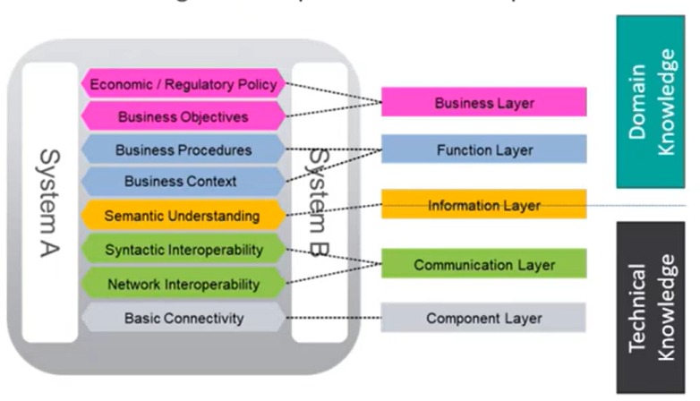
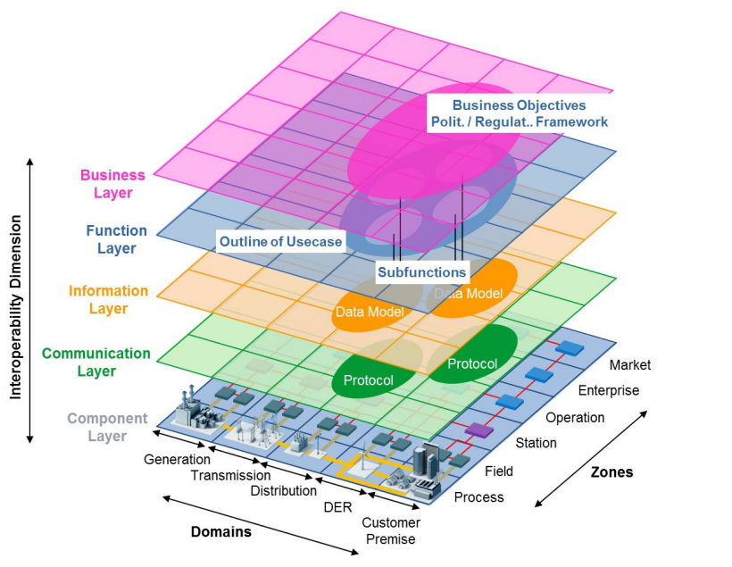
Vendor lock-in and TSO-DSO responsibility
Notes:
Top-Down View:
Business Layer: Domain knowledge level
Function Layer: Organizational level
Information Layer: Mid-level technical
Communication Layer: Lower technical level
Component Layer: Individual technical level
Knowledge Distribution:
Lower Levels (Component/Technical): Manufacturer’s technical knowledge
Higher Levels (Business/Functional): Grid operator domain knowledge
Point: Grid operators must provide domain knowledge to manufacturers as constraints for products, enabling integration at business and functional levels rather than individual silos.

Slide 24
Collaboration of Digital Systems
Standardised interfaces
Manufacturer-independent, modular system architectures
Follow the principles of the IEC 61850 and IEC 61970
Networking and Consolidation of Data
Break down data silos
Single Source of Truth (SSoT)
Normalise and structure data for algorithms
Migration Path
prioritisation of use cases
Start with a limited use case
Connect the internal and external processes
Training to the staff
Notes:
1st: Standardised interfaces
Manufacturer-independent, modular system architectures for use case requirements
Follow the principles of the IEC 61850 and IEC 61970 standard families in terms of compatibility
2nd: Break down data silos and validate/consolidate data needs against each other.
Single Source of Truth (SSoT) principle: no uncontrolled redundancy, defined responsible party
Normalise and structure data for algorithms
3rd: Precise analysis and prioritisation of use cases
Start with a limited use case and take stock of the available data
Connect the internal and external processes of the company to the digital twin
Provide appropriate training to the staff

Slide 25
Thank You
Questions?
Notes:
And that brings us to the final slide: “¡Muchas gracias! ¿Preguntas?”
Let me close with three short messages:
Digital twins are a means, not an end. They are practical tools to run and transform an increasingly complex grid.
Federation is the realistic path. We will never have a single super-twin; instead we must federate many twins horizontally, vertically and across Europe.
Interoperability and openness are shared responsibilities. Through projects like TwinEU and the work of TSOs, DSOs, regulators and industry, we have the building blocks – but turning them into reality requires concrete choices in standards, data management and collaboration.

