Slide 1
The Iberian Blackout 28/04/2025
What lessons for the future
João Peças Lopes, Francisco Fernandes, Rui Sousa

Slide 2
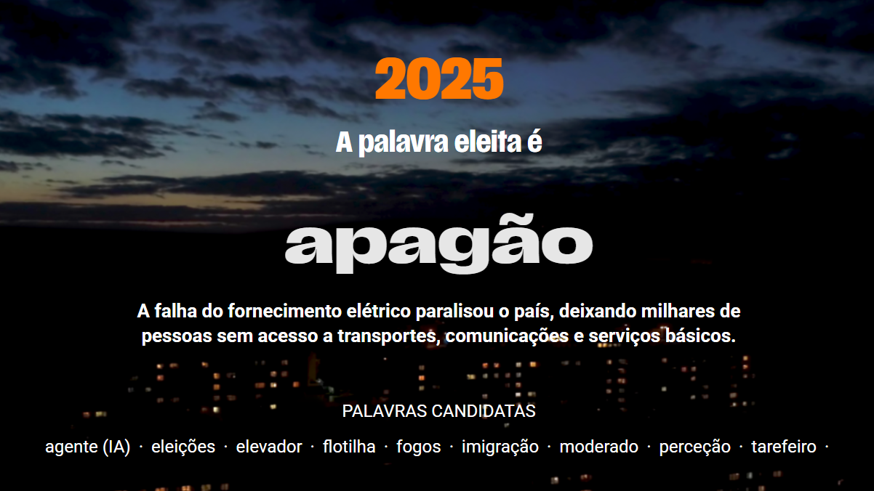

Slide 3
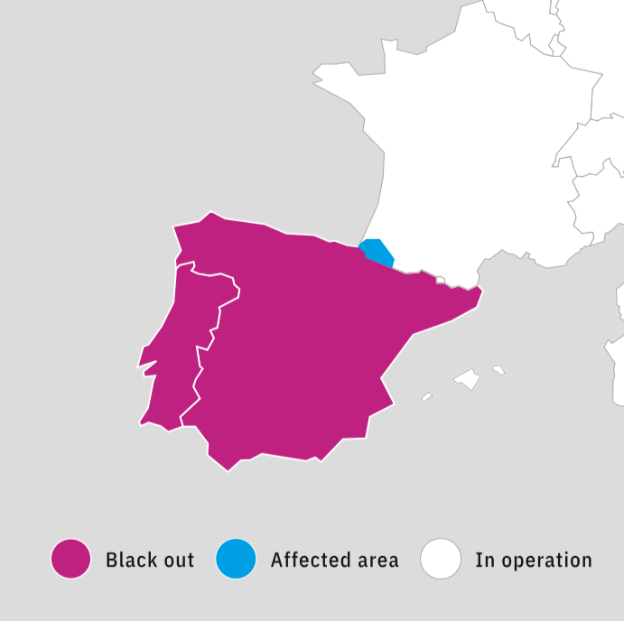
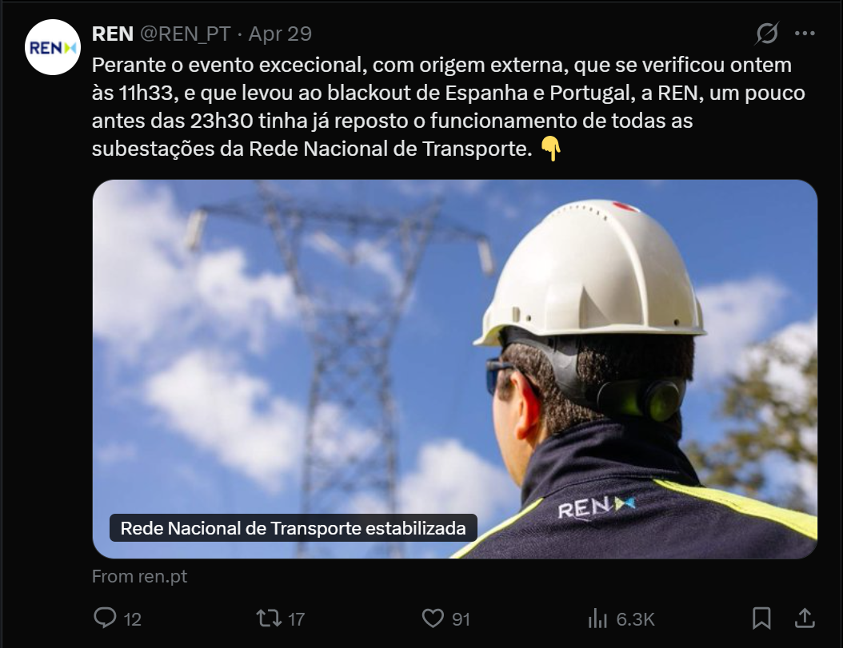
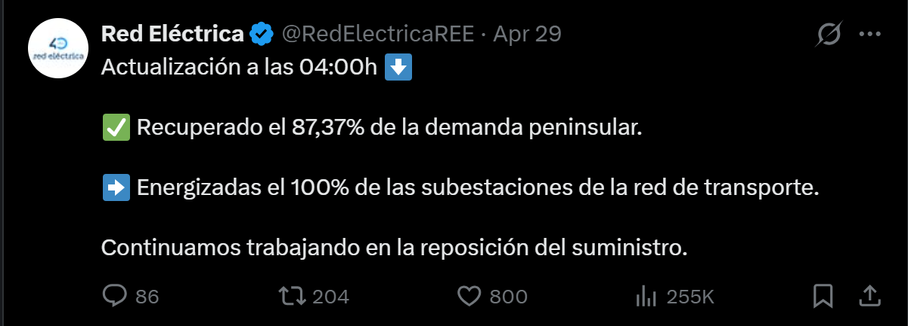
On 28 April, at 12:33 CEST, the Iberian power system experienced a blackout.
Transmission system restoration completed by:
  00:22 on 29 April in Portugal
  04:00 on 29 April in Spain
“This blackout was the most serious incident to occur on the European power system in over 20 years …”
Image from ENTSO-E blackout webpage (https://www.entsoe.eu/publications/blackout/28-april-2025-iberian-blackout/ )

Slide 4






16 June
30 June
Q1 2026
Factual Report
01
02
03
04
05
18 June
3 October
Final Report
Government of Spain: https://www.lamoncloa.gob.es/consejodeministros/resumenes/Documents/2025/Informe-no-confidencial-Comite-de-analisis-28A.pdf
Red Elétrica: https://www.ree.es/en/press-office/news/press-release/2025/06/red-electrica-presents-report-incident-28-april-/and-proposes-recommendations
INESCTEC & Compass Lexecon: https://aelec.es/wp-content/uploads/2025/07/20250730_CL_INESCTEC_Blackout_full-report_en.pdf
ENTSO-E Factual Report : https://www.entsoe.eu/publications/blackout/28-april-2025-iberian-blackout/

Slide 5
System Conditions before the Blackout
01

Slide 6
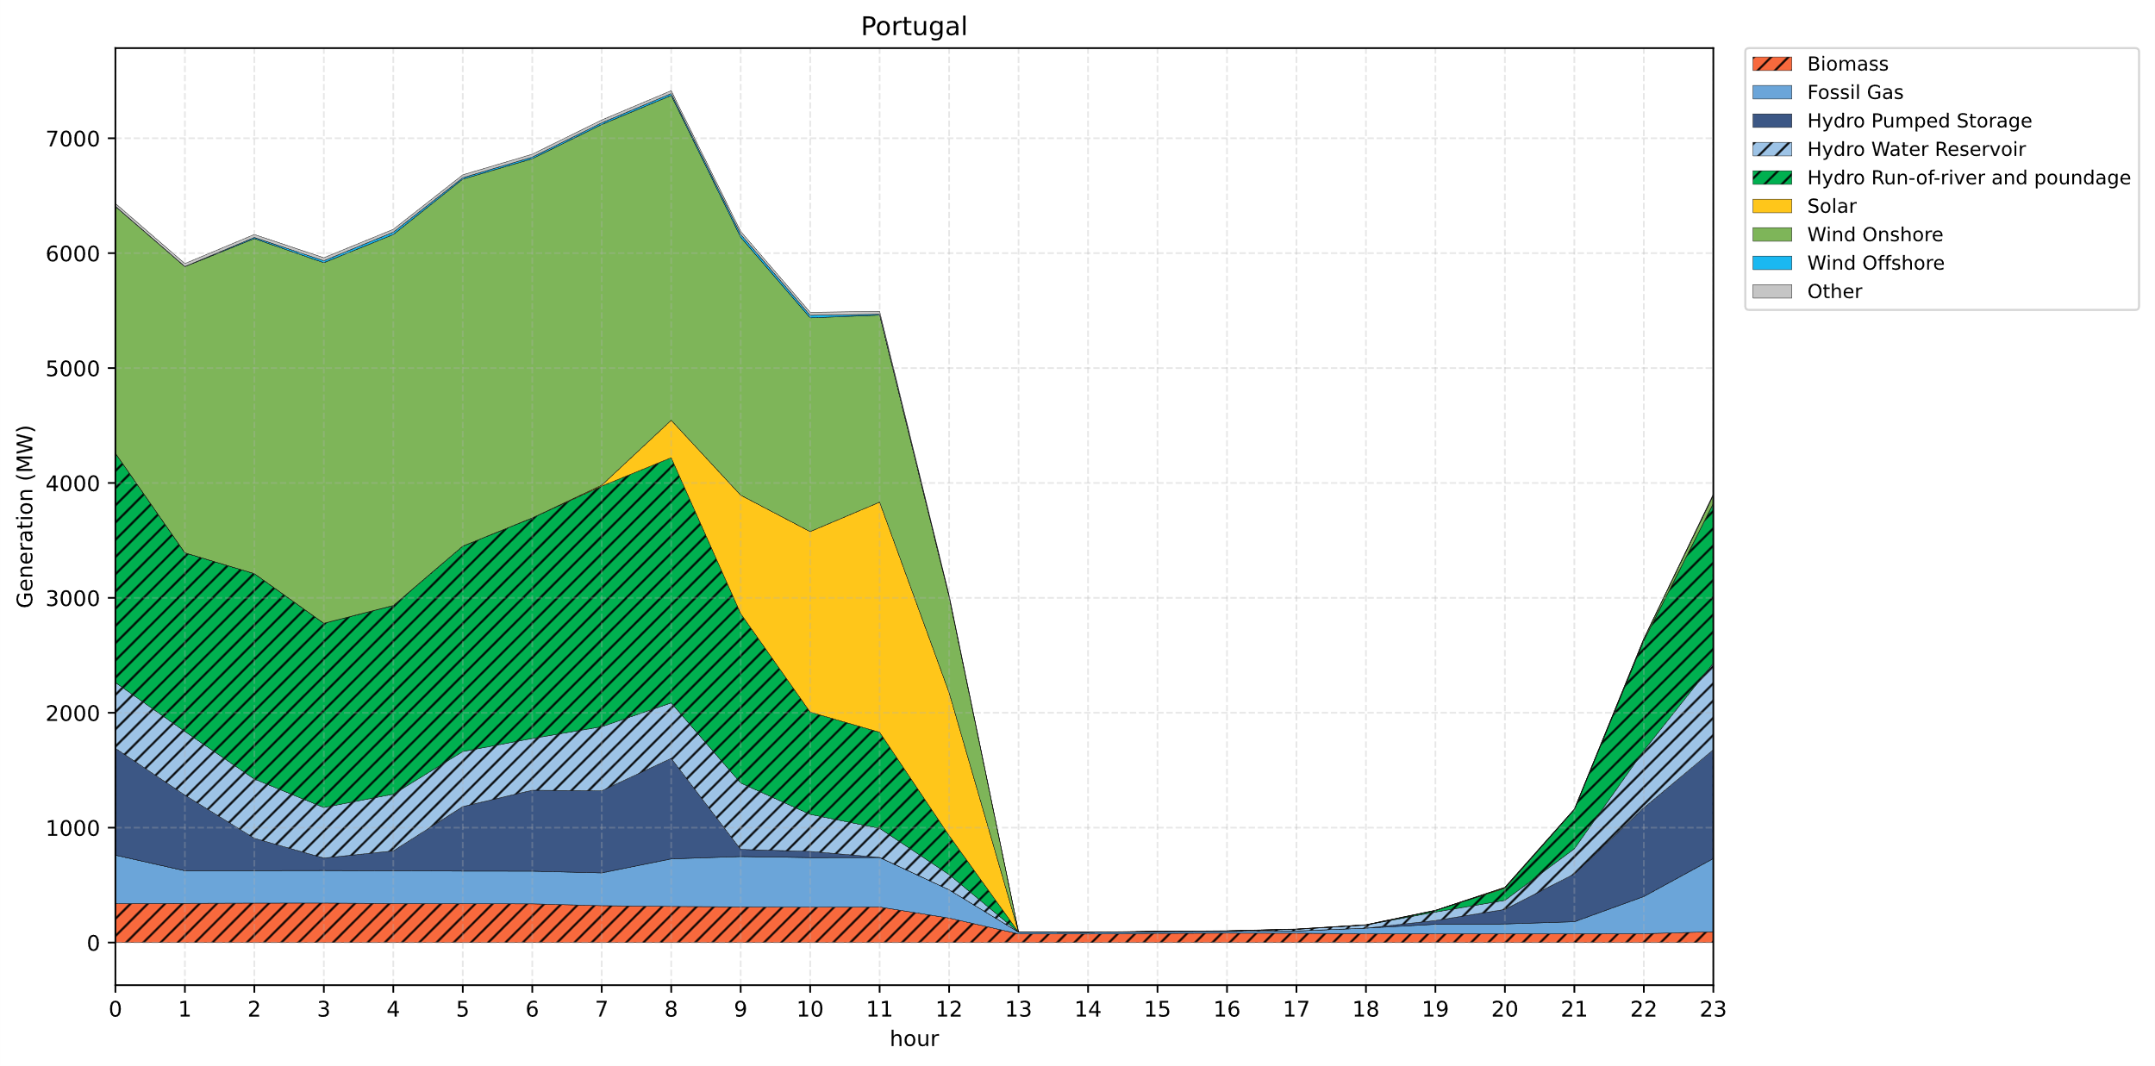
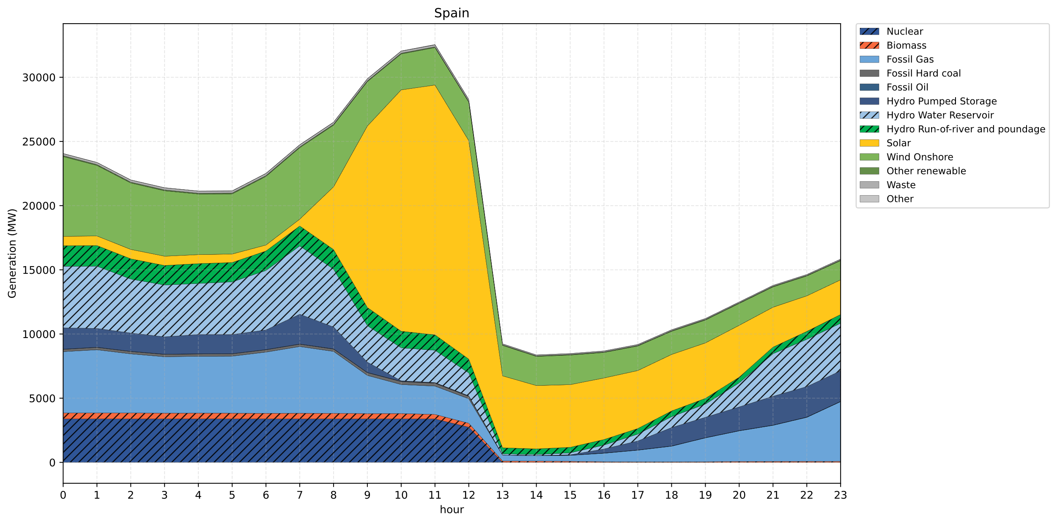
Generation Mix Before the Blackout

Slide 7
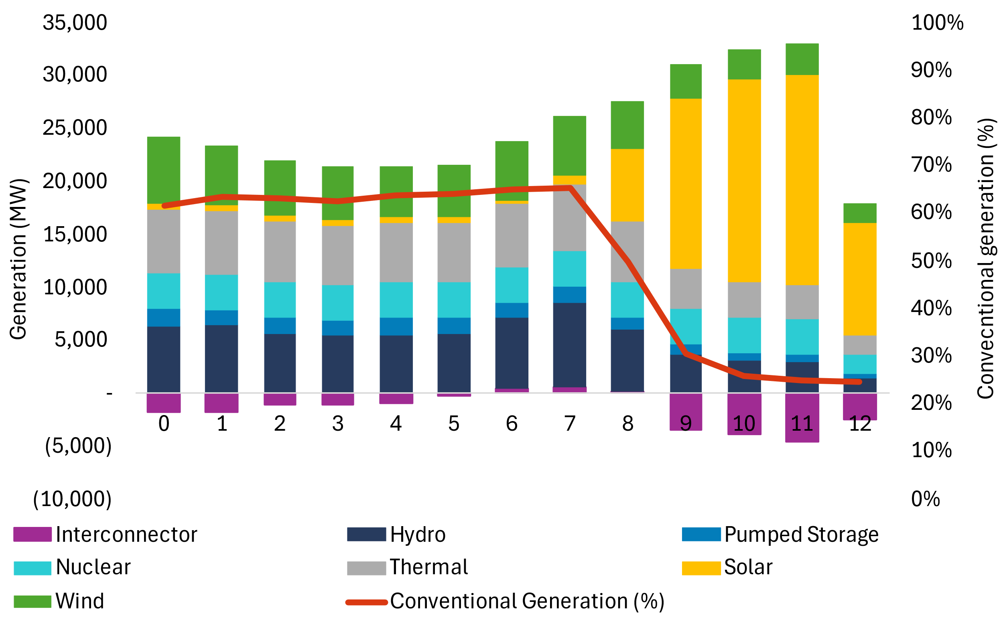
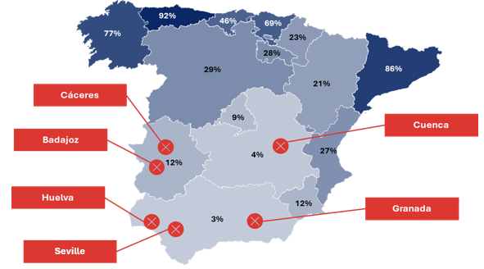
Conventional Generation on the Grid
D-1 generation schedule
The number of coupled thermal groups was the lowest of the year, and they were concentrated in the north
76 %
Share of conventional generation at 11:00 CET on 28 April, by Autonomous Community (%)
Hourly generation on 28 April 2025
- 15 CCGT
Location of the first generation trips
CCGT scheduled for the 28th in the southern area was declared unavailable on the afternoon of the 27th due to a fire and was not replaced
Source: Own elaboration with data from REE and AELEC Members

Slide 8
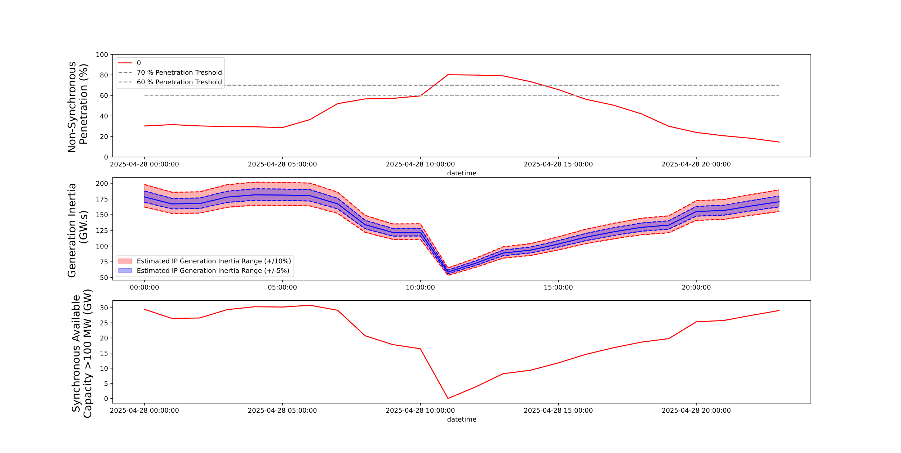
System Inertia
The System’s generation inertia is estimated using:
The data of the ENTSO-E transparency platform on the dispatched units for each hour interval;
The data of the ENTSO-E transparency platform on the nominal power of these units;
Typical inertia values (provided by ENTSO-E) on the typical inertia of each generation technology;
H > 2,5 s
Both the Government of Spain and ENTSO-E estimate similar system inertia values. Red Elétrica states that inertia was higher than ENTSO-E recommendation.

Slide 9
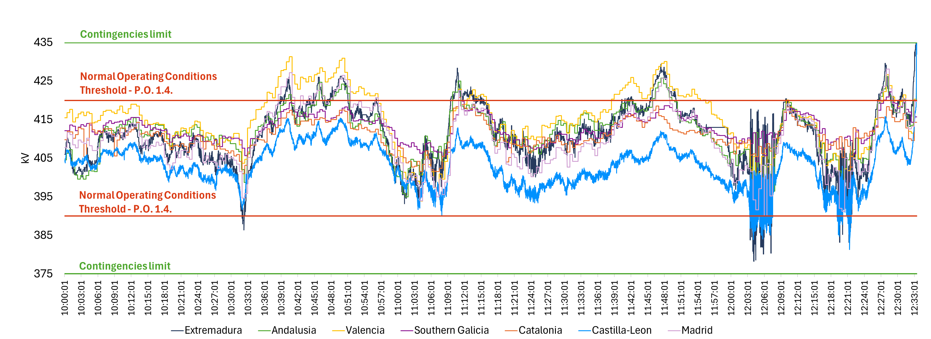
Voltage Fluctuation
between 10:00-12:00
There were strong voltage fluctuations that repeatedly exceed the limits of normal operating conditions
Source: Own elaboration with data from REE and AELEC Members

Slide 10
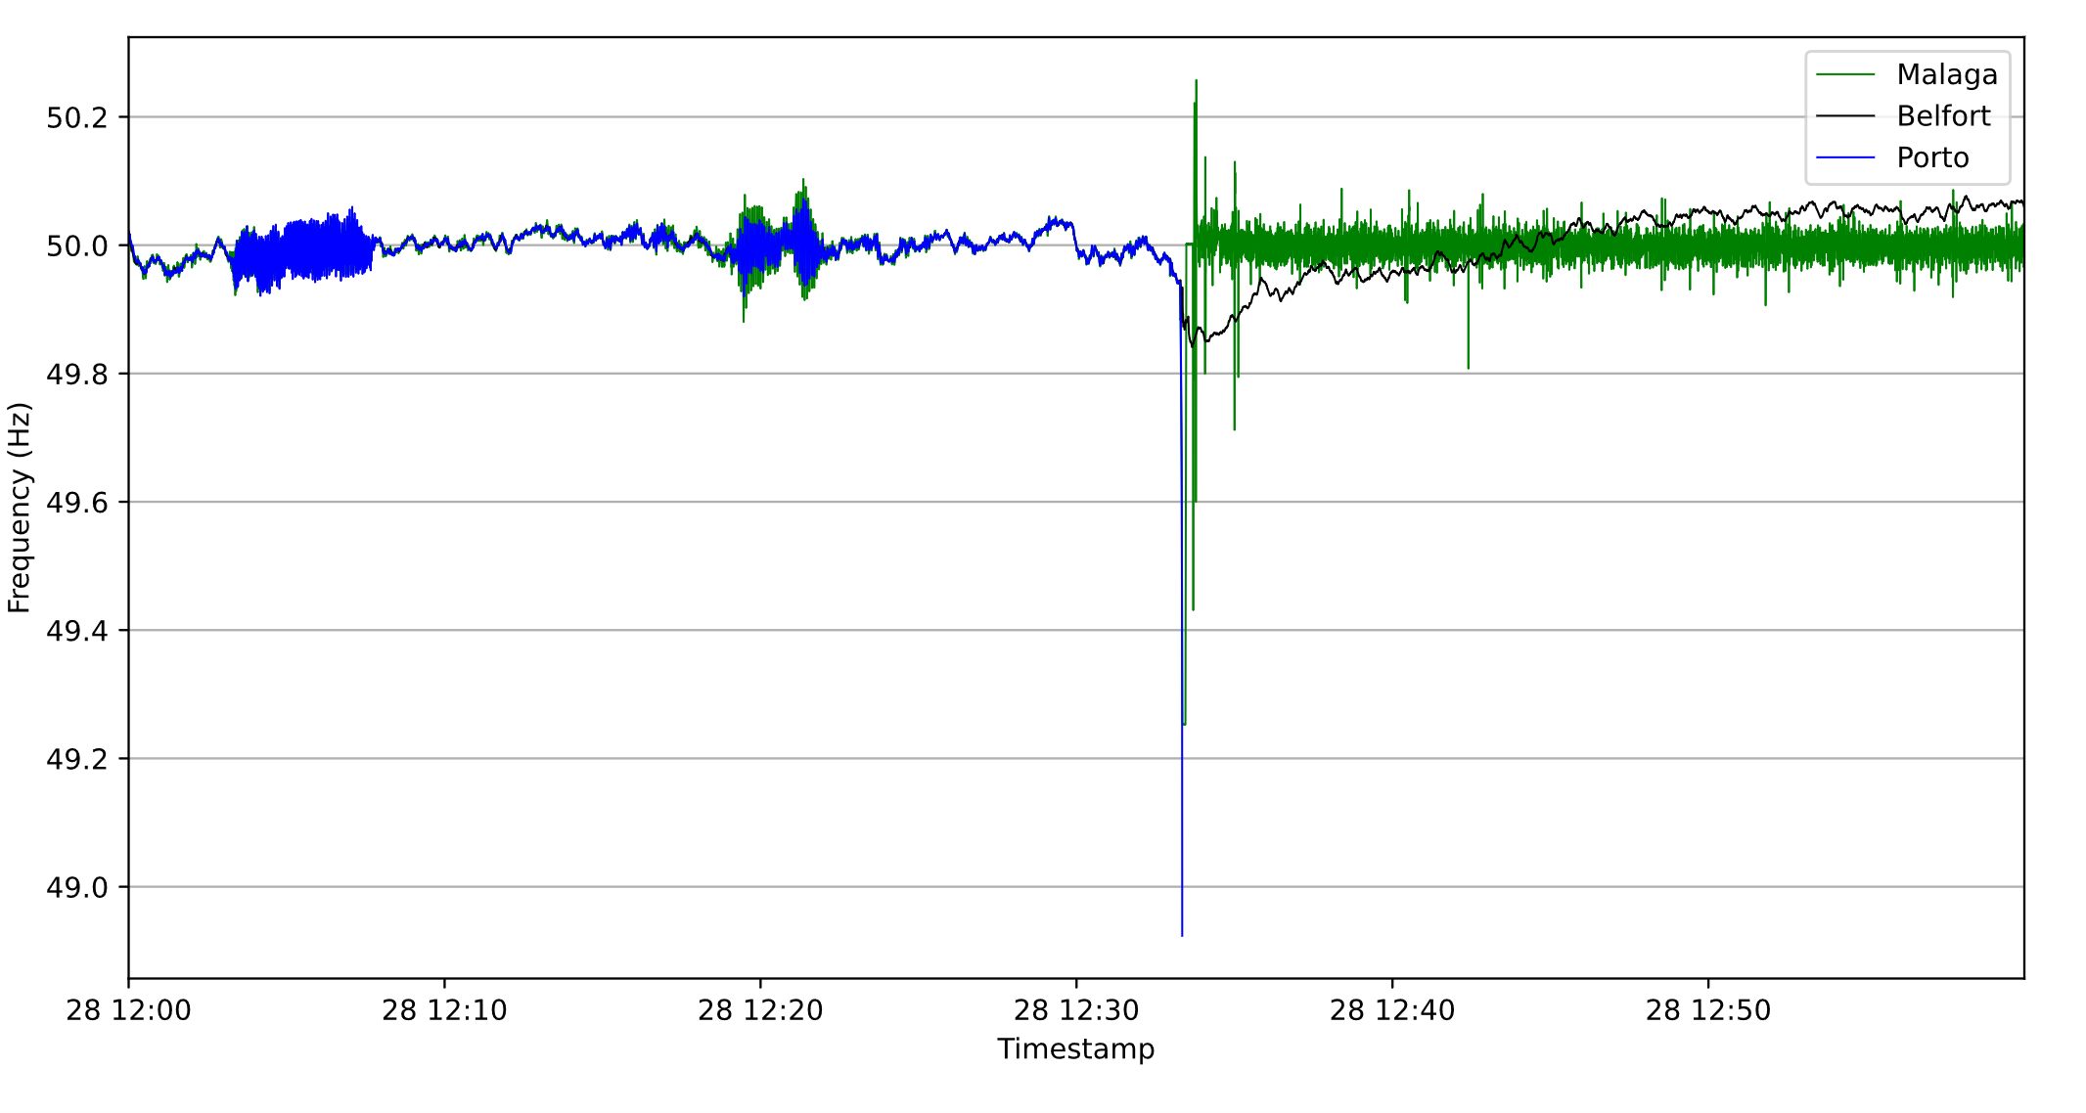
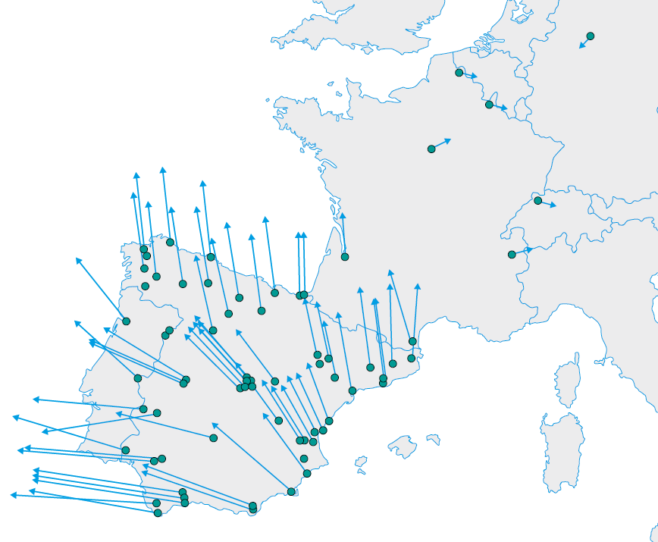

System Oscillatory Behavior
1
2
1
Intra-area oscillation with 0,65Hz
No conclusion yet on the nature of the oscillation.
Mitigating measures
Mitigating measures:
  INELFE HVDC link operated in constant power;
  Topological changes to decrease system impedance;
  Shunt reactors switched off due to lower voltages during oscillation
2
Inter-area oscillation with 0,22Hz
Source: Frequency measurements from Gridradar PMUs / Mode shape figure from ENTSO-E factual report

Slide 11
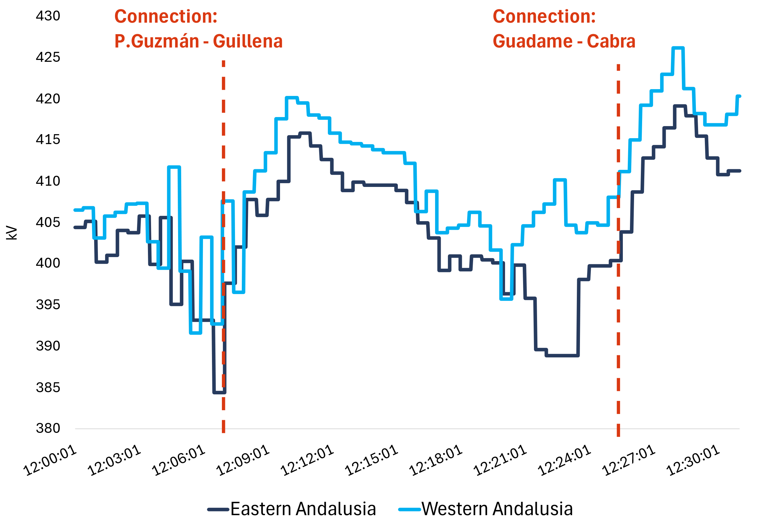
Maneuvers on transmission lines
Line connection impact on voltage in the South zone
(# days since they were disconnected)
La Robla
(14 days)
Grijota
(2 days)
Mudarra 1
Tordesillas
Villarino 2
(8 days)
(0 days)
Galapagar
Cerro Plata
Villaviciosa
Morata
Villaverde
(2 days)
Romica 2
(11 days)
Pinilla
Guadame
(9 days)
Guillena 1
(4 days)
(15 days)
Rocamora
P. Guzmán
(15 days)
El Palmar
(3 days)
Cabra 3
Carril
The connection of lines, which had been disconnected for several days, aggravated the overvoltage situation that existed minutes before the blackout
11
Source: Own elaboration with data from REE and AELEC Members

Slide 12
Sequence of events leading to the blackout
02

Slide 13
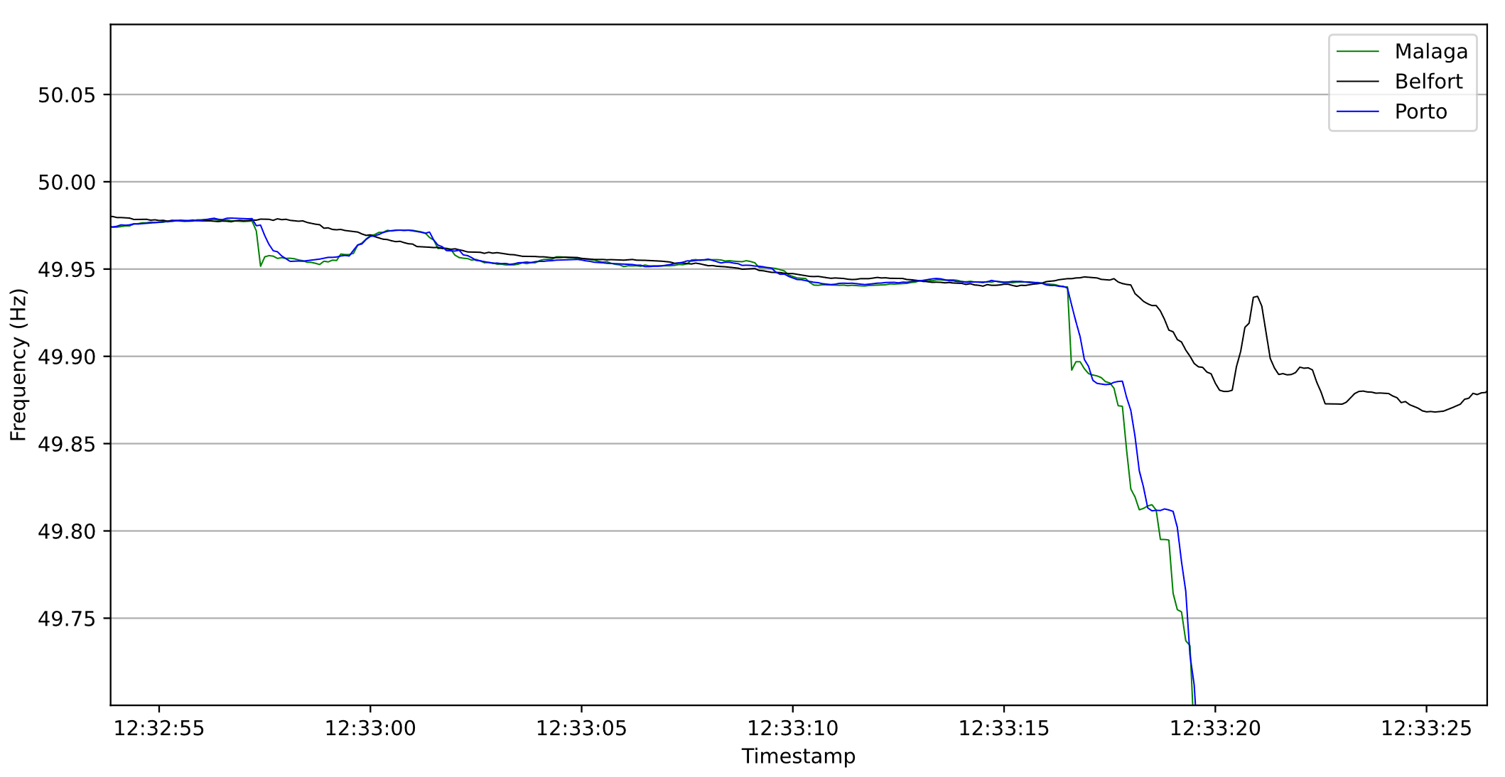
The main events
12:33:21 (CET/CEST)
Activation of LoS protections
12:32:57 (CET/CEST)
Granada (Andalusia, south-east)
Generation transformer tripping while injecting 355 MW in the 400 kV transmission grid.
Cause: Transformer (third-party) owner reported the tripping of the overvoltage function on the 220 kV side. Although, there are no voltage measurements available.
12:33:16 (CET/CEST)
Badajoz (Extremadura, south-west)
Tripping of 725 MW of PV and thermo-solar powerplants connected to 400 kV transmission substations.
Cause: Unknown
12:33:17 (CET/CEST)
Generation Losses Cascade
Wind and Solar generation tripping in Sevilla, Caceres, Segovia, Huelva, Badajoz accounting for a loss of 930 MW. High voltage and frequency profiles led to cascading tripping.
Source: Frequency measurements from Gridradar PMUs / Events description from ENTSO-E factual report

Slide 14
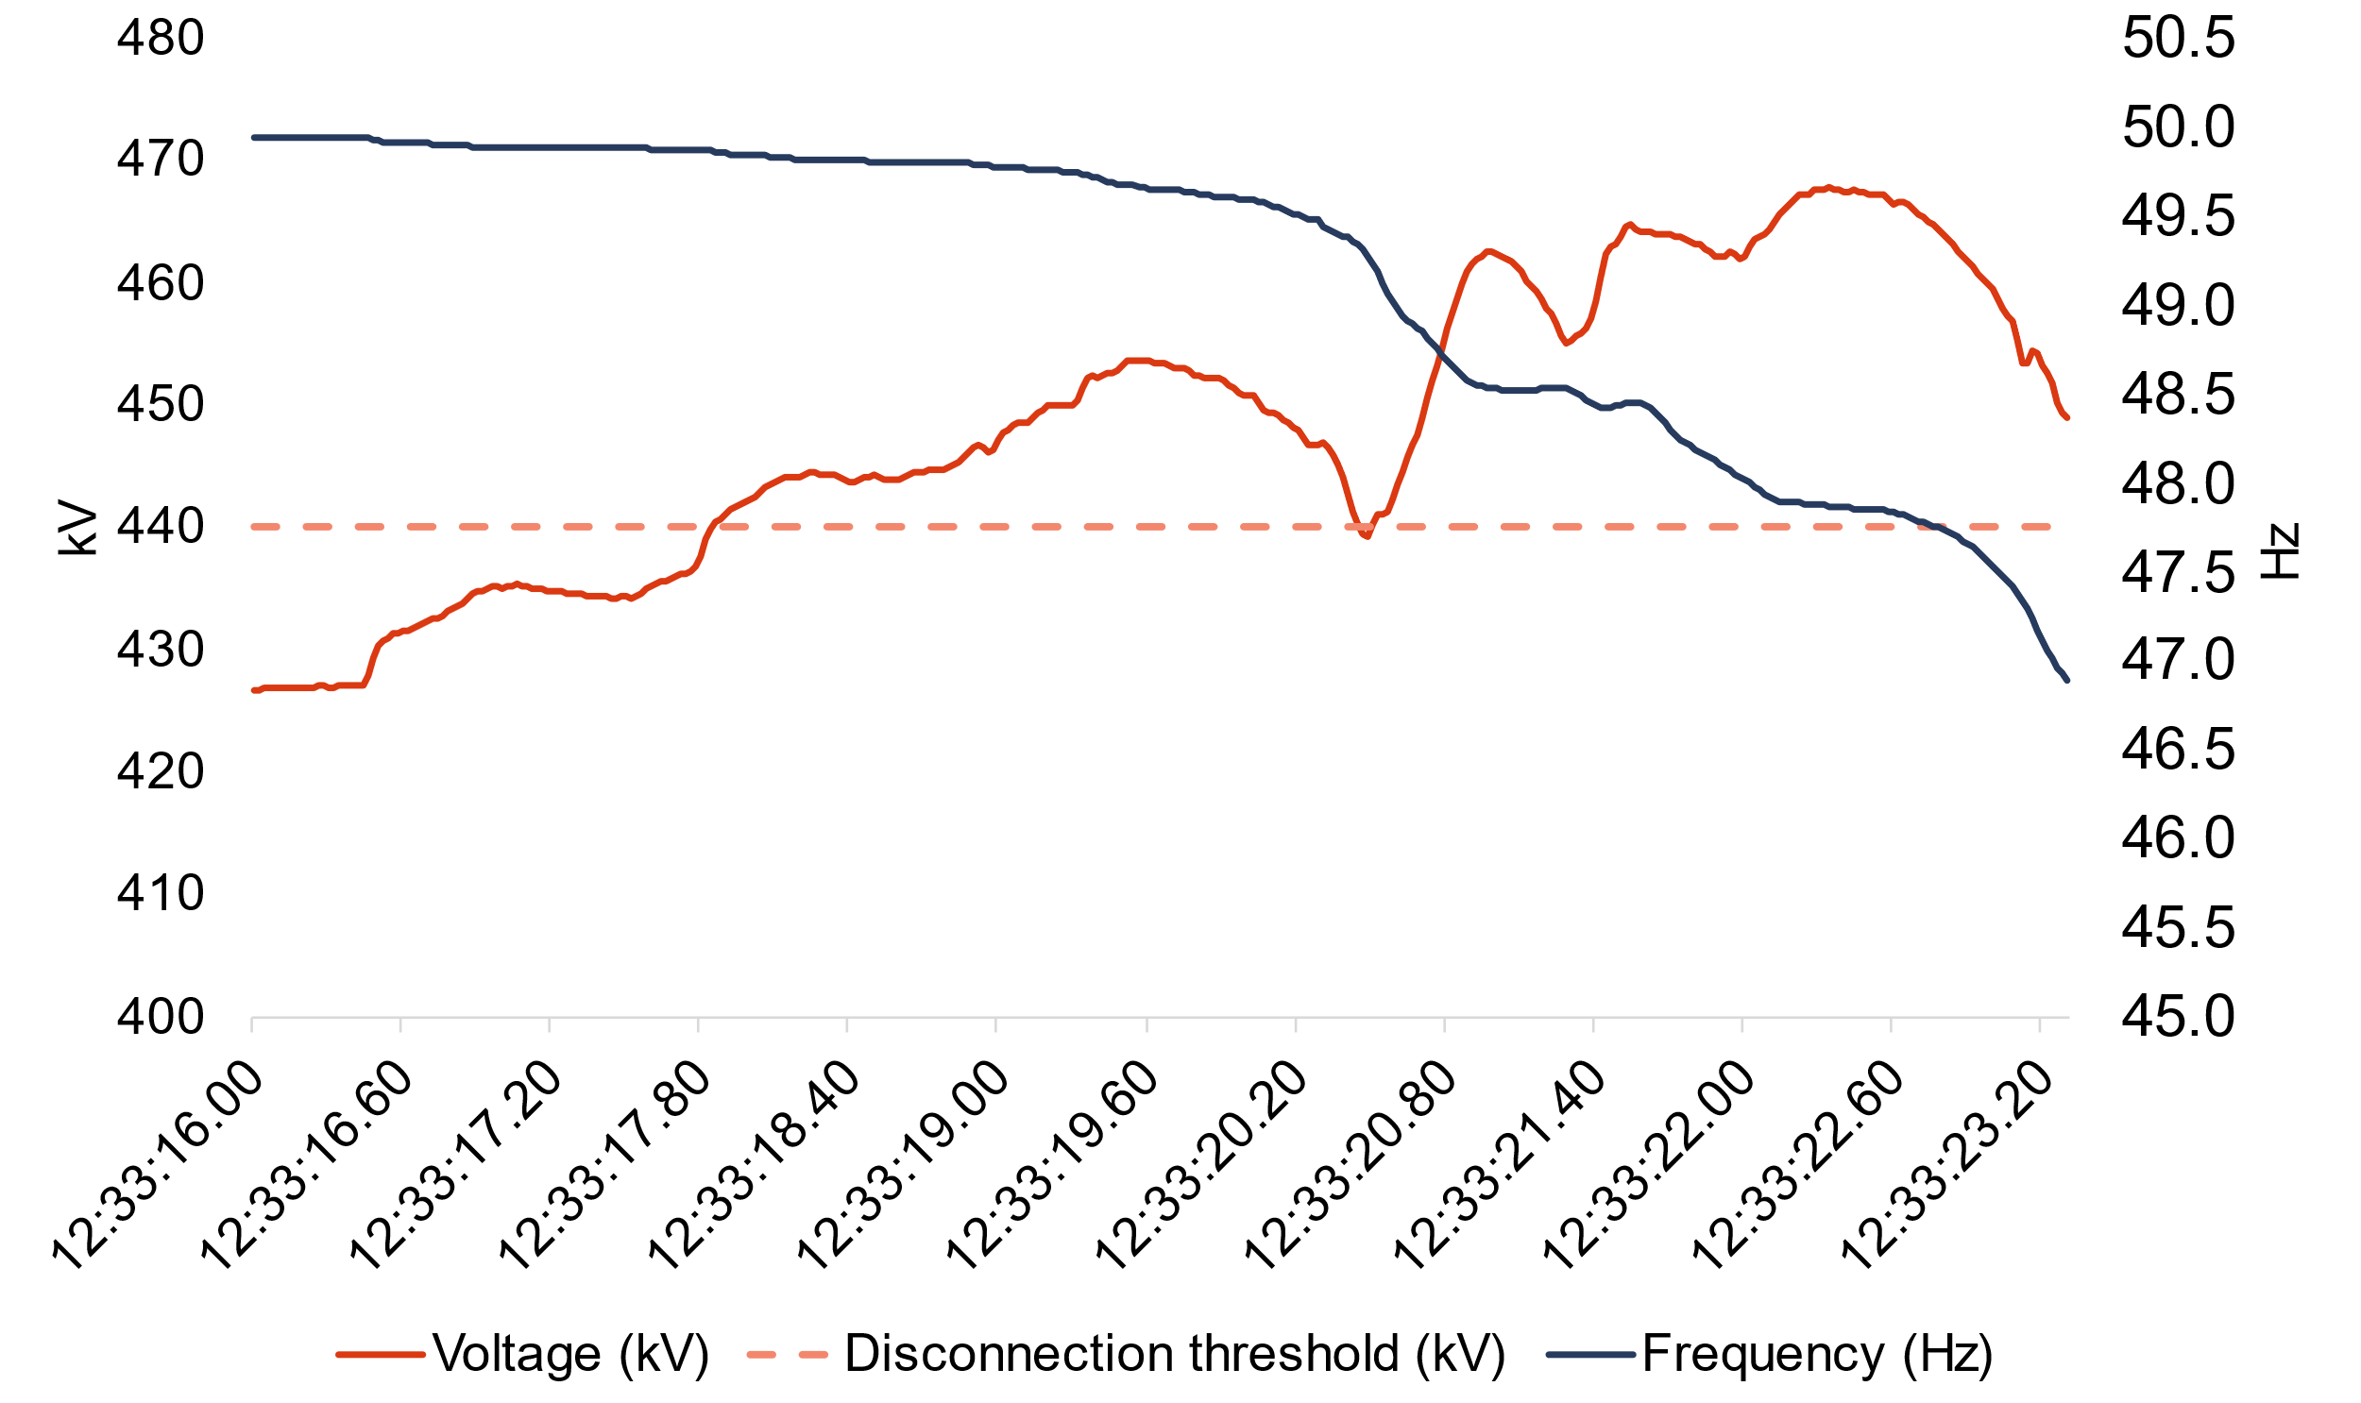
Geographic distribution of voltage in the transmission grid
Given the various outages, the voltage keeps rising.
Assuming that the units that went out of service were operating in voltage control mode, then it is natural that the disappearance of their voltage regulation capability caused the system voltage to rise further.
Second tripping
event (Badajoz): 12:33:16
THE BLACKOUT THAT OCCURRED IN THE IBERIAN ELECTRICITY SYSTEM ON 28 APRIL 2025, Luis Rouco et al., September 2025

Slide 15
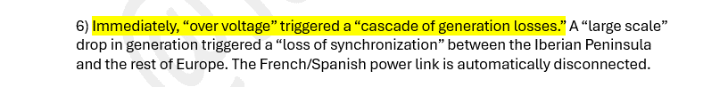
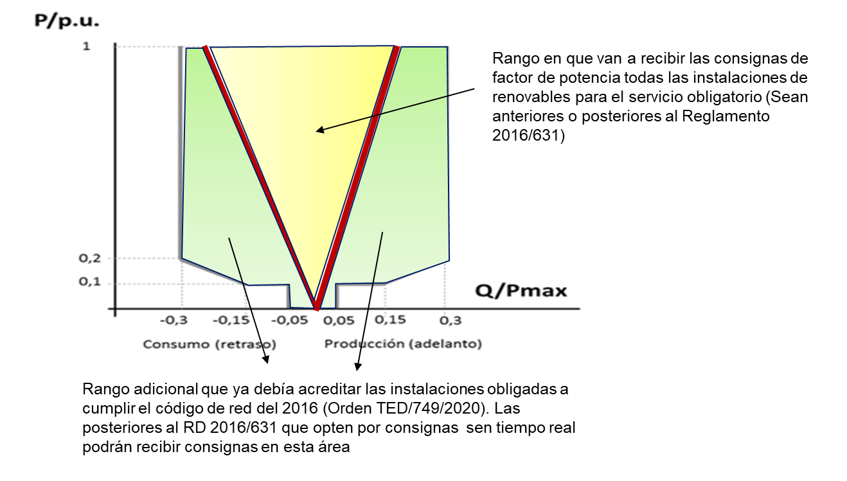
What could have caused the large generation loss?
Given the extremely high voltage levels detected after the three generation losses, and the inability of the voltage to return to acceptable values, several units went out of service simultaneously due to overvoltage.
The lost power corresponds in part to the loss of a large aggregation of distributed generation, which, due to the grid code cannot survive to overvoltage’s.
Large generation blocks were also disconnected from the grid due to increasing overvoltages.
Obsolete operation rules for solar PV and wind power plants operated in Spain: a constant power factor and PQ diagrams that prevent their capability of reactive power support to the grid.
15

Slide 16
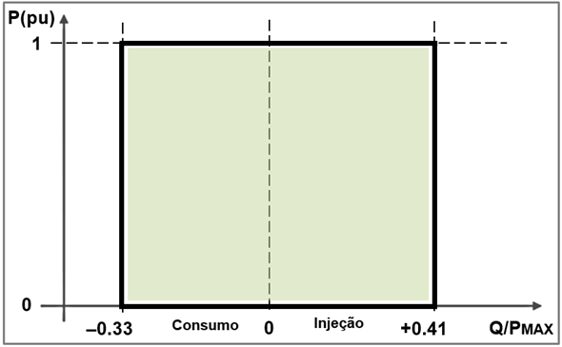
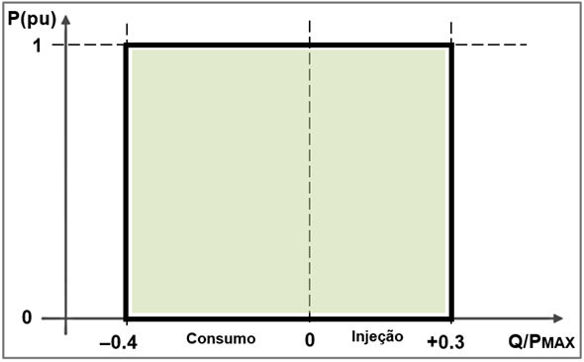
What lessons for the future
RES power plants need to be used for the participation of voltage → Demanding and strict requirements for generation.
See the Portuguese case for the P/Q diagrams:
Strict verification of the compliance of the plant wit these RfG
Mandatory contributions for voltage /reactive power support control
Voltage was under control from the side of the Portuguese Grid!

Slide 17

What lessons for the future
Identify new ancillary services (FFR, synchronous and synthetic inertia) as well as identify the volumes of these services. Decision-support systems.
Development of new tools to help defining the decision control solutions to be adopted at the dispatch control centers.
Installation of Grid Forming control modes in electronic power converters of batteries with a complementary strategic location and sizing of these units.
Need of operational decision tools regarding mobilization of voltage control solutions (settings for reactive power support from conventional and RES generation plants, connection /disconnection of reactors, FACTS /SVC, Connection / disconnection oh HV lines, dispatch of synchronous condensers)
Dynamic security assessment for a set of critical contingencies / disturbances
Definition of preventive control measures like dispatch of synchronous units to deal with technical restrictions (like voltage control) and redispatches.

Slide 18
Replicating the Event: A Digital Twin of the Iberian System
03

Slide 19

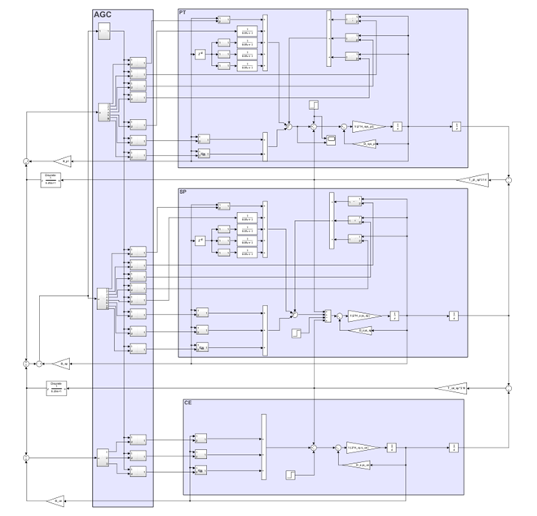
Equivalent dynamic model of Iberia interconnected with Central European System
Digital Twin representing the dynamic behavior of Iberian system interconnected with the Central European system
OBJECTIVES
To assess the frequency stability of the Iberian grid.
Identification of required ancillary services to improve the dynamic behavior.
To evaluate the effectiveness of the load shedding schemes.

Slide 20
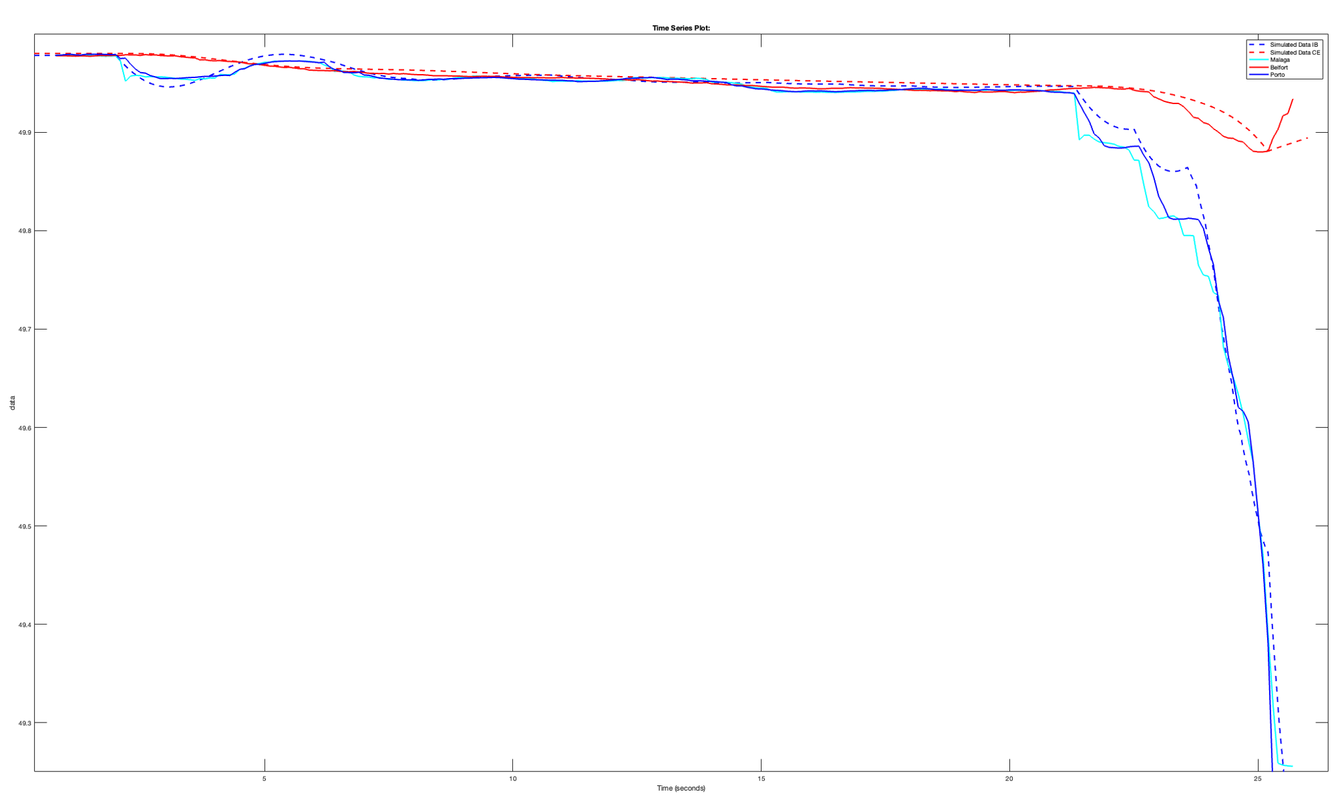
Replicating the event in INESCTEC’s physics based inter-area model

Slide 21
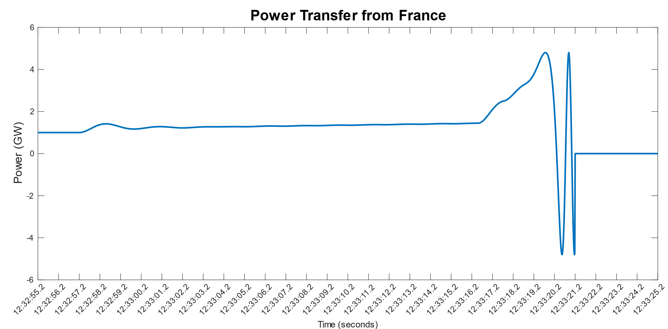
Replicating the event in INESCTEC’s physics based inter-area model

Slide 22
Opportunities for Foundational Models
04

Slide 23
What information could have helped the operator during this day?
The effect of the measures taken to damp the system oscillations on the system N-k security
Allows the operator to perform an informed decision in terms of the actions taken to damp system oscillations.
A small description of the event;
Provide operators with an early sketch of what might have happened.

Slide 24
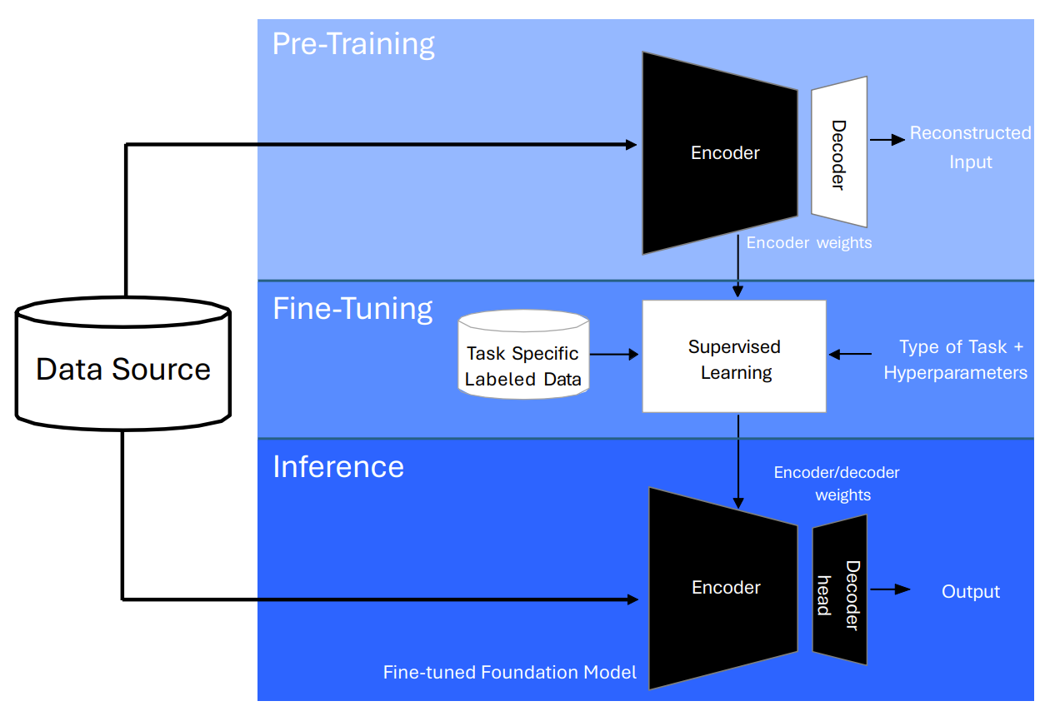


What are Foundational Models?
Once developed, FMs can be readily adapted to multiple downstream applications via fine-tuning with minimal labeled data.

Slide 25

Forecast the effect of the measures taken to damp the system oscillations on the system N-k security
The actions taken to dampen oscillations are often defined
beforehand, as established procedures.
Opportunity
Problem
Continuously forecast the impact of these measures on the system N-1 or N-K security.
The dimension of the contingencies to be analysed could make the analysis unfeasible in real-time.
Leverage the ability of Foundational models to perform fast and accurate predictions.
Data for Training/Fine-Tuning:
A large dataset of solved load flow cases may be used to train the FM for contingency analysis.
INESCTEC’s equivalent model of the Iberian System can be used to generate data on the loss of synchronism problem.

Slide 26
Provide a first report on the blackout based on the PMU and alarm data.
Understanding some of the specifics of the event that just took place can help the system operator have a first idea of what just happened.
Problem: Pinpointing root causes and gathering critical details often demands time and human resources.
Combining a Foundational model fine-tuned for disturbance classification/location with a Power System Specific LLM
Data for Training/Fine-Tuning:
Existing PMU units spread to the Peninsula; Synthetic data generated through high-fidelity system models;

Slide 27

Other opportunities for AI
Support the Operators during the Black Start procedure.
Forecasting Damping associated with common Oscillatory modes
PMU

Slide 29
O que acha?
Envie-nos o seu feedback!
Isso ajuda-nos a melhorar ainda mais os webinars da Every1. Obrigado.
Aceda ao inquérito de 3 a 5 minutos:
https://ec.europa.eu/eusurvey/runner/Every1WebinarPortuguese

