Slide 1

The changing role of citizens in the energy transition
date
Lorem
Notes:
Our society faces enormous challenges. Challenges that require fundamental changes – not only in technology, but also in how we live, produce and consume.
One of the biggest and most difficult tasks is the energy transition: the switch to sustainable, fair ways of producing and using energy.
This transition is often presented as a technical or political issue – more wind turbines, more solar panels, more policy.
But in reality, the energy transition requires something from all of us.
It is not only businesses or governments that need to change, but also individuals, in our daily routines, in our behaviour and in the way we think about energy.
Citizens are increasingly being called upon to do their bit: by saving energy, consciously choosing a sustainable supplier, or even investing in renewable energy.
But if we want the energy transition to be fair and inclusive, we need to go beyond simply “supporting” it.
We need to think about how citizens themselves can become active participants and what new roles they can take on in this process.
Researchers refer to this as energy citizenship. This is not about an official status or a right that someone grants you, but about actively participating in the energy system: using energy consciously, producing it yourself (at least in part), developing new skills,
and taking responsibility for contributing to change both locally and socially.

Slide 2
How to use this slide deck
This Slide deck is meant as a guide and easy starting point for a person that will explain the topic to an audience that isn't familiar with the topic yet.
Feel free to adapt and expand to your own need.
  The material is licensed under CC4.0 SA BY
You can find guidance text in the notes of each slide

Slide 3
Agenda
Energy citizenship
From consumer to co-creator
The theoretical basis: what does “energy citizenship” mean and why is it important?
What studies show about how citizens are redefining their role in the energy transition.
challenges
What impedes or promotes active participation?

Slide 4
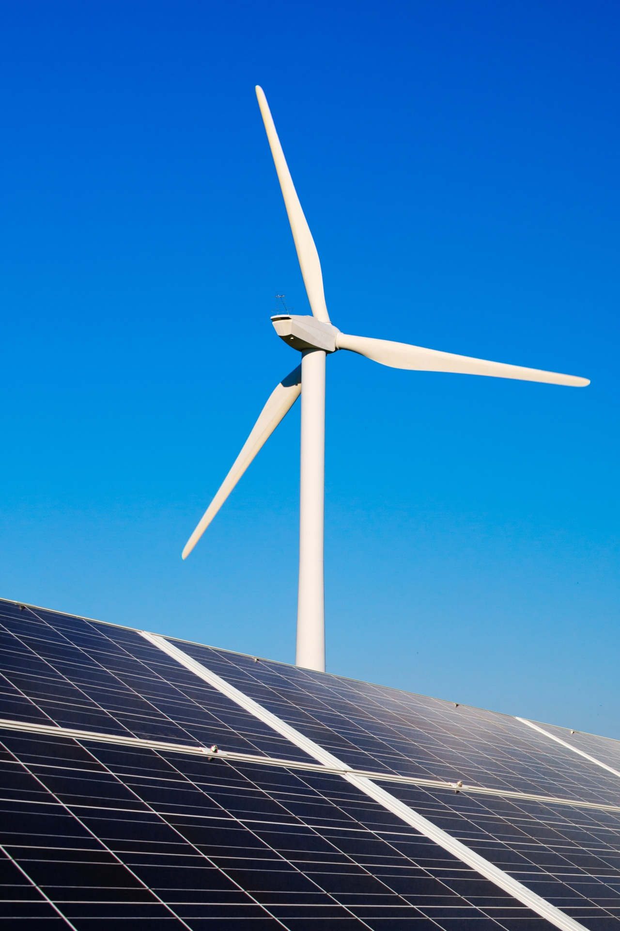
energy citizenship
What is the energy transition?
What is energy citizenship?
Why normal people are essential.
Notes:
With the Green Deal and the Paris Climate Agreement, the European Union has committed to becoming climate neutral by 2050. This means not only a transition to renewable energy sources, but also a fundamental redesign of the way energy is produced, distributed and used. To accelerate this change, the European Commission launched the Clean Energy Package, which gives citizens a central role in the energy transition. This policy marks a
clear shift: from a centralised energy system dominated mainly by large companies and governments to a more decentralised and democratic system in which ordinary people are no longer mere consumers but active
participants.
The world is facing a fundamental change in the way we produce and use energy. We call this change the energy transition. Essentially, the energy transition is about moving from an energy system based on fossil fuels, such as oil, coal and natural gas, to a system that runs on renewable, sustainable energy sources such as solar, wind and hydro power. The aim is to significantly reduce greenhouse gas emissions and thus combat global warming.
The energy transition is much more than a technological change. It requires not only new infrastructure such as wind turbines, solar panels and smart grids, but also social and cultural changes. It forces us to think about
power, responsibility and participation. Whereas energy used to be something abstract – something that came out of the socket automatically, it is now becoming an area of involvement and decision-making.
The transition from fossil fuels to renewable energy sources requires a different kind of relationship between citizens and the energy system, in which individuals and communities become co-creators of the future.
In this context, the concept of energy citizenship is receiving increasing attention. It refers to the active role of citizens in the energy system, not only as energy users, but also as co-producers, co-owners and
co-decision-makers. Energy citizenship means that people are no longer passive consumers who simply purchase energy, but conscious actors who reflect on their own energy consumption and are committed to making that consumption more sustainable. It involves more than practical actions, such as installing solar panels or participating in an energy cooperative. It also has a psychological and moral dimension: citizens develop a sense of responsibility, connection and influence with regard to the energy they use and the impact that has on society and the climate. At the same time, it is also a social and political process, in which people organise themselves
collectively and make their voices heard in decision-making on energy policy.
Why ordinary people are so crucial in this regard becomes clear when we look at the share of households and transport in total energy consumption. Together, they account for almost 70% of European energy consumption. Without changes in citizens' daily lives, in how we live, travel, heat our homes and consume, a successful energy transition is simply not possible. Moreover, citizens' attitudes largely determine the legitimacy of energy policy. Policy measures that are perceived as unfair, such as rising energy prices or unfair subsidies, can lead to protests and resistance, as the “yellow vests” movement in France has shown. When citizens are involved in local
initiatives, decisions or ownership models, however, their understanding, trust and willingness to embrace change grow. This makes the energy transition not only technologically feasible, but also socially just.
Energy citizenship is therefore about fundamentally redefining the relationship between citizens and energy. It requires individuals to rethink their own role, but it also requires institutions and governments to create space for participation, co-ownership and democratic decision-making. In this way, the energy transition becomes not just a technical or economic challenge, but a social project in which the active involvement of citizens is central.
Energy citizenship essentially means that the energy transition is not something that happens to people, but something that is shaped by people. It is a call for awareness, responsibility and cooperation, an invitation to be not just an energy consumer, but a full citizen in the energy system of the future.

Slide 5

From consumer to co-creator
Notes:
The energy transition requires not only policy changes or technological innovations; it also requires citizens to redefine their own role. Research shows that people are increasingly moving from a passive attitude as consumers to an active position as co-changemakers of the energy system. A striking example of this is the co-creative project Your Balcony Network, in which citizens were involved in small solar energy installations on their own balconies or roofs. This project showed how learning by doing can be a powerful way to increase engagement and competence. By gaining practical experience themselves, participants discovered how the technology works, but also what choices and responsibilities are involved.
Studies show that such a change in role manifests itself at various levels. Firstly, there is behavioural change: participants adjust their energy consumption, save more and integrate renewable energy into their daily lives. Secondly, they acquire new knowledge and skills, from technical knowledge about solar panels to insights into energy planning and local policy. In addition, their environmental awareness often grows, giving them a better understanding of the impact of their choices. Crucial to this is the feeling of self-efficacy: citizens notice that their actions matter and that they can influence the energy transition. Finally, a new role identity often develops; people start to see themselves as “energy makers”, someone who actively contributes to a sustainable future.
Various mechanisms stimulate this transformation. Practical experimentation offers direct experiences and tangible results that support the learning process. Social interaction also plays an important role; collaborating with other participants and receiving
recognition for efforts strengthens motivation and commitment. Furthermore, reflection on one's own actions helps: looking back on choices, successes and challenges deepens insight and increases the sense of responsibility. The result is a clear shift from a
passive to a proactive mindset, in which citizens see themselves as active participants who are making a real contribution to the energy transition.

Slide 6
From consumer to
co-creator
Savings
Citizens can make their energy consumption more sustainable by making conscious choices in their daily lives.
Notes:
Citizens play a central role in the energy transition because their choices and behaviours directly influence the energy system. Active participation goes beyond mere conservation; it involves redefining their role from passive consumers to co-creators of change. Specifically, citizens can contribute in three main areas: behavioural change, sustainable energy production, and policy and community engagement.
The first pillar is making energy behaviour in daily life more sustainable. This goes beyond simply turning off lights or appliances. It encompasses a wide range of actions, such as insulating homes, installing energy-efficient appliances, optimising heating and cooling systems, and consciously planning energy-intensive activities. Mobility also plays a role: choosing public transport, cycling or electric vehicles contributes to lower energy consumption. Through these behavioural changes, citizens can reduce their energy consumption, save costs and at the same time reduce the demand for fossil fuels. These are concrete, tangible steps that have an immediate effect and also reinforce the sense of self-efficacy: citizens notice that their actions are actually making a difference.

Slide 7
From consumer to
co-creator
Savings
Citizens can make their energy consumption more sustainable by making conscious choices in their daily lives.
Generation
Citizens can generate their own energy and participate in local sustainable projects.
Notes:
The second pillar is the generation and use of sustainable energy. Citizens can, for example, invest in solar panels, small wind turbines or heat pumps for their homes, thereby not only making their own energy supply more sustainable, but also contributing to the broader energy transition. By producing their own energy, they become prosumers, actors who both produce and consume. A step further is participation in collective projects, such as neighbourhood batteries, local solar cooperatives or communal charging points for electric vehicles. These initiatives combine individual actions with collective impact: they increase energy independence, strengthen social cohesion and demonstrate that cooperation is a powerful tool for shaping the energy transition.

Slide 8
From consumer to
co-creator
Savings
Citizens can make their energy consumption more sustainable by making conscious choices in their daily lives.
Generation
Citizens can generate their own energy and participate in local sustainable projects.
Participation
Citizens can participate in decision-making on energy policy and share and increase knowledge about sustainability.
Notes:
The third pillar concerns policy and community engagement. Citizens can make their voices heard by participating in local energy projects, municipal decision-making, or public consultations. They can become members of energy cooperatives or other participatory platforms, thereby not only influencing practical energy projects but also policy decisions and the direction of local transitions. Education plays an important role in this: by spreading knowledge about sustainable technologies, energy consumption, and climate impact, citizens can not only make better choices but also inspire and involve others. This creates a network of collective engagement that goes beyond individual action.
By combining these three pillars, citizens develop a new self-image: from passive consumer to active energy actor, who has an impact both locally and collectively. It is about strengthening knowledge, skills, and awareness, but also about increasing responsibility and involvement. This shift is crucial because the energy transition is not only a technical or policy issue, but a societal change that requires the active participation of citizens.

Slide 9

A fair transition
challenges
Balance between consumption & production
Flexibility for supply & demand side
Notes:
Although citizens can play a crucial role in the energy transition, their active participation depends on a complex interplay of factors that offer both opportunities and constraints. These challenges are physical, social, institutional and psychological in nature and largely determine whether citizens can actually fulfil their role as co-changemakers.
A first challenge concerns the physical and technical preconditions. Many citizens do not have suitable space to generate energy themselves, such as roofs or balconies, or do not have the financial means to invest in sustainable technologies. Without this basic infrastructure and resources, participation remains limited to a small group of early adopters or wealthy citizens, making the transition less inclusive. Decentralising energy production, for example through local solar energy projects, can help citizens gain insight into energy use and thus increase their energy awareness and skills. This is important because many citizens are psychologically and socially disconnected from centralised energy systems, making it difficult to motivate them to participate actively.

Slide 10
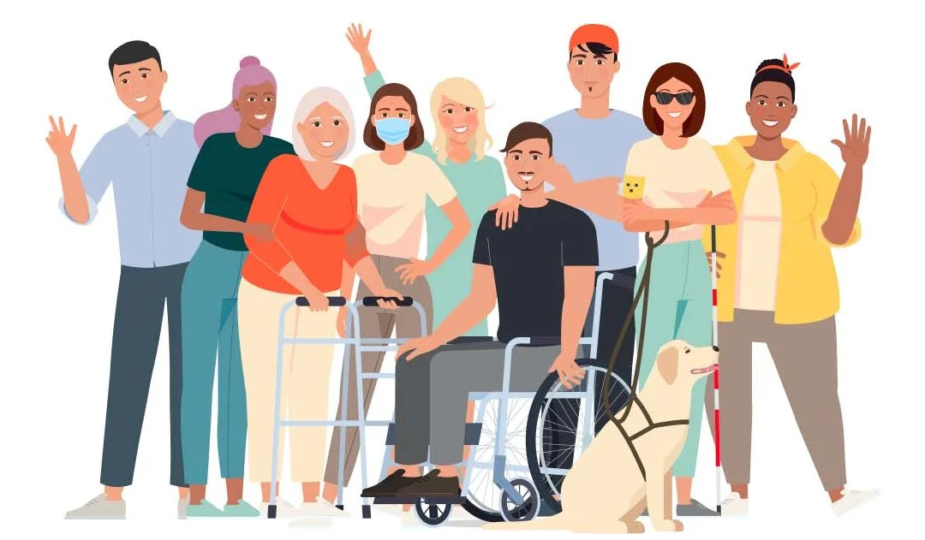
challenges
Notes:
In addition, social and organisational factors are crucial. Participation is facilitated by cooperation, trust and peer learning within communities. Initiatives such as energy cooperatives or neighbourhood projects show that joint efforts and social recognition strengthen motivation and lead to sustainable behavioural change. At the same time, conflicts or differences in knowledge, time and ambition can limit the effectiveness of projects. Building a supportive social environment requires attention and time, but is essential for long-term engagement.
Cultural and psychological barriers are an important dimension. Many people feel powerless or believe that their personal actions have little effect. A lack of knowledge about opportunities for participation and technologies limits their willingness to
participate. Increasing energy literacy is therefore essential; only when citizens understand how their actions have an impact will they develop an intrinsic motivation to contribute. At the same time, attention must be paid to perceptions of injustice or
exclusion. Examples such as the “Yellow Vests” in France and the Swedish “Bensinupproret” show what can happen when citizens feel they are not being heard in decisions that profoundly affect their daily lives.

Slide 11
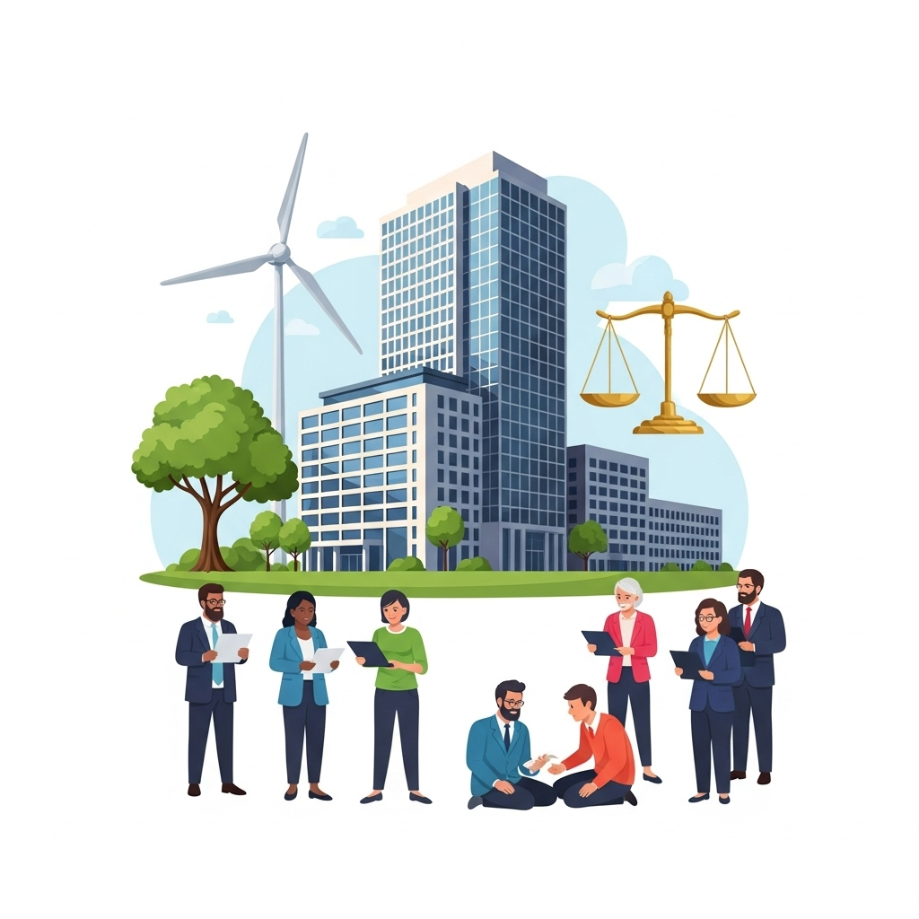
challenges
Notes:
The institutional and policy context can also offer both opportunities and barriers. Legislation and regulations, subsidies, administrative procedures and bureaucracy directly or indirectly influence the extent to which citizens can participate. Unequal access to technology and resources can reinforce existing social and economic inequalities. Policy instruments must therefore promote inclusion so that underrepresented groups—such as low-income families, tenants, women, indigenous communities or other marginalised groups—can also participate. This is not only a matter of fairness, but also contributes to broader acceptance and legitimacy of the policy.
In addition, there is a tension between speed and participation. While rapid energy transitions are necessary to achieve climate goals, inclusive participation requires time, deliberation and citizen engagement. Greater engagement can lead to productive plurality, but also to conflict and slower decision-making. Researchers therefore advocate a reflexive approach to energy transitions, in which both democratic participation and efficiency in policy and implementation are carefully weighed.
Finally, systemic challenges play a role. The dominant centralised energy system limits citizens' influence on production, distribution and policy. At the same time, too much emphasis on individual responsibility can place the burden on citizens while governments and businesses retain their responsibility. It is essential that participation enables both individual empowerment and collective impact, so that citizens can truly participate in decision-making and contribute to a sustainable transition.
In short, active citizen participation in the energy transition requires a combination of practical, social, institutional, psychological and systemic factors. Addressing these challenges is essential in order to position citizens not only as consumers, but as accomplished co-changemakers who make a substantial contribution to an inclusive, equitable and effective energy future.

Slide 12
acknowledgements
This slide deck was produced for by the Every1 project.
The images used in this presentation are as follows:
Slide 3: Renewable energy by Petr Kratochvil CC0 license
Slide 4: Can You Still Go Solar Without Owning Your Home? by solarprosaz.com CC BY-NC 4.0 license.
Slide 8: Lush green living walls on urban buildings by
freerangestock.com CC0 1.0 license
Slide 9: The Rewards of Working for a Nonprofit Healthcare Center: Making a Difference One Patient at a Time
by cvhnc.org CC BY-NC 4.0 license
Slide 10: Visualizing Impact of ESG Factors on Company Growth by easy-peasy.ai CC BY-ND 4.0 license

Slide 13
Thank you!

