Slide 1

Energy: how it gets smart
2026
A 50-minute lesson for 12-year-olds
Notes:
Welcome the class. Quick teacher framing: today we're going to learn how the way we get electricity is changing — and why that matters for them, even at 12 years old. Tell them they'll do a quick detective activity halfway through the lesson to find the 'energy thieves' in their own homes.

Slide 2
Today's lesson
The old way
What's changing
How electricity used to travel from a big power station to your living room.
Solar panels, electric cars and smart meters are turning your home into part of the system.
What you can do
A detective activity to spot the energy thieves at home, and 3 things you can do today.
Notes:
Run through the three parts in 30 seconds. Tell them the middle part will be a hunt for 'energy thieves' using their workbook. Lesson timing: ~8 min for 'The old way', ~12 min for 'What's changing', ~20 min for the activity and discussion, ~10 min for the wrap-up.

Slide 3
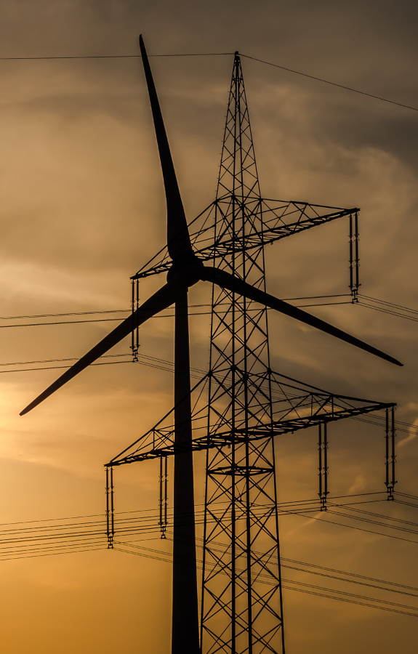
The old way
One big power station made the electricity
It travelled one way — to your home
A meter on the wall counted the total each month
Notes:
Ask: who has seen the meter at home? It might be a black or grey box in the hall, garage or basement. The old type had a spinning wheel. Each month someone came to read the number and you got a bill in the post. Electricity flowed in one direction only — power station → big wires → little wires → your wall socket. Nobody knew what you used during the day, just the total for the month.

Slide 4
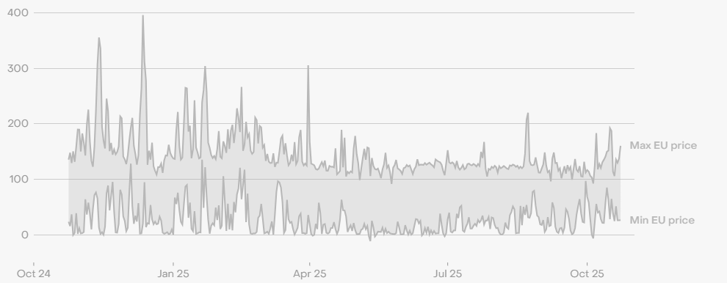
What's changing?
Notes:
Three things are changing all at once. We'll look at each in turn. Optional: ask the class to guess what's changing before you reveal it.

Slide 5
Three things are changing
1. Solar panels everywhere
Your neighbour's roof is now a tiny power station. When the sun shines, those panels make electricity for the home — and any extra gets pushed back into the grid for others to use.
Notes:
Ask: who has seen solar panels on a roof on the way to school? Many cities now have thousands of small rooftop solar systems. Each one is a tiny power station. When more electricity is made than the house uses, the rest flows back into the shared electricity grid for someone else to use. Electricity no longer travels in just one direction!

Slide 6
Three things are changing
1. Solar panels everywhere
Rooftops are now tiny power stations. Extra electricity flows back into the grid for someone else to use.
2. Electric cars and batteries
Cars used to run on petrol. More and more now run on electricity — and so do bikes, scooters and even some homes. A car battery can hold enough electricity to power a house for two days!
Notes:
Electric cars are becoming common. A typical EV battery stores about 60 kilowatt-hours of energy — enough to power an average home for around two days. Some new cars can even feed that electricity back into the home (called vehicle-to-home). Phones, bikes, scooters: anything that used to burn fuel is becoming electric.

Slide 7
Three things are changing
1. Solar panels everywhere
Rooftops are now tiny power stations. Extra electricity flows back into the grid for someone else to use.
2. Electric cars and batteries
Cars, bikes and homes are switching to electricity. A car battery can power a home for two days.
3. Smart meters
The new meter on the wall measures your electricity every 15 minutes — and sends the data to your phone. You can see when your home uses the most energy.
Notes:
The smart meter is the change you'll see in your own home. Instead of one number per month, it measures every 15 minutes and sends the data to an app on your parents' phone. You can see when your home uses the most electricity — usually morning (everyone showering) and early evening (cooking, TVs, lights). That detail is what lets you become smart about energy.

Slide 8
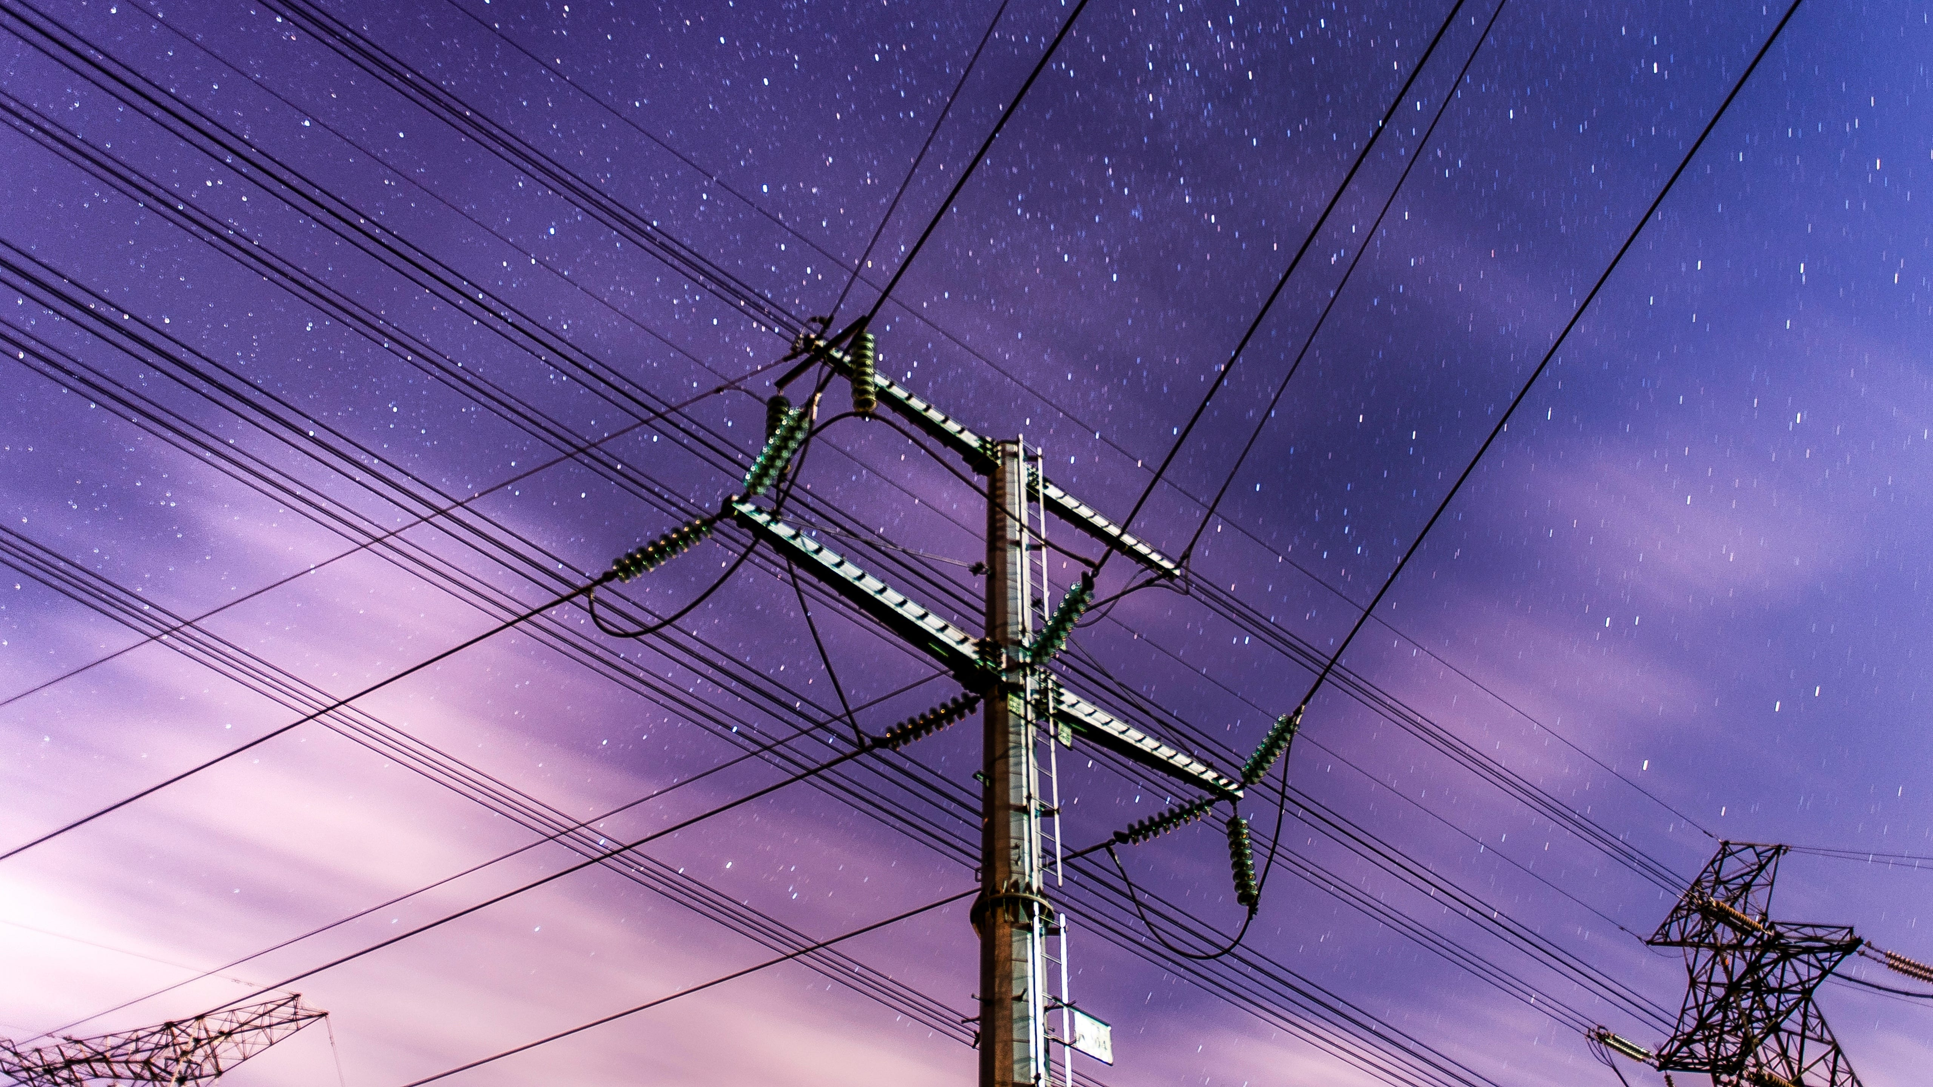
What does it all mean?
Time to be
smart
More clean energy. Lower bills. And you get a job to do.
Notes:
Bridge into the practical part. Tell them: 'Now you've seen what's changing. The next bit is what you can actually do about it — starting with a detective game in your own home.'

Slide 9
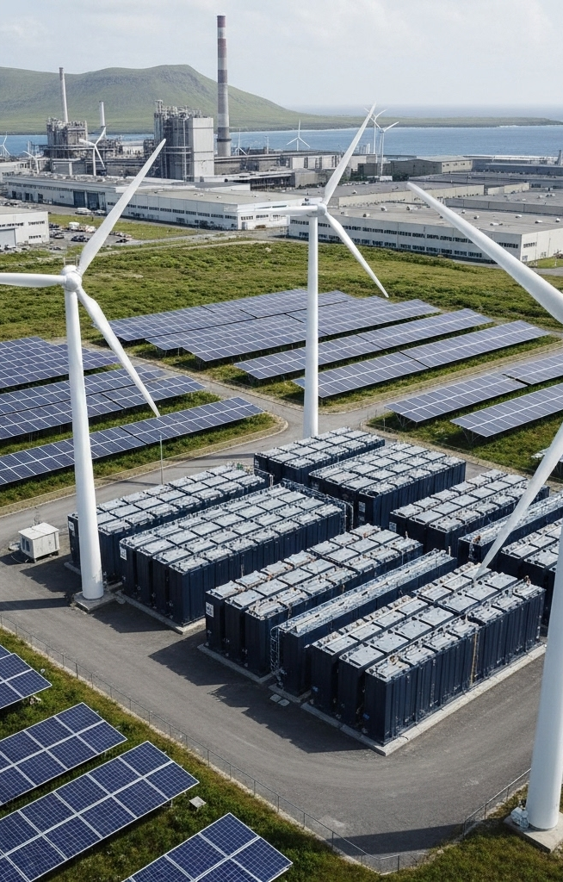
Why this matters for you
Three big wins of energy getting smart:
Cleaner air — fewer fossil fuels burnt
Less wasted electricity
Cheaper bills if you use power at the right time
Notes:
Quick teacher discussion: which of these matters most to them? Most students at 12 connect strongly with the environmental angle. The 'right time' point is the key new idea — electricity is sometimes cheap (sun is shining, wind is blowing) and sometimes expensive (everyone gets home from work). Using cheap electricity is good for your wallet AND the environment.

Slide 10
Activity: Energy thieves!
Open your workbook to page 4. In pairs:
List five things in your house that use electricity 24/7
Tick the ones that don't need to be on right now
Guess: how much could you save by turning them off?
Notes:
TIMING: 12 minutes total. 8 minutes in pairs, 4 minutes class share-out. Walk around and prompt: 'always-on' devices — Wi-Fi router, fridge, microwave clock, TV standby, phone chargers left plugged in, instant water heaters. Big reveal: even devices that look off can use 1–5 watts of standby power. Add up across 10 devices and 365 days and that's ~50 kWh per year — about €15 per household.

Slide 11
Three things you can do today
Be a smart energy citizen:
Look at the smart-meter app — find your home's busiest hour
Move one thing (charger, dishwasher) to a sunny hour
Tell a grown-up about an energy thief you spotted
Notes:
These three actions are deliberately small. Anyone in the class can do them this evening. Most homes have a smart-meter app — the supplier sends an email about it. If they tell a parent or grandparent about an energy thief and that thief gets fixed, they've saved real money.

Slide 12
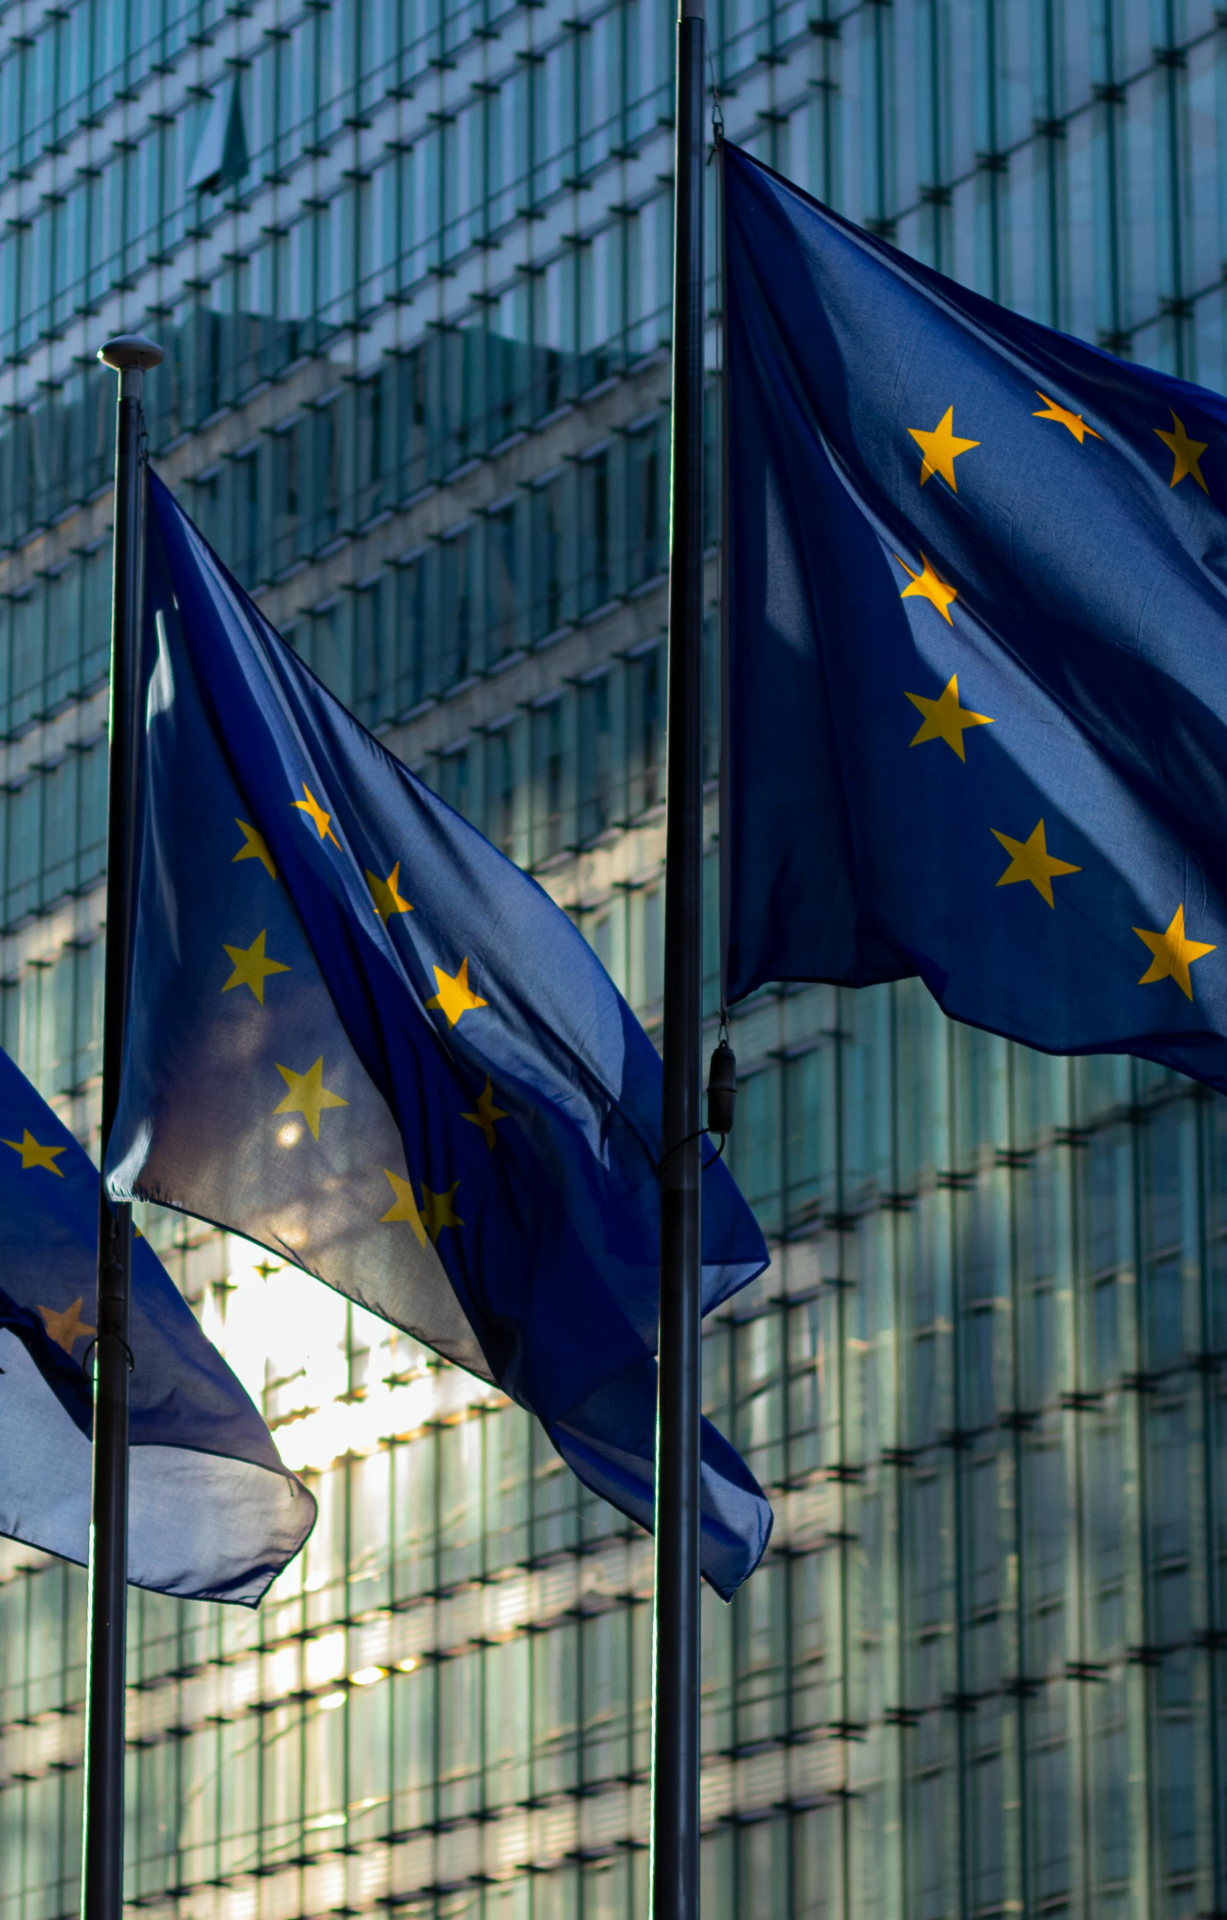
Three things to remember
Today's three big ideas:
Electricity used to flow one way — now it flows both ways
Smart meters let you see when your home uses energy
When you use electricity matters as much as how much
Notes:
End with a quick check-in: ask each student to say one of the three ideas in their own words. If time allows, the 30-second quiz on the next slide is a fun closer.

Slide 13
acknowledgements
“Energy: how it gets smart” was produced by Th!nk E for the Every1 project, licensed CC BY-SA 4.0. Every1 has received funding from the EU Horizon Europe programme under grant agreement No. 101075596.
Images reused from the Every1 deck “How to make our grid cheaper” (CC BY-SA 4.0). Original attributions:
Slide 3 — K.H. Reichert, “Billions of pounds of green infrastructure…”, CC BY-NC 2.0.
Slide 4 — ember.com, “Wholesale electricity prices in Europe”, CC BY 4.0.
Slides 8 & 11 — rawpixel.com, “Electric pole” and “Black transmission towers”, CC0.
Slide 9 — easy-peasy.AI, “High-Tech Microgrid Setup with Renewable Energy Resources”, CC BY 4.0.
Slide 10 — pensionpolicyinternational.com, “Inflation, war, rising interest rates…”, CC BY-ND 4.0.
Slide 12 — pexels.com, “European Commission Flags on Poles”, CC0.

Slide 14
Thank you!
Notes:
Optional 30-second exit ticket: 'tell your neighbour one thing you'll do differently after today.' Workbook page 6 is for them to write down what they learned.

