Slide 1

How to make our grid cheaper
date
Lorem
Subtitle of the presentation
Notes:
Electricity is the backbone of our modern society. We use it to heat our homes, manufacture goods, communicate and travel. But in recent years, it has become clear that energy is not necessarily cheap or stable. The energy crisis of 2021–2023 painfully
exposed how vulnerable Europe is to international tensions and price shocks. As gas prices exploded, households and businesses saw their electricity bills double. In 2023, prices for medium-sized industrial users were on average 97% higher than in the period 2014–2020. For millions of Europeans, this led to energy poverty and uncertainty.
The European Commission warns that high energy prices not only affect households, but also threaten the competitiveness of European industry. If energy in the EU remains structurally more expensive than in the US or Asia, investments and jobs are likely to shift elsewhere. At the same time, we must continue to invest in a cleaner and more sustainable future. Affordable electricity is therefore not only a social issue, but also a strategic prerequisite for the green transition and for Europe's economic resilience.
That is why the European Commission launched the Action Plan for Affordable Energy in 2025. This plan combines measures that will reduce energy bills in the short term while tackling the structural causes of high prices. The ambition is to build a true European Energy Union: an integrated, efficient and clean energy system that benefits everyone.

Slide 2
How to use this slide deck
This Slide deck is meant as a guide and easy starting point for a person that will explain the topic to an audience that isn't familiar with the topic yet.
Feel free to adapt and expand to your own need.
  The material is licensed under CC4.0 SA BY
You can find guidance text in the notes of each slide

Slide 3
Agenda
Why is electricity expensive?
Why do prices fluctuate?
Electricity is expensive due to structural factors in production, the network and the market.
Electricity prices fluctuate constantly due to changes in supply, demand and external influences..
How to make it cheaper?
Electricity can be made cheaper by producing it more intelligently, consuming it more efficiently, and taxing it more fairly.
Notes:
In this presentation, we examine three key questions:
Why is electricity so expensive today?
Why can prices fluctuate so much?
And above all: how can we make our electricity cheaper again without losing sight of our climate goals?

Slide 4
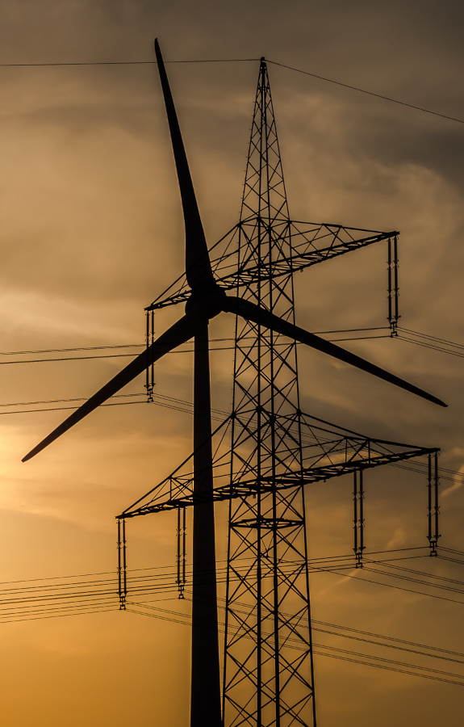
Why is electricity expensive?
Imported fossil fuels
Inefficiencies and shortages
Taxes, levies and network costs
Notes:
Although Europe is increasingly committed to renewable energy, it is not yet independent of fossil fuels. In 2024, almost 29% of electricity production still came from coal, gas and oil. The problem is that 90% of natural gas in the EU is imported, making its
price highly dependent on the global market. The energy crisis revealed how vulnerable this makes us: Russia used gas as a political weapon, leading to uncertainty and explosive price increases. In 2022, the EU's fossil fuel import bill rose to €604 billion, almost four times as much as in 2020. Because the European electricity price is still largely determined by the most expensive production unit (usually gas-fired power stations), any increase in the price of gas translates directly into higher electricity prices. Even when cheaper solar or wind energy is available, gas often remains the price setter on the market (merit order effect).
The EU has one of the most integrated electricity markets in the world, but the system is not yet operating optimally. In some regions, interconnections between countries or regions are insufficiently developed, which means that cheap energy from windy or
sunny areas cannot be used everywhere. According to the European Agency for the Cooperation of Energy Regulators (ACER), around half of the necessary new cross-border capacity will not be realised by 2030 if nothing changes. Permit procedures for new
projects also take too long, often 7 to 10 years for wind farms or major grid expansions. These bottlenecks lead to grid congestion, which means electricity is not distributed efficiently and additional costs are incurred. In 2022, the costs of grid management
(redispatching and congestion management) already exceeded €5 billion, and that amount could rise to €26 billion by 2030 without reforms.
Up to 40% of households' electricity bills consist of taxes, levies and network costs. Network tariffs cover the costs of maintaining and expanding the network. These costs are rising because massive investments in electrification and renewable infrastructure
will be needed in the coming years. Taxes and excise duties often make electricity more expensive than fossil fuel alternatives, which slows down electrification. The Commission argues that the Energy Taxation Directive should be reformed to make electricity
structurally less taxed than gas or oil. Member States can also apply temporary tax reductions, during the crisis, France reduced the electricity tax from €22.5/MWh to €0.6/MWh.
https://creativecommons.org/licenses/by-sa/2.0/

Slide 5
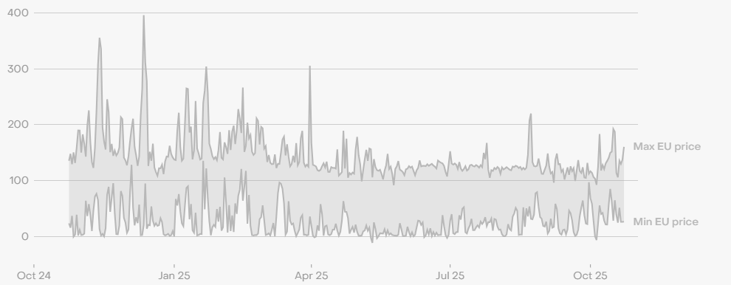
Why do prices fluctuate?

Slide 6
Why do prices fluctuate?
Daily price fluctuations
The price of electricity changes every fifteen minutes due to variations in demand, solar and wind production, and the activation of more expensive gas-fired power stations.
Notes:
Electricity prices are among the most volatile prices in our economy. They can vary by tens of euros per megawatt hour within a single day, but can also vary significantly on a seasonal or annual basis. These fluctuations are not coincidental, but the result of a complex combination of market dynamics, weather influences, geopolitical developments and structural characteristics of the European energy system.
The electricity price on the wholesale market in Europe is determined by the so-called merit order system. This means that the cheapest energy sources, such as solar, wind, nuclear and hydroelectric power, are used first. Only when demand exceeds what
these sources can supply are more expensive power stations, usually gas-fired, started up. Because these gas-fired power stations are often the last resort to meet demand, the gas price at that moment also determines the electricity price. This explains why
the price of electricity can rise sharply even in periods of abundant cheap renewable production as soon as gas-fired power stations are needed. Prices thus follow a recognisable daily rhythm: at night, when demand is low, they often fall sharply; during the
day, they rise due to industrial activity and domestic consumption. In the early evening, when people come home, cook, charge their devices and heat their homes, the price usually reaches its highest point. In Southern Europe, where a lot of solar energy is
generated, the price even drops temporarily during the day, only to rise sharply again at sunset.
Weather conditions play a major role in this. Wind and solar energy are variable: on windless or cloudy days, supply falls, requiring more expensive production to be brought online. Conversely, windy weekends with low demand can lead to extremely low or
even negative prices, because the grid becomes saturated at that point and producers have to pay to sell their electricity. Restrictions in the electricity grid also cause price fluctuations. When electricity cannot be transported smoothly between regions, price
differences arise: in areas with high production, the price falls, while elsewhere it rises. The European transmission grid is not yet fully integrated, in 2025, less than 70% of interconnection capacity will remain effectively available for trading in many Member
States.

Slide 7
Why do prices fluctuate?
Daily price fluctuations
The price of electricity changes every fifteen minutes due to variations in demand, solar and wind production, and the activation of more expensive gas-fired power stations.
Seasonal influences and medium-term fluctuations
In cold, dark winters, the price rises due to higher consumption and lower renewable production, while in sunny summers it often falls.
Notes:
In addition to daily fluctuations, there are also clear seasonal patterns. In winter, demand rises sharply due to heating, lighting and shorter days. Especially in countries such as France, where electric heating is widespread, this leads to peak consumption and
therefore higher prices. In summer, on the other hand, demand falls in Northern Europe but rises in Southern Europe due to the use of air conditioning. Renewable energy production also follows seasonal cycles. Solar energy is more abundant in spring and
summer, while wind energy is often stronger in autumn and winter. Hydropower plants depend on rain and meltwater: in dry years, such as 2022, hydropower production fell significantly, driving up prices. The natural gas market also plays a role. Gas is often
used for electricity production during peak periods. When gas reserves are low or international markets become more expensive, the price of electricity also rises. The price of gas itself experiences seasonal peaks: in spring and summer, countries replenish
their reserves, which can temporarily put pressure on the market.

Slide 8
Why do prices fluctuate?
Daily price fluctuations
The price of electricity changes every fifteen minutes due to variations in demand, solar and wind production, and the activation of more expensive gas-fired power stations.
Seasonal influences and medium-term fluctuations
In cold, dark winters, the price rises due to higher consumption and lower renewable production, while in sunny summers it often falls.
Long-term and structural factors
Geopolitical tensions, gas dependency and investment levels determine structural price differences on an annual basis.
Notes:
In the long term, price movements are linked to geopolitics, investments and the European market design. Europe remains largely dependent on imports for its gas: around 90% of the gas consumed in the EU comes from abroad. This dependence makes the price of electricity particularly sensitive to international events. The war in Ukraine clearly demonstrated this: the cessation of Russian gas supplies in 2022 led to record prices on the European electricity market. Tensions in the Middle East or disruptions in LNG supplies can also cause prices to rise suddenly.
Investment decisions also play a structural role. When new wind farms, solar parks or interconnections are built on time, the supply of cheap energy increases and prices become more stable. If investments are delayed due to slow permitting processes or
policy uncertainty, scarcity arises and thus price pressure. The CO₂ price within the European Emissions Trading System (ETS) also influences the price. Higher CO₂ costs make electricity from coal and gas more expensive, which temporarily increases the
wholesale price as long as fossil fuel power stations remain necessary. In the long term, however, this promotes the switch to renewable sources, which are less sensitive to fuel or emission prices.
Finally, the liberalisation of the European electricity market means that prices are freely determined by supply and demand. This leads to more competition, but also to greater exposure to market shocks. Without sufficient regulation or flexibility mechanisms, any external crisis quickly translates into higher end prices for consumers. Electricity prices fluctuate at various levels: from hour to hour, season to season, and year to year. The immediate cause usually lies in the balance between supply and demand, but
underlying this are structural and geopolitical factors that determine the vulnerability of the system. As long as Europe remains heavily dependent on imported fossil fuels and does not have fully integrated, flexible grids, electricity will remain a volatile market. Only when the energy transition is sufficiently advanced, with more renewable production, storage capacity and smart grids, can prices become more stable and predictable.

Slide 9
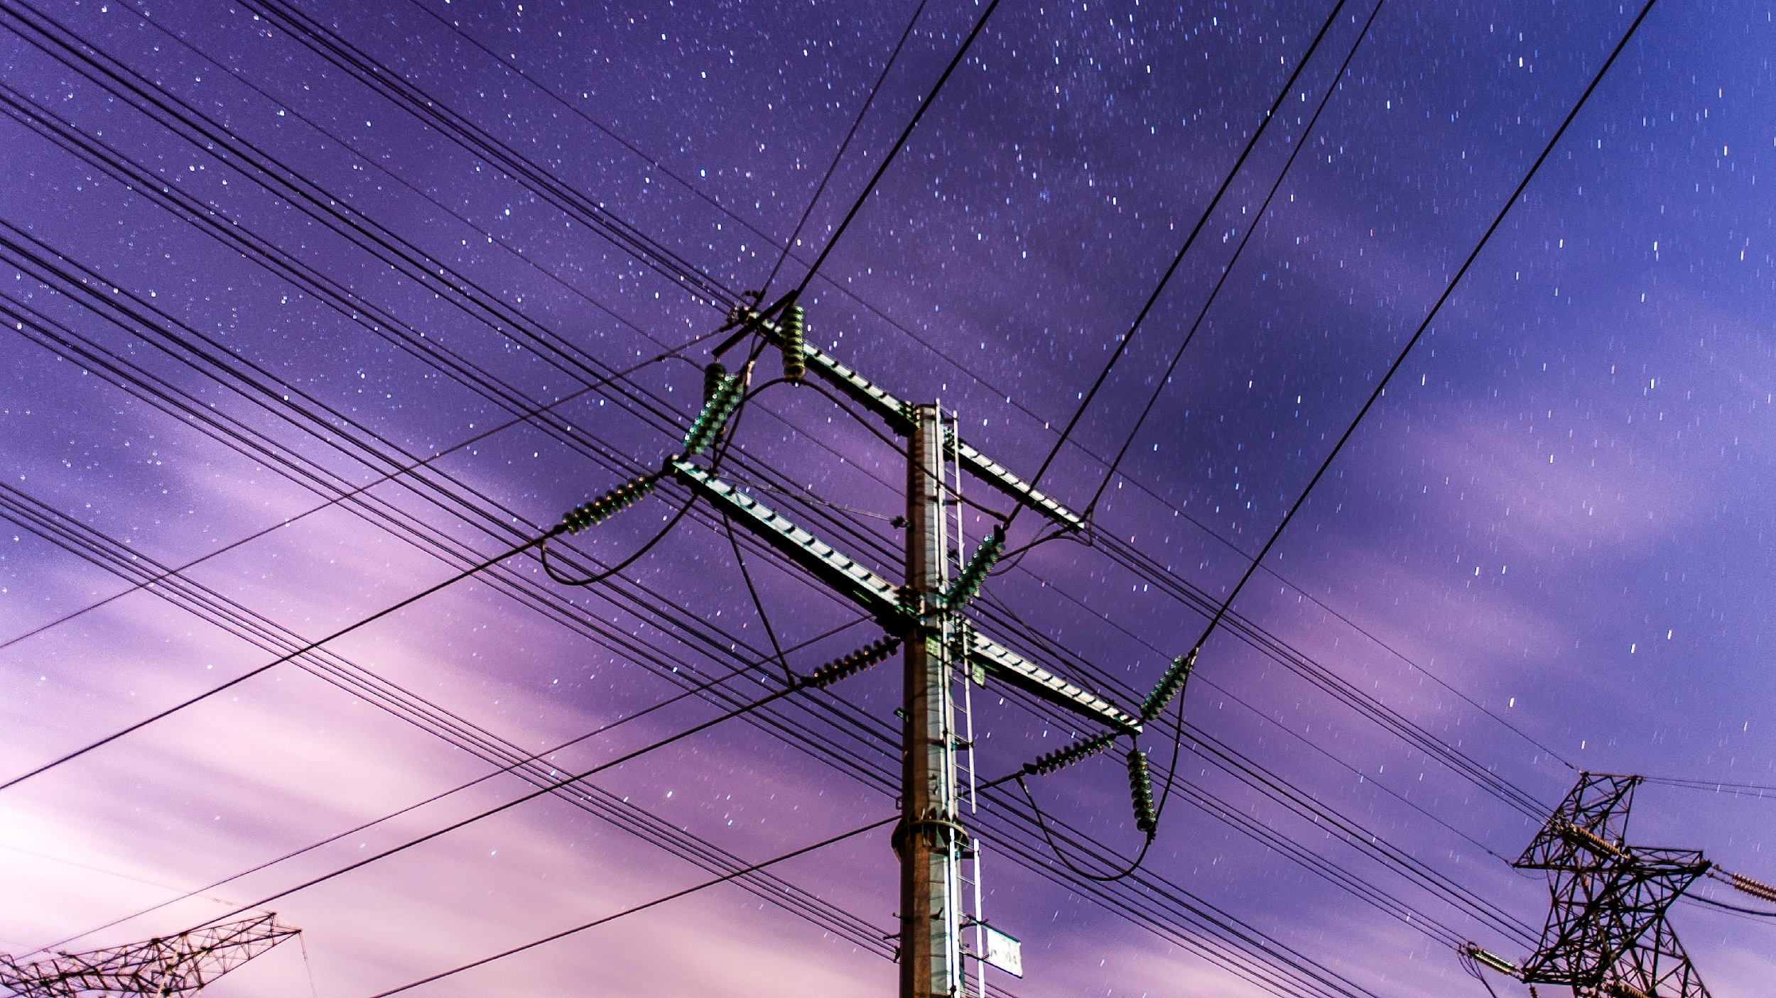
A fair transition
How to make it
cheaper
Balance between consumption & production
Flexibility for supply & demand side
Notes:
The price of electricity depends on many factors: the cost of production, transport via networks, taxes and levies, but also how and when we use energy. To make electricity structurally cheaper, we therefore need to take action at various levels, from the way
we generate electricity to the way we consume it. The European Commission has summarised this approach in five main areas: cheaper production, more efficient networks, fair taxation, smarter use and structural cooperation.
https://katiesinger.substack.com/p/utility-bill

Slide 10
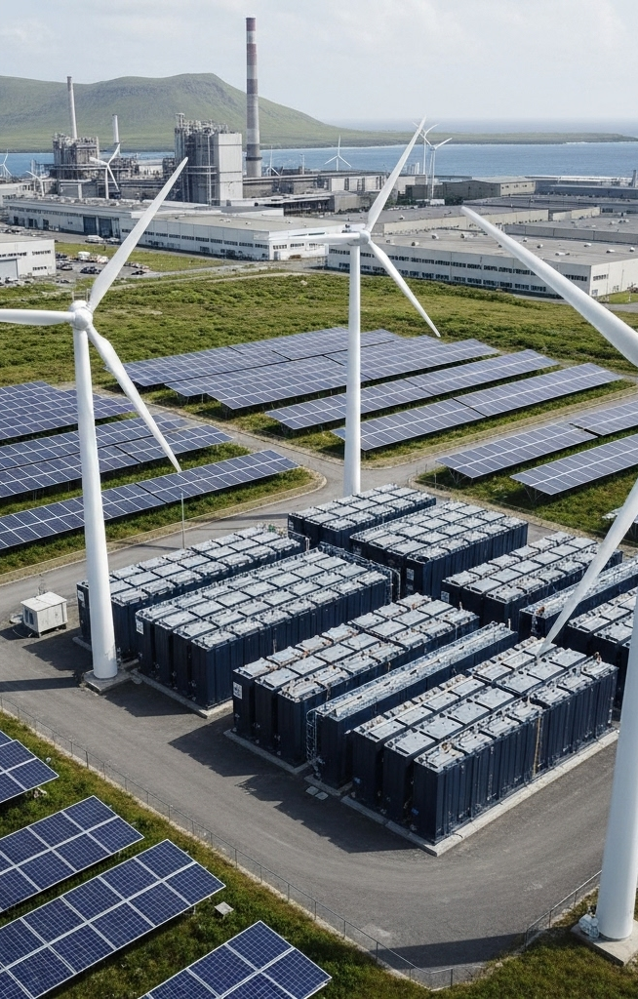
How to make it cheaper
Cheaper electricity production:
Renewable energy
Less dependence on fossil fuels
Storage and grid integration
Notes:
How can we make electricity production cheaper?
The price of electricity depends heavily on how we generate it. To reduce it structurally, Europe must focus on three levers: more renewable energy, less dependence on fossil fuels, and a better integrated energy system with storage capacity.
More renewable energy
Renewable energy sources such as solar, wind and hydro power are the key to structurally lower electricity prices. They have a high initial investment cost, but their marginal production cost is virtually zero: solar and wind power cost nothing to use.
Once the infrastructure is in place, they produce energy without fuel costs or CO₂ taxes. Technological advances have also led to a sharp drop in prices. The cost of solar energy has fallen by more than 80% since 2010, and wind energy has become about 60% cheaper. As a result, renewable sources can now compete with, or even be cheaper than, fossil fuels. As the share of renewable energy increases, the average cost of electricity production decreases. This not only results in cheaper electricity, but also more
stable prices, as production is not dependent on fluctuating fuel markets.
Less dependence on fossil fuels
A second factor is reducing our dependence on fossil fuels. As long as gas and coal play an important role in electricity production, the price of electricity will remain linked to international energy prices. During the energy crisis of 2022–2023, Europe's gas
import bill quadrupled to more than €600 billion, which directly led to record high electricity prices. By expanding local and sustainable energy production, Europe will be less exposed to such price shocks. The use of renewable energy reduces the demand for imported fuels, which not only benefits the price but also energy security. In addition, diversifying energy sources, such as biomethane, nuclear energy and hydrogen, can help to further reduce dependence on expensive and unstable fossil fuel markets. Fewer imports mean greater price stability, more control and, ultimately, cheaper electricity.
Storage and grid integration
Even with a lot of renewable energy, one challenge remains: sun and wind are not always available. That is why energy storage is essential to make electricity cheaper and more reliable. Batteries, hydrogen storage and pumped storage power stations can store energy when it is produced in abundance and cheaply and release it later when it is scarce. This prevents price spikes and waste of surpluses. In addition, European electricity grids need to be better connected. A highly integrated network makes it possible to export cheap electricity from countries with abundant sun or wind to regions with less production. This makes the balance between supply and demand more efficient, which pushes down prices. According to the European Commission, a fully integrated
European electricity market could save up to €40 billion per year by 2030. Together, storage and grid integration form the backbone of a flexible, resilient and affordable energy system.

Slide 11
How to make it cheaper
A fairer and more dynamic market for consumers
More competition
Smart meters and dynamic rates
Local energy cooperatives
Notes:
A fairer and more dynamic market for consumers
Cheaper electricity depends not only on how cheaply it is produced, but also on how efficiently the market works and how well the benefits of low production costs are passed on to the end user.
Today, this is often not the case. The European electricity market is still characterized by limited competition, slow switching between suppliers and little price dynamism.
More competition, more pressure on prices
In many Member States, a large proportion of consumers remain tied to fixed contracts or long-standing suppliers. Only 7% of households switch energy suppliers each year, which limits competition and keeps prices high. When switching becomes easier and more transparent, energy suppliers are forced to offer more competitive rates. More market movement leads to price pressure and innovation, just as in other sectors. The European Commission therefore wants to facilitate switching by removing
administrative barriers, supporting digital price comparison platforms, and enabling smart contracts that automatically choose the cheapest rate. The goal is a market in which consumers do not passively pay but can actively benefit from the best price.
Smart meters and dynamic rates
A second way to make electricity cheaper is through smart consumption management. Smart meters give households and businesses real-time insight into their energy consumption and allow them to choose when to consume. In combination with dynamic
rates, where the price varies by the hour, consumers can shift their consumption to times when there is a lot of cheap renewable production, for example, during the day when the sun is shining or at night when the wind is strong. This shift reduces peak
demand and thus the need for expensive reserve power plants, which pushes down the average market price of electricity. It also helps to keep the electricity grid in balance, which in turn saves costs on grid management. For consumers themselves, this
means immediate savings: households that actively respond to price signals can reduce their energy bills by 10 to 20%, depending on their flexibility and type of contract.
Local energy cooperatives and energy communities
A fairer market also means that citizens have more control over their own energy. That is why the EU encourages the development of energy cooperatives and local energy communities. In such models, citizens jointly invest in solar panels, small wind turbines, or neighborhood batteries, and share the electricity generated among themselves. This reduces costs because the electricity is produced and consumed locally, without the intervention of wholesale markets or long transport distances. In addition, profits are
reinvested in the community, rather than remaining with commercial suppliers. According to figures from the European Commission, households participating in an energy community can save between €500 and €1,100 per year. On a larger scale, this also
contributes to price stability, as local production is less dependent on fluctuations in international markets.
https://theshiftproject.org/en/publications/european-commissions-sustainable-finance/

Slide 12
How to make it cheaper
Smart and more economical consumption
Energy efficiency
Conscious behavior
Efficient industry
Notes:
Smart and economical energy consumption as the key to cheaper electricity
Making electricity cheaper means not only producing it more efficiently or distributing it more fairly but also being more conscious of what we consume. A large part of energy costs in Europe is not due to the price per kilowatt hour, but to how and when we use electricity. By limiting consumption and avoiding waste, not only does the consumer's bill decrease, but so does the overall pressure on the energy system, which lowers the price for everyone.
Energy efficiency: lower consumption, lower costs
Energy efficiency is the most direct way to make electricity cheaper. Every kilowatt hour that is not needed does not have to be produced, transported, or taxed. Better insulated homes, efficient appliances, LED lighting, and modern heating and cooling
systems can reduce household electricity consumption by 20 to 30%. On a large scale, this means less demand, less need for expensive peak power plants, and lower wholesale prices. The European Commission is therefore encouraging renovation projects,
subsidies for energy-efficient appliances, and support for companies that modernize their production processes. According to EU estimates, improved efficiency could reduce the total European energy bill by tens of billions of euros per year.
More conscious consumption and behavioral change
In addition to technological improvements, behavior also plays a major role. Small adjustments in daily routines have a noticeable effect on total energy demand: lowering the thermostat by one degree, switching appliances off completely instead of leaving
them on standby or washing and drying at lower temperatures. According to research by the European Commission, behavioral change alone can yield savings of 5 to 10% on the average household's electricity consumption. When millions of families and
businesses make such choices, it reduces overall demand in the market, causing prices to fall structurally.
More efficient use in industry and services
Companies can also make an important contribution to cheaper electricity through energy management and process optimization. By reducing waste, replacing motors with more efficient types, and making better use of heat and cooling flows, companies can drastically reduce their consumption. According to the European Commission, industrial energy efficiency could reduce electricity consumption in the EU by up to 15% by 2030, representing a significant reduction in production costs and pressure on the grid.
This lower system demand translates into more stable and cheaper wholesale prices for all users.
https://www.strategypolicyresearch.com.au/project/integrated-system-plan-energy-efficiency-forecasting

Slide 13

How to make it cheaper
Smart and more economical consumption
Lower taxes
Fair pricing
Less dependence
European cooperation
Notes:
Lower taxes, fairer prices, and structural measures
The price of electricity is determined not only by production and consumption costs, but also by policy choices and market structures. Taxes, levies, and geopolitical dependencies can have a significant impact on price. By addressing these structural factors,
Europe can make electricity cheaper in a sustainable and fair way.
Lower taxes and fair pricing
In many European countries, taxes and levies account for a significant proportion of the electricity price – in some cases up to 40% of the total bill. These costs have often grown historically, for example to finance infrastructure or support green subsidies, but
today they make electricity more expensive than other energy sources. The European Commission therefore wants electricity to be taxed less heavily than fossil fuels. This is not only fair in the context of climate targets, but also makes the transition to
electric heating, mobility, and industry more attractive. The revision of the Energy Taxation Directive should give Member States more flexibility to temporarily reduce taxes or transfer non-energy-related levies to the general budget. France has already applied this principle: by temporarily reducing the electricity tax from €22.5 to €0.6 per MWh in 2022, the average electricity price for households fell immediately. In addition, the EU wants to reform pricing on the electricity market. Today, the most expensive energy
Source, usually natural gas, often determines the price of all electricity, including cheaper renewable production. By adjusting the market system, the lower costs of solar and wind energy can be better passed on to consumers. A fairer link between production and consumer prices ensures more stable, lower rates.
Structural and geopolitical measures
In addition to taxes and market rules, structural and geopolitical factors also play a major role in the price of electricity. Europe is still heavily dependent on imported fossil fuels, especially natural gas. This dependence makes European electricity prices
vulnerable to international tensions and price shocks. The energy crisis of 2022–2023 demonstrated this painfully: European gas prices quadrupled when supplies from Russia collapsed. Because gas-fired power plants often determine the marginal price on the electricity market, this led to record-high electricity prices. To avoid this in the future, the EU is working on strategic energy independence. This is being done in three ways:
- Diversification of energy sources: more domestic production of renewable energy and nuclear energy, fewer imports of fossil fuels.
- Better energy infrastructure: investments in cross-border networks and interconnections so that countries can supply each other in times of scarcity.
- Joint European energy procurement: by acting as a bloc, the EU can conclude better and more stable supply contracts.
According to the European Commission, a fully integrated European electricity market could save up to €43 billion per year by 2030, while reduced fossil fuel imports could reduce Europe's energy bill by more than €130 billion per year.
https://www.pexels.com/photo/european-commission-flags-on-poles-13153479/

Slide 14
acknowledgements
This slide deck was produced for by the Every1 project.
The images used in this presentation are as follows:
Slide 3: Billions of pounds of green infrastructure investment
jeopardised by GB regulations which favour EU energy
imports by K.H. Reichert CC BY-NC 2.0 license.
Slide 4: Wholesale electricity prices in Europe by ember.com
CC-BY-4.0 license
Slide 8: Electric pole with power lines. by rawpixel.com
CC0 license
Slide 9: High-Tech Microgrid Setup with Renewable Energy
Resources by easy-peasy.AI CC BY 4.0 license.
Slide 10: Inflation, war, rising interest rates posed steep
challenges for investors in 2022 by
pesionpolicyinternational.com CC BY-ND 4.0 license
Slide 11: Black transmission towers under green sky. by
rawpixel.com CC0 license
Slide 12: European Commission Flags on Poles by pxels.com
CC0 license

Slide 15
Thank you!

