Slide 1

How flexibility helps the grid
date
Lorem
Notes:
Today, the energy system is undergoing a transition from centralised, fossil fuel-based production to a more decentralised system powered by renewable energy sources.
Traditionally, power plants provided constant and predictable electricity production. Renewable energy sources, on the other hand, are inherently variable and therefore more difficult to predict, as their output depends on changing weather conditions.
In 2023, two-thirds of the electricity in the EU will came from clean sources. Excluding nuclear it was almost half. This growing variability requires flexible resources and an adaptable electricity grid to effectively absorb shortages and surpluses. At the same time, Europe is
gradually phasing out base load production from fossil fuels such as coal, oil and natural gas.
This transition is essential for decarbonisation, but it also means that a once reliable source of controllable electricity is disappearing. This increases the need to compensate for this loss with systems that can respond quickly to changes in production and
consumption.

Slide 2
How to use this slide deck
This Slide deck is meant as a guide and easy starting point for a person that will explain the topic to an audience that isn't familiar with the topic yet.
Feel free to adapt and expand to your own need.
  The material is licensed under CC4.0 SA BY
You can find guidance text in the notes of each slide

Slide 3
Agenda
A changing energy world
Grid flexibility
There is more renewable production and growing demand for electricity, putting pressure on the grid.
Flexibility helps to balance supply and demand and make the electricity system reliable.
Solutions
From smart households and batteries to businesses and grid operators: various players can contribute to a flexible energy system.

Slide 4
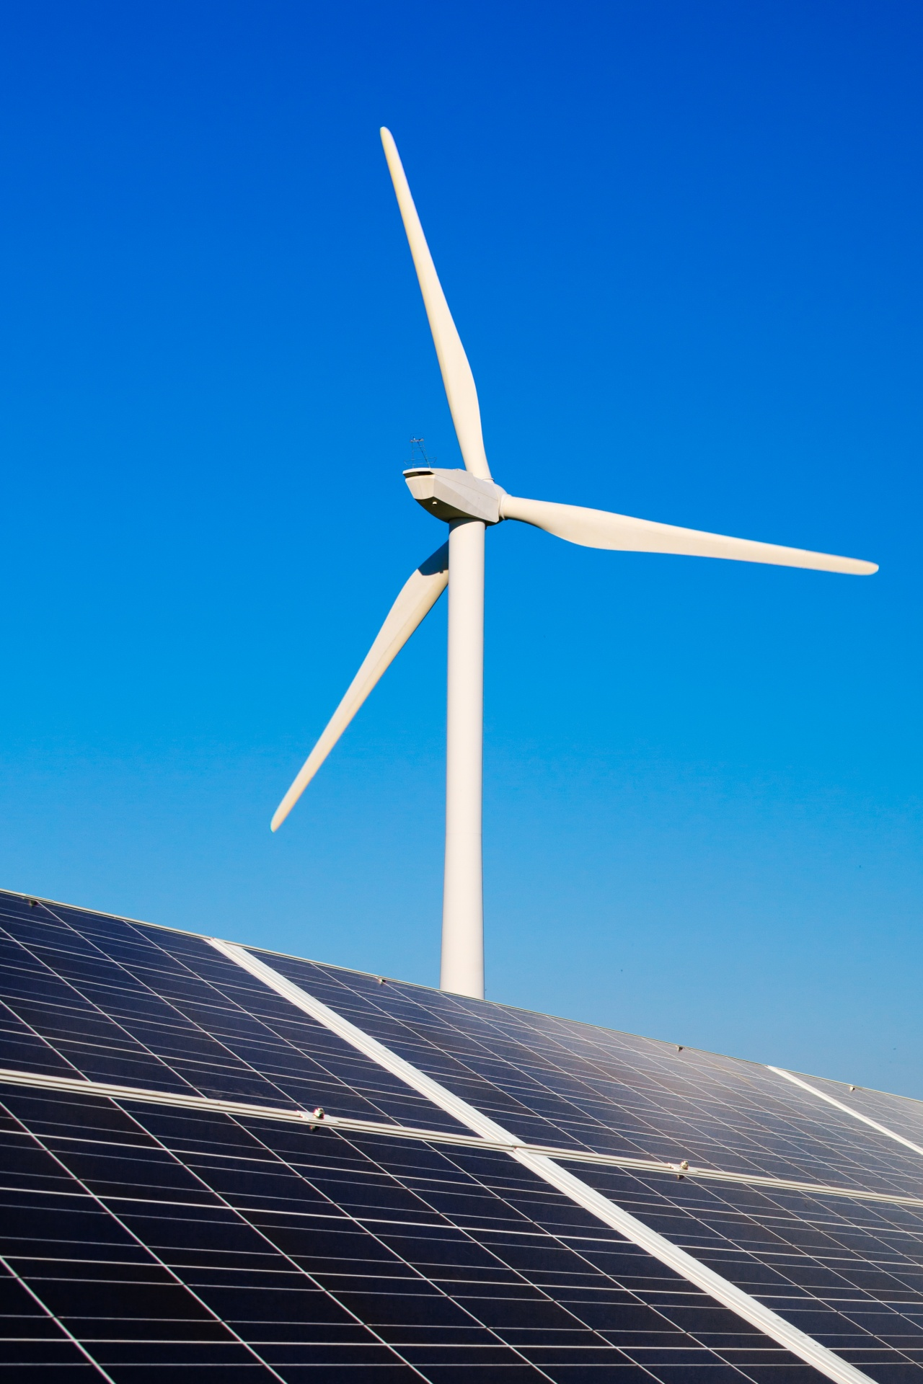
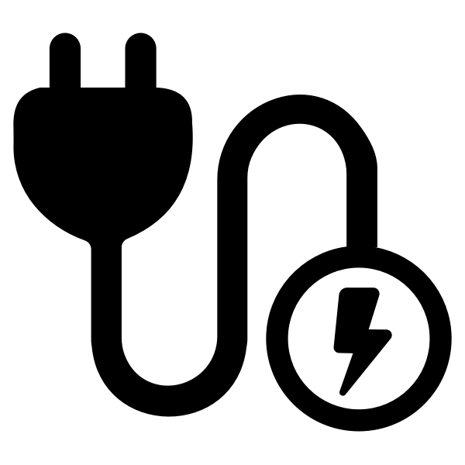
A changing energy world
Carbon emissions
Renewable energy
Electrification
Decentralized
Notes:
The way we produce and use energy is changing dramatically. Rising CO₂ emissions over the past decades have led to accelerated global warming, with visible consequences such as extreme weather conditions, rising sea levels and threats to ecosystems.
To slow down this climate change, countries around the world – and certainly within Europe – have set ambitious climate targets. The European Union has committed to becoming completely carbon neutral by 2050. This means that a fundamental change is
needed in how we generate, distribute and consume energy.
Renewable energy sources such as solar and wind are increasingly replacing fossil fuels, but these sources are not continuously available. When the sun is not shining or the wind is not blowing, production drops, while demand for electricity remains.
In addition, the electrification of our society is increasing rapidly. Cars are increasingly electric, homes are heated with heat pumps and industries are switching to electric processes. These developments are leading to higher and highly variable demand for
electricity, which puts extra strain on the grid. The old electricity grid was also originally designed for one-way traffic: from large power stations to consumers. Today, we have thousands of small producers, solar panels on roofs, wind turbines, batteries, all
generating energy and sometimes feeding it back into the grid. This makes the system much more complex to manage.
In short, the climate challenge, the European CO₂ targets for 2050, and the rapid electrification of our society are fundamentally changing the electricity grid. It must not only become more sustainable, but also smarter, more flexible, and more resilient to
enable the energy transition.

Slide 5
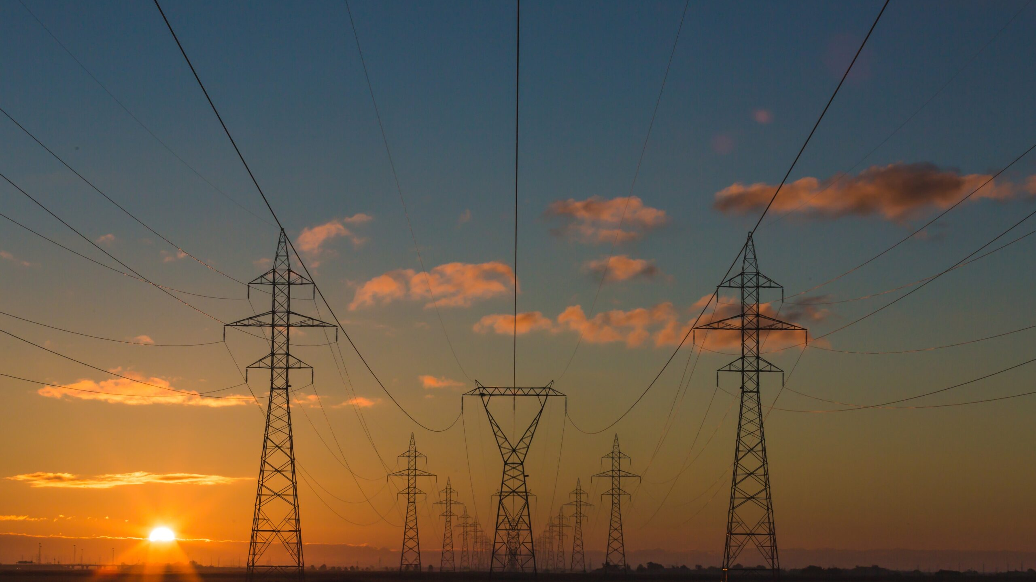
Grid flexibility
Balance between consumption & production
Flexibility for supply & demand side
Notes:
Flexibility in the electricity grid – or grid flexibility – means that we can adjust electricity consumption, production or storage to what is available at that moment. The aim is to maintain a continuous balance between supply and demand, because electricity
must be consumed at the same time as it is produced.
On the supply side, flexibility can mean that producers, such as gas-fired power stations, temporarily generate more or less electricity. On the demand side, it means that users adjust their consumption to the available supply. Storage helps to preserve
surpluses for later use, while grid management ensures that energy is distributed efficiently across the network.
In short, flexibility makes the system agile and prevents waste or overload.
A basic principle of energy is that the supply and demand of electricity must be exactly equal at all times. Unlike gas or heat, for example, electricity cannot simply be stored in large quantities. If more electricity is produced than consumed, the frequency on
the grid increases; if there is a shortage, it decreases. Both situations can lead to disruptions or even failures in parts of the system.
As we increasingly use renewable energy sources such as solar and wind power, which are dependent on the weather, electricity production is constantly changing. On sunny or windy days, there is a surplus of energy, while on grey or windless days,
production drops sharply. In addition, demand for electricity is rising sharply due to electric vehicles, heat pumps and industrial processes. Moreover, this demand is not evenly distributed throughout the day: there are peaks in the morning and evening, while
consumption is much lower at night. If the grid is not flexible enough to respond to these fluctuations, voltage problems, overloads or congestion will occur. In extreme cases, this can lead to power outages or the need to disconnect producers, which is
inefficient and costly. That is why a modern electricity grid must be able to respond flexibly to changes in production and consumption. Only then can the system remain stable, reliable and sustainable, even with a large share of renewable energy.
Furthermore, the ongoing electrification of transport, heating and industry is making the management of the electricity grid even more complex. The growing use of electric vehicles, heat pumps and smart appliances is placing new and highly variable loads
on the grid. Without sufficient flexibility measures, ranging from fast-responding energy storage to advanced demand response systems, the grid runs the risk of congestion, negative electricity prices and even power outages during peak periods.
To cope with these changes, modern electricity grids utilise both flexibility on the generation side and flexibility on the consumption side.

Slide 6
Grid flexibilty
Short-term
This form of flexibility revolves around balancing supply and demand within a single day using storage and smart control.
Medium-term
Long-term
Notes:
What types of flexibility are there?
Flexibility in the electricity system operates across multiple time scales and sources, ensuring that electricity supply and demand remain balanced under changing conditions. This flexibility can be classified based on both duration and origin – whether it stems from adjustments in consumption, changes in production or energy storage.
Short-term flexibility is the ability to respond to fluctuations in electricity supply and demand within a single day. This can be achieved by shifting demand to off-peak hours – when there is plenty of cheap renewable energy available and demand is low – or by scaling up rapid-response generation during peak hours, when demand is high and supply is scarce. Battery storage and demand management via smart technologies, such as smart charging of electric vehicles, play an important role in this.

Slide 7
Grid flexibilty
Short-term
This form of flexibility revolves around balancing supply and demand within a single day using storage and smart control.
Medium-term
This flexibility revolves around balancing supply and demand over days or weeks, using storage and industrial demand management.
Long-term
Notes:
Managing fluctuations over several days or weeks, often influenced by weather patterns that determine renewable energy production. Hydropower reservoirs and demand response programmes in industry help to balance supply and demand over this period.

Slide 8
Grid flexibilty
Short-term
This form of flexibility revolves around balancing supply and demand within a single day using storage and smart control.
Medium-term
This flexibility revolves around balancing supply and demand over days or weeks, using storage and industrial demand management.
Long-term
This form of flexibility ensures that supply and demand remain balanced across seasons, with the help of storage, sustainable production and international exchange.
Notes:
Adapting to shifts in electricity demand and renewable production across seasons, such as lower solar production in winter or higher electricity demand for cooling in summer. Technologies such as pumped hydro storage, nuclear energy, electricity production via green molecules and cross-border electricity transfers contribute to long-term flexibility.

Slide 9
Grid flexibility
Consumption
Production
Storage
This flexibility allows consumers to temporarily adjust their energy consumption to grid conditions and market incentives in order to keep the electricity grid balanced.
Notes:
Flexibility can also be categorized based on its source. There are again 3 different categories.
This type of flexibility on the consumption side involves temporarily increasing or decreasing electricity consumption depending on grid conditions and market incentives. Large industrial consumers, such as energy-intensive factories or electrolysers, can, for example, reduce their power consumption during peak hours. Smart household appliances, such as smart thermostats and electric heat pumps, also dynamically adjust their energy consumption. In addition, electric vehicles can delay charging or even feed electricity back into the grid when necessary, thanks to technologies such as smart charging and vehicle-to-grid (V2G). In this way, consumers actively contribute to keeping the electricity grid in balance.

Slide 10
Grid flexibility
Consumption
Production
Storage
This flexibility allows consumers to temporarily adjust their energy consumption to grid conditions and market incentives in order to keep the electricity grid balanced.
On the supply side, the electricity grid can be kept in balance because power stations, hydroelectric plants and renewable energy sources can flexibly increase or decrease their production.
Notes:
On the supply side, power stations can also increase or decrease their output in response to fluctuations in demand or in the output of renewable energy. Important sources include conventional power stations, such as gas-fired plants and combined heat and power (CHP) plants, which can quickly scale up when necessary. In addition, hydroelectric power stations, especially those with reservoirs, provide fast-responding production. Renewable energy sources, such as wind and solar farms equipped with balancing capabilities and hybrid battery systems, can also be used flexibly to keep the grid in balance.

Slide 11
Grid flexibility
Consumption
Production
Storage
This flexibility allows consumers to temporarily adjust their energy consumption to grid conditions and market incentives in order to keep the electricity grid balanced.
On the supply side, the electricity grid can be kept in balance because power stations, hydroelectric plants and renewable energy sources can flexibly increase or decrease their production.
Energy storage, combined with flexibility on the supply and demand side, makes the electricity grid resilient and capable of integrating large amounts of renewable energy.
Notes:
Energy storage makes it possible to store surplus electricity and use it later when demand increases. Different storage technologies serve different time scales: lithium-ion batteries and flywheels provide short-term storage for rapid and frequent balance corrections; redox flow batteries and thermal storage systems assist with medium-term storage for daily and weekly fluctuations; and pumped hydro and hydrogen storage provide long-term storage to accommodate seasonal differences.
By leveraging both supply-side and demand-side flexibility across these different time periods, a more resilient and adaptive electricity grid is created that can integrate large amounts of renewable energy while maintaining security of supply.

Slide 12
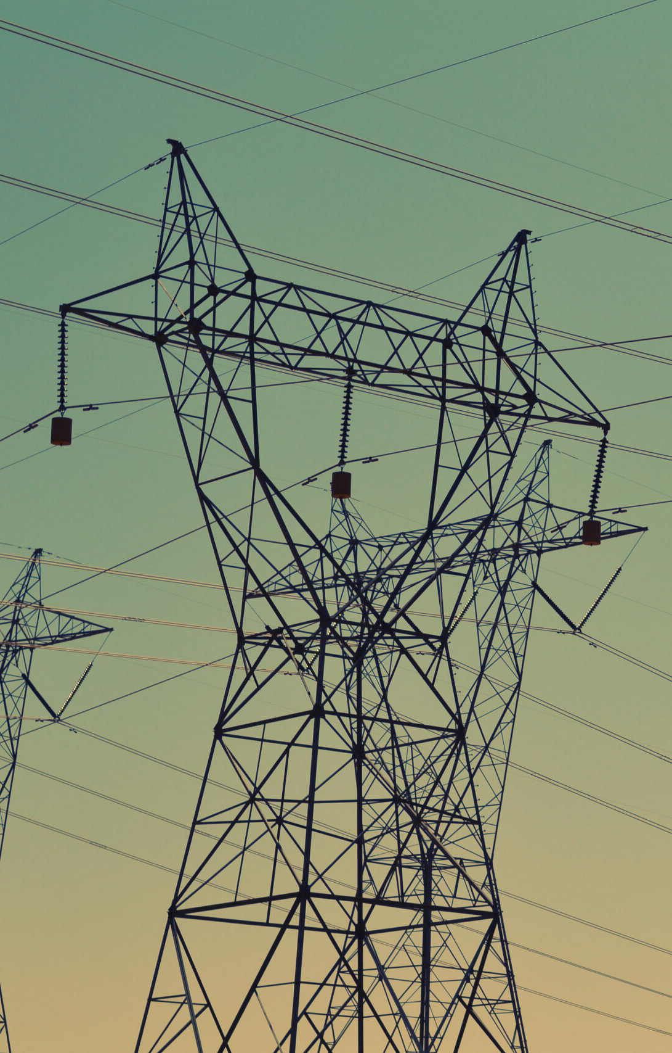
Solutions on the supply side
Storage
Flexible Power Stations
Interconnectors
Notes:
Which technologies offer flexibility?
To accommodate the variability of renewable energy sources and changing electricity demand, various technologies are essential for a flexible and reliable electricity system.
Storage technologies
Energy storage is the backbone of flexibility. It makes it possible to store surplus electricity at times when production exceeds demand and release it later when demand rises. In the short term, battery storage systems offer rapid response capacity: they absorb surplus energy when demand is low and feed it back during peak hours. In the longer term, pumped storage hydroelectric power stations play a crucial role. In the Nordic and Alpine regions, these are often combined with reservoirs, which not only supports
the daily balance between supply and demand, but also enables the management of seasonal energy differences. Together, these technologies ensure that renewable energy can be used efficiently, even when production and consumption do not occur
simultaneously.
Flexible power stations
Flexible power stations play a crucial role in balancing the electricity grid, especially now that the share of renewable energy is rapidly increasing. Sun and wind do not provide energy continuously — they depend on the weather and the time of day. At some
times, they produce much more electricity than is needed, while at other times there is too little available. During periods of shortage, flexible gas-fired power stations or combined heat and power (CHP) plants can quickly ramp up their production. They
respond within minutes to changes in demand or supply, ensuring that the grid remains stable. When there is a lot of renewable energy available, they can easily scale back their production. This adaptability makes them particularly valuable as backup
capacity. Without such flexible power stations, the risk of power shortages or voltage drops wouldm be greater, especially during cold winter days with little wind or sun. In the longer term, these power stations can also become more sustainable by switching
from natural gas to green fuels, such as hydrogen or biomethane. This allows them to retain their flexibility, but without the high CO₂ emissions associated with fossil fuels.
Interconnections
Interconnections enable electricity to be exchanged between countries and regions. These connections – via submarine cables, underground pipes or overhead high-voltage lines – strengthen the stability of the European grid. They offer both short- and
long-term flexibility and increase security of supply. During the recent energy crisis, for example, interconnections enabled Germany to export electricity to France, which was then struggling with reduced nuclear production due to maintenance work.

Slide 13
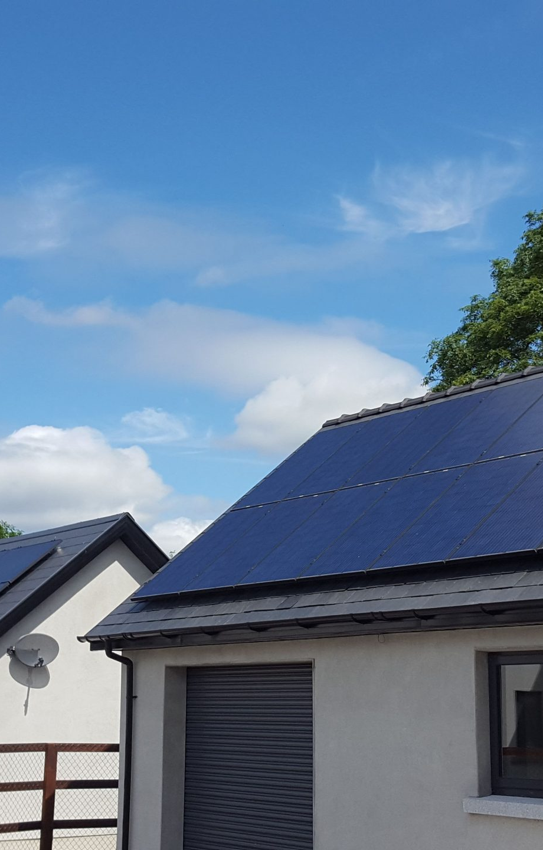
Solutions on the demand side
Change in Behavior
Smart Devices
Electric Vehicles
Notes:
Change in behavior
Demand response means that consumers, both households and businesses, temporarily adjust their electricity consumption to the situation on the grid. Instead of always using electricity at fixed times, people can shift their consumption to times when there is a lot of renewable energy available or when electricity prices are low. Households can contribute to this in simple ways. Think, for example, of charging an electric car or running the washing machine during hours when cheap, renewable energy is available.
Smart energy meters and dynamic tariffs make it possible for appliances to do this automatically, without the user having to intervene each time. Demand response improves the balance of the electricity grid: there is less chance of overload during peak times, and renewable energy is used more efficiently. This means that fewer fossil fuel power stations need to be used, which reduces both emissions and costs.
Smart Devices
Smart devices are playing an increasingly important role in the flexibility of the electricity grid. They are equipped with sensors and software that enable them to respond automatically to price signals or grid load, without the user noticing. The real potential of this technology lies in communication between devices. When devices can “talk” to each other and to the grid, they can jointly decide when is the best time to consume or save electricity. This creates a smart, self-regulating energy system that constantly
adapts to circumstances. A good example is a smart hot water boiler. At times when there is little demand for hot water but the electricity grid is heavily loaded, the appliance can temporarily heat up slightly less. The user hardly notices this, but it does help to save electricity at crucial moments. Conversely, the boiler can heat up extra when there is a lot of cheap solar or wind energy available. In this way, smart appliances become an active player in the energy system: they provide comfort, save energy and at the
same time help to keep the grid stable.
Electric Vehicles
Electric vehicles (EVs) represent a largely untapped source of flexibility within the electricity system. As the adoption of electric cars increases, these vehicles are evolving from mere means of transport to mobile energy sources. Thanks to smart charging systems, EVs can strategically shift their charging to off-peak hours when there is a surplus of renewable energy. In this way, they not only help to absorb excess electricity, but also reduce pressure on the grid during peak hours.
According to Eurelectric's latest e-mobility study, an estimated 114 terawatt hours (TWh) of battery capacity will be available to support the electricity grid by 2030, based on current EV market growth expectations. That is enough to power 30 million
households every year, an impressive potential that remains largely untapped today. The next step in this story is bidirectional charging, also known as vehicle-to-grid (V2G) technology. This allows electric vehicles not only to absorb energy, but also to feed it back into the grid. In this way, stationary vehicles are transformed into decentralised energy storage units that can support the electricity system during peak loads or unexpected shortages in production.
A concrete example of this is the Renault project in Utrecht, the Netherlands. In collaboration with MyWheels and the city of Utrecht, Renault launched Europe's first car-sharing project that makes full use of V2G technology at the end of 2024. The project
involves 500 electric Renault E-Tech vehicles, all of which are capable of bidirectional charging. This innovative collaboration demonstrates how shared electric fleets can actively contribute to the balance of the electricity grid and can serve as an example for
future urban initiatives in Europe.
Harnessing the flexibility of electric vehicles not only strengthens the resilience of the energy system, but also delivers cost savings and environmental benefits for consumers. By aligning their charging behaviour with grid needs, drivers help to reduce grid
congestion, which in turn lowers electricity costs in the long term. At the same time, they can save money by charging during off-peak hours when rates are low and even generate income by selling energy back via V2G. The benefits for consumers are
considerable. In the Netherlands, drivers of compact electric cars save an average of 9% on total running costs, which amounts to approximately €450 per year. For larger cars or SUVs, the savings can be as high as 26%, or
€2,700 per year. In Spain, the figures are similar: drivers there save between 13% (€780) and 25% (€2,500) per year, depending on the type of vehicle.
With ongoing advances in smart charging infrastructure and growing supportive policies, electric vehicles are poised to play an important role in the flexibility of the European energy system. What was once just a means of transport is now becoming an active part of the energy transition, and a key player in keeping the electricity grid stable, sustainable and affordable.

Slide 14
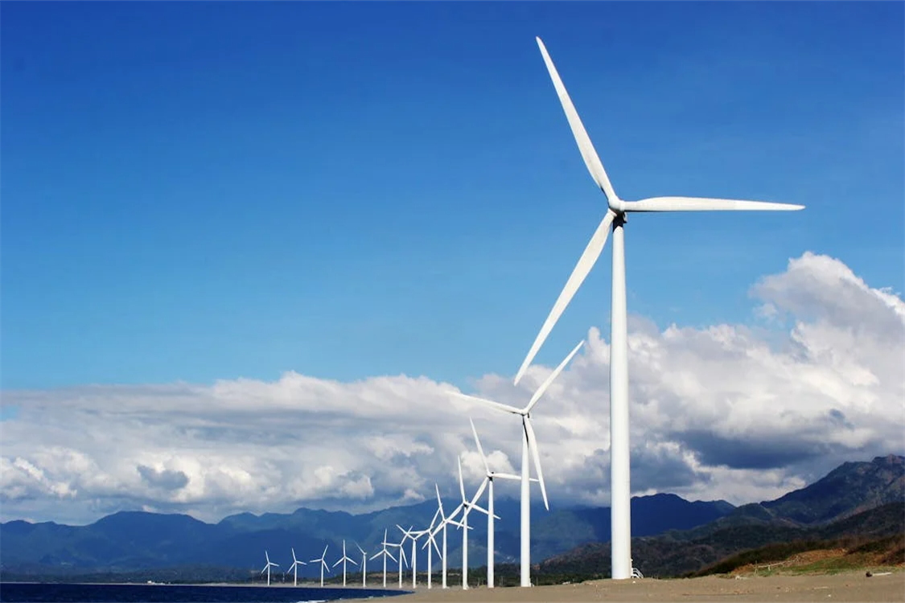
Initiatives in the eu
Balance between consumption & production
Flexibility for supply & demand side
Notes:
The European Union recognises that flexibility plays a crucial role in ensuring a resilient and low-carbon electricity system. That is why it has launched several initiatives in recent years to accelerate the development of flexibility in the energy market.
One important initiative is the reform of the Electricity Market Design (EMD), which was approved in 2024. The aim of this reform is to create a more stable, flexible and consumer-oriented electricity market. Among other things, it provides for a strengthening of support mechanisms for flexibility, so that resources such as demand response, energy storage and controllable low-carbon production are more readily available. In addition, there is a focus on expanding long-term contracts, such as Power Purchase Agreements (PPAs) and Contracts for Difference (CfDs), which offer investors greater certainty, reduce price fluctuations and thus encourage investment in renewable and flexible solutions. These measures should accelerate the integration of flexibility services into electricity markets, allowing for better integration of renewable energy and making the grid more resilient to external shocks.
In the same vein, the new Affordable Energy Action Plan emphasises the importance of increasing flexible capacity on both the production and demand sides. This plan aims to address the remaining barriers to demand response and energy storage, and to ensure that flexibility is also rewarded within small consumer contracts. By the end of the year, the European Commission is expected to publish non-binding guidelines to advise Member States on how best to remunerate flexibility providers in the small consumer market.
The EU is also taking important steps in the field of energy storage and vehicle-to-grid (V2G) technology. In March 2025, the European Commission published its Action Plan for the automotive industry, which aims to strengthen the competitiveness of the European automotive sector vis-à-vis foreign players. An important part of this is the development of a competitive ecosystem for e-mobility, in which electric vehicles also play an active role in flexibility markets. Among other things, the plan provides financial support for the roll-out of smart charging infrastructure that enables large-scale two-way charging, incentives for the electrification of vehicle fleets so that commercial vehicles can also contribute to the balance of the grid, and regulations that promote interoperability between vehicles and grids. Together with existing funding programmes such as the Innovation Fund and the Connecting Europe Facility (CEF), this policy should help to scale up both stationary and mobile storage solutions, thereby strengthening Europe's flexibility potential.
By combining these policy and financing mechanisms, the European Union is positioning itself as a pioneer in the development of energy flexibility. In doing so, it is laying the foundations for a future electricity system that is not only cleaner but also more resilient to fluctuations in supply and demand.
This is essential in the longer term. As Europe moves towards a net-zero electricity sector, flexibility will become an indispensable part of a secure and reliable energy system. This requires a combination of technological innovation, regulatory coordination and cross-border cooperation to fully integrate variable renewable energy sources without compromising security of supply.
The European Union must continue to play a central role in this. Harmonising regulations on flexibility between Member States can create a more integrated European electricity market. At the same time, increased support for research and development can accelerate the commercialisation of new flexibility technologies. Better cooperation between countries will also strengthen interconnections and enable more efficient energy flows between regions with different renewable production profiles.
Without a large-scale expansion of flexibility, Europe risks compromising its security of supply, just as the continent is trying to break away from oil and gas imports from Russia. However, with the right investments and policy choices, flexibility can become the driving force behind a new, resilient electricity system that supports the full electrification of society.

Slide 15
Thank you!

Slide 16
acknowledgements
This slide deck was produced for by the Every1 project.
The images used in this presentation are as follows:
Slide 3: Renewable energy by Petr Kratochvil CC0 license
Slide 4: Electricity pylons at sunrise OR sunset by
rawpixel.com CC0 license
Slide 11: Black transmission towers under green sky. by
rawpixel.com CC0 license
Slide 12: What is a 2kW PV Solar Panel System? by
caldorsolar.ie CC BY-NC 4.0 license
Slide 13: White Wind Turbines on Gray Sand Near Body of Water by Kervin Edward Lara CC0 license

