Slide 1

Energy digitalisation
2026
The system reshaping your future electricity bills
Notes:
Welcome the class. Frame the lesson: in five years, when most of you have moved out, the way you buy and use electricity will look completely different from how it works in your parents' homes today. This lesson is about the technical, economic and social shift behind that — energy digitalisation. We'll cover what it actually means, look at real Belgian price data, and finish with an activity where you design a 'smart day' to save money.

Slide 2
Today's lesson
The shift
Reading the system
From a one-way grid to a two-way system — and the four ingredients of digitalisation.
Real Belgian electricity prices, dynamic tariffs and how demand response works.
Your role
Design a smart day for a household, plus careers, privacy and fairness questions.
Notes:
Three parts. Timing: ~10 min on the shift and ingredients, ~15 min on reading system data, ~20 min on the activity and discussion, ~5 min wrap-up. The workbook accompanies parts 2 and 3.

Slide 3
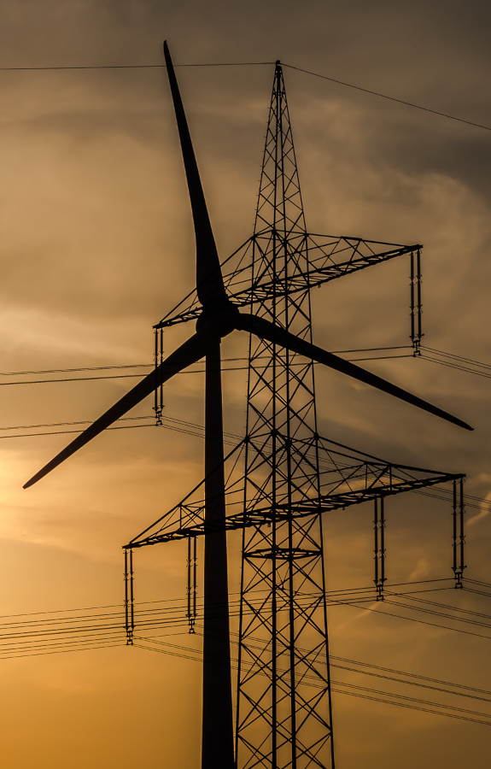
What's actually changing
Three dimensions of the shift:
Generation: centralised → millions of small generators
Direction: one-way → two-way energy flows
Pricing: monthly average → quarter-hourly
Notes:
Bring out the four parallel shifts. Generation: 20 years ago, a country's electricity came from ~20 large plants. Today, the Belgian grid has more than 800,000 small producers (rooftop PV alone). Direction: electricity used to flow from large plants down to consumers; now it flows both ways. Pricing: most households were on a flat tariff; smart-meter rollouts make 15-minute dynamic tariffs possible. (The fourth shift — measurement, from monthly to real-time — is implicit in the others; if you have a strong class, mention it explicitly.)

Slide 4
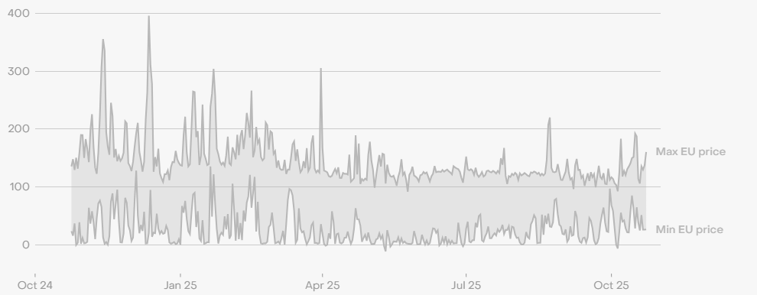
How does digitalisation actually work?
Notes:
Bridge into the technical mechanism. Three building blocks coming up: distributed measurement (smart meters), dynamic pricing (markets every 15 minutes), and flexibility services (demand response and storage).

Slide 5
Three building blocks
1. Distributed measurement
Smart meters measure every 15 minutes — not once a month. That data lets the system see the demand profile of every home in real time, and lets every home see its own consumption pattern.
Notes:
A digital/smart meter records electricity used in 15-minute slots. The data is sent back to the supplier and is also available to the household through an app (MyFluvius in Belgium, Smets in the UK). Average Belgian household: 3,500 kWh/year, spread very unevenly — typical evening peak between 18:00 and 21:00.

Slide 6
Three building blocks
1. Distributed measurement
Smart meters measure every 15 minutes. The system sees every home in real time, and every home sees its own pattern.
2. Dynamic pricing
Wholesale electricity has a different price every hour (or 15 minutes). Dynamic tariffs pass that price through to the consumer. In 2024 the average daily price spread in Belgium was about €93/MWh — a real arbitrage opportunity.
Notes:
The wholesale electricity market clears every hour or quarter-hour on EpexSpot. Prices vary because solar and wind output vary, demand varies, and gas plants are expensive to start. In 2024 the average difference between the cheapest and most expensive hour of the same day was €92/MWh — about 9 cents per kWh. A household on a dynamic tariff that runs the dishwasher at the right time captures that difference directly.

Slide 7
Three building blocks
1. Distributed measurement
Smart meters measure every 15 minutes. The system sees every home; every home sees its own pattern.
2. Dynamic pricing
Wholesale prices change every hour. Dynamic tariffs pass them through. The 2024 average daily spread in Belgium was about 9 cents/kWh.
3. Flexibility services
Cars charging, heat pumps and home batteries can respond to price or grid signals. Aggregators bundle thousands of households into a single flexibility resource for the grid operator — and pay the participants.
Notes:
Flexibility is the most interesting layer for them. Concrete example: a battery in their garage providing 'frequency containment reserve' to the Belgian TSO Elia earns about €60–100 per kW per year. A 5 kW battery could earn €300–500/year just for being available to react in seconds. The aggregator handles the complexity; the household sees a monthly payment.

Slide 8

What does it mean for you?
Smart
citizen
Three lenses: the household bill, the career opportunity, and the privacy question.
Notes:
Bridge: now we move from 'how the system works' to 'what does it mean for you personally'. Three angles — money, careers, fairness.

Slide 9
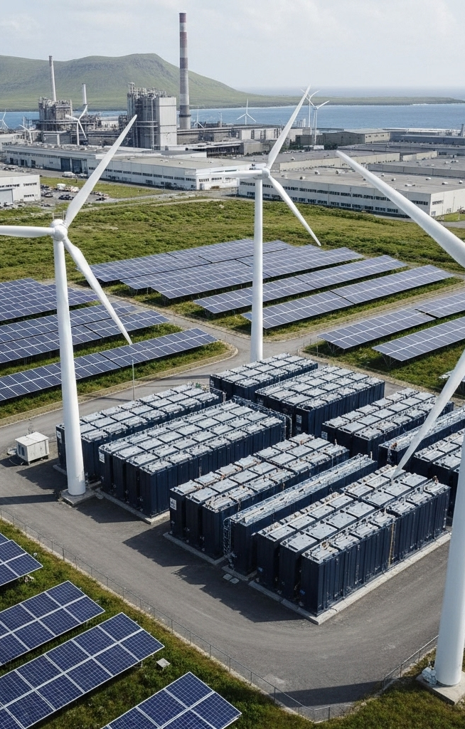
Demand response in practice
How a smart home responds to the system:
EV charges at noon when prices are low
Heat pump boosts when wind is strong
Aggregator pays the household for being flexible
Notes:
Belgian context: a 4-person household with PV, EV and heat pump can realistically shave 15–25% off the annual electricity bill by being flexible. That's €400–600/yr in 2024 prices. The catch: you need a smart-meter contract, a dynamic tariff, and either an aggregator or an Energy Management System (EMS) to automate it.

Slide 10
Energy communities
Neighbours sharing energy locally:
Co-own a solar installation or community battery
Share PV with neighbours who need it now
EU Clean Energy Package made this legal in 2019
Notes:
Renewable Energy Communities (RECs) and Citizen Energy Communities (CECs) are the two legal forms set by the EU Clean Energy Package. Members can be households, schools, SMEs or even local authorities. The European Commission estimates participating households save €500–1,100/year. Ask: are there any energy cooperatives in your town? (Most Belgian cities have at least one.)

Slide 11
Careers and the privacy question
Many new jobs are appearing:
Smart-grid and battery engineers
Data analysts and platform developers
And ask: who sees your 15-min usage data?
Notes:
Career angle: ENTSO-E projects ~250,000 new jobs in EU electricity by 2030, most of them in the digitalisation and renewables space. Privacy angle: 15-minute consumption data reveals when you're home, when you sleep, even (with enough data) what appliances you use. EU GDPR and national rules limit how that data can be shared. This is a strong cross-curricular link to citizenship / digital literacy classes.

Slide 12

Activity: design a smart day
Open your workbook to pages 3–4. In pairs:
Read the real Belgian price profile for a sample day
Place a household's main loads at the best hours
Calculate the savings versus a flat tariff
Notes:
TIMING: 15 minutes total. 10 minutes in pairs, 5 minutes share-out. Workbook gives them a real hourly price profile for a sample day in March 2025 (€/MWh by hour), a household with known appliances (EV, heat pump, dishwasher), and asks them to decide when each appliance should run. The expected answer pushes most loads to 10:00–16:00 (solar peak, low prices) and avoids 18:00–21:00 (peak prices). Savings calculation: about €4/day versus a flat tariff at €0.30/kWh.

Slide 13
acknowledgements
“Energy digitalisation” for ages 16+ was produced by Th!nk E for the Every1 project, licensed CC BY-SA 4.0. Every1 has received funding from the EU Horizon Europe programme under grant agreement No. 101075596.
Images reused from the Every1 deck “How to make our grid cheaper” (CC BY-SA 4.0). Original attributions:
Slide 3 — K.H. Reichert, “Billions of pounds of green infrastructure…”, CC BY-NC 2.0.
Slide 4 — ember.com, “Wholesale electricity prices in Europe”, CC BY 4.0.
Slides 8 & 11 — rawpixel.com, “Electric pole” and “Black transmission towers”, CC0.
Slide 9 — easy-peasy.AI, “High-Tech Microgrid Setup with Renewable Energy Resources”, CC BY 4.0.
Slide 10 — pensionpolicyinternational.com, “Inflation, war, rising interest rates…”, CC BY-ND 4.0.
Slide 12 — pexels.com, “European Commission Flags on Poles”, CC0.

Slide 14
Thank you!
Notes:
Optional close: each pair shares one decision they made in the activity and the saving they calculated. If time allows, point students to the Every1 knowledge hub (every1.energy) for the underlying on-demand decks ('The energy market explained', 'Why is my solar suddenly worth nothing?', 'Avoiding the Matthew effect').

