Slide 1
Flexibility: why and how?
Opportunities for the smart prosumer
Every1 Slide Deck

Slide 2
How to use this slide deck
This Slide deck is meant as a guide and easy starting point for a person that will explain the topic to an audience that isn't familiar with the topic yet.
Feel free to adapt and expand to your own need.
  The material is licensed under CC4.0 SA BY
You can find guidance text in the notes of each slide

Slide 3
Agenda
Introduction
The changing electricity system
Balancing and Day ahead market
Dynamic prices and how to reduce your costs
Imbalance in real time and how to contribute/gain
Flexibility in your processes
Your energy buffers
EMS and maakjemeterslim.be
Conclusions

Slide 4
Agenda
Introduction
The changing electricity system
Balancing and Day ahead market
Dynamic prices and how to reduce your costs
Imbalance in real time and how to contribute/gain
Flexibility in your processes
Your energy buffers
EMS and maakjemeterslim.be
Conclusions

Slide 5
Introduction - Preface
The focus is to learn some backgrounds of the electricity system, to understand that flexibility in energy consumption is relevant and valuable.
This presentation shows the mechanisms and examples on the electricity markets in Belgium.
In most European countries the same or similar mechanisms exist.
  ENTSO-E, the European Network of Transmission System Operators for Electricity tries to bring standardisation across Europe.

Slide 6
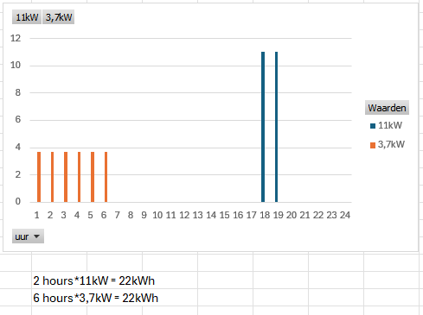
Introduction: Electricity – kW versus kWh?
Power: kW
Energy: kWh
A device that consumes 1kW during 1 hour consumes 1kWh
A home battery can:
  deliver power at 5KW
  contain 10kWh of energy
An EV can charge 22kWh of energy by:
  Charging at 11kW during 2 hours
  Charging at 3,7kW during 6 hours
  … or faster: at 150kW during 0,15 hours (=9 minutes)

Slide 7
Introduction: Electricity – Contract versions
Fixed price contract (26%)
  A whole year the same price per kWh
Variable price contract (74%)
  Every month a different price per kWh
Dynamic price contract (0,4%)
  Every hour/quarter a different price per kWh
Fixed and variable
  Day tariff
  Day/night tariff
Fixed is +-10% more expensive than variable.
Dynamic: price without controlled consumption
https://www.vtest.be/ Supplier Engie 13-12-2025
https://www.vlaamsenutsregulator.be/publicaties/rapp-2025-08

Slide 8
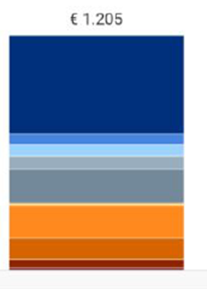
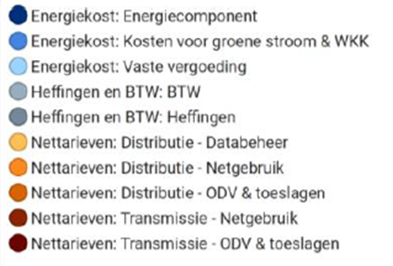
Introduction: Yearly cost – Typical household
    Daytime usage 1600 kWh
    Night time usage 1900 kWh
    Peak offtake 4,26kW
    Statistical mix of energy contracts
Prijzenrapport 2024 VREG
https://www.vlaamsenutsregulator.be/publicaties/rapp-2025-08

Slide 9
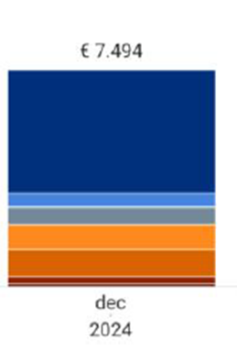
Introduction: Yearly cost – Typical SME
    Daytime usage 17500 kWh
    Night time usage 12500 kWh
    Peak offtake 18kW
    Statistical mix of energy contracts
Prijzenrapport 2024 VREG
https://www.vlaamsenutsregulator.be/publicaties/rapp-2025-08

Slide 10
Agenda
Project Every1
Introduction
The changing electricity system
Balancing and Day ahead market
Dynamic prices and how to reduce your costs
Imbalance in real time and how to contribute/gain
Flexibility in your processes
Your energy buffers
EMS and maakjemeterslim.be
Conclusions

Slide 11
The changing electricity system
From central production with controlled generation…
  Production adapted to consumption
… to decentral, less controlled (renewable) production
  Consumption adapts to (prices of) production
Renewables
  Intermittent generation
  Forecasting of sun and wind becomes better and better
  Residual load – duck curve – evening peak ramp up

Slide 12
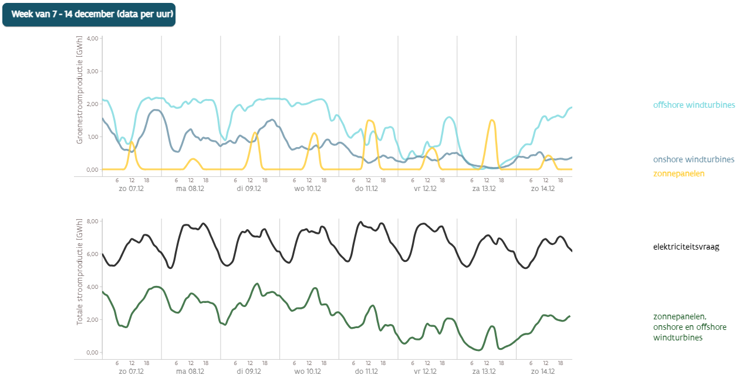
The changing electricity system - Flanders
https://apps.energiesparen.be/stroomvoorspeller-grafieken

Slide 13
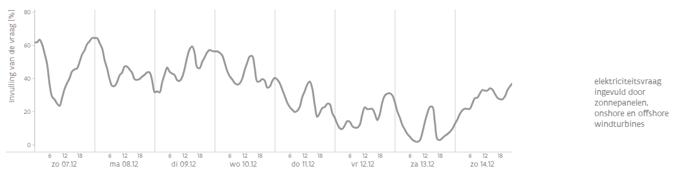
The changing energy system - Flanders
https://apps.energiesparen.be/stroomvoorspeller-grafieken

Slide 14
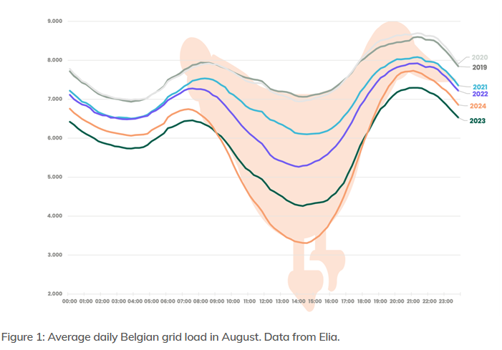
The changing energy system – residential load Belgium in August
Load on the transmission grid (without self consumption)
Deep valley, high ramp up
Strong challenge for the Tso (Elia)
Econopolis; Is the Belgian Duck Curve Growing Deeper in 2024?

Slide 15
The changing energy system – residential load Belgium in August
Production still continues in the valley
  Nuclear is inflexible
  Wind, solar, CHP: not always stopped
Overproduction leads to negative prices
  >400 hours in 2025 (5%); sunny Sundays in spring and summer
Solutions for TSO
  Export to neighboring countries
  Activate/deactivate gas-fired power stations
  Promote flexibility in production and consumption
  Promote flexible energy buffers like batteries
Econopolis; Is the Belgian Duck Curve Growing Deeper in 2024?

Slide 16
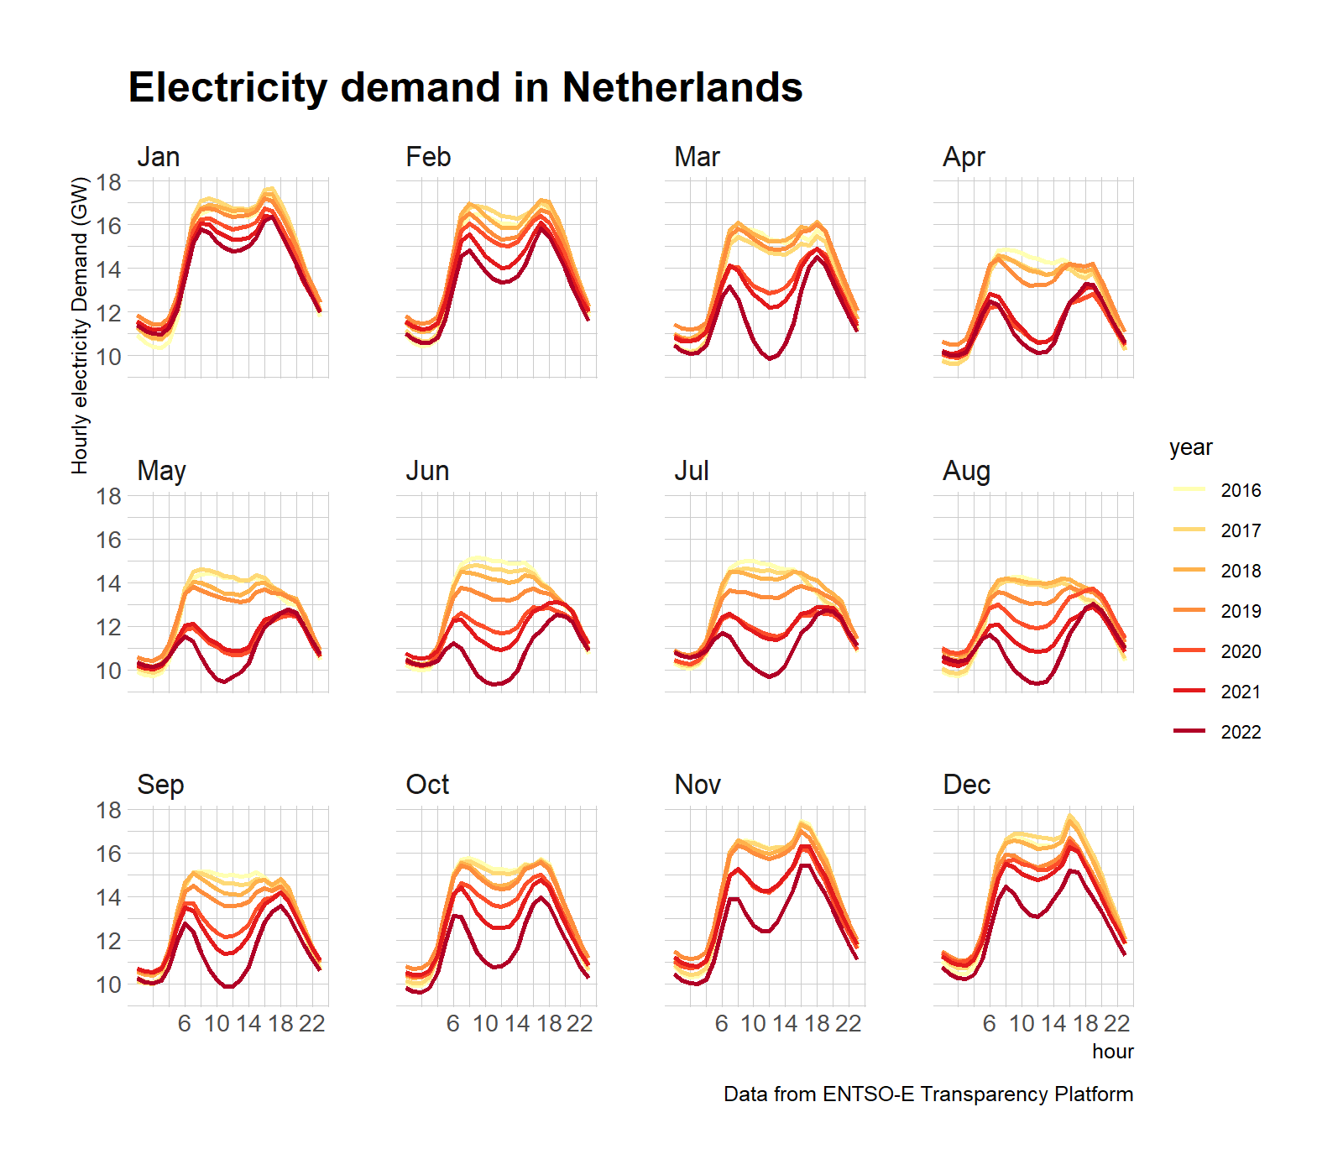
The changing energy system – residential load in the Netherlands - evolution
http://www.matteodefelice.name/post/netherlands-is-that-a-duck/

Slide 17
Agenda
Introduction
The changing electricity system
Balancing and Day ahead market
Dynamic prices and how to reduce your costs
Imbalance in real time and how to contribute/gain
Flexibility in your processes
Your energy buffers
EMS and maakjemeterslim.be
Conclusions

Slide 18

Balancing
Balance between energy production and energy consumption
  Switch on a 6W LED lamp
    run a gas-fired power station somewhere a little bit faster
50 Hz: mandatory indicator
Predictions
  Consumption:
    statistical estimate fairly good
  Production:
    a bit more difficult with renewable (solar, wind);
    getting better and better

Slide 19
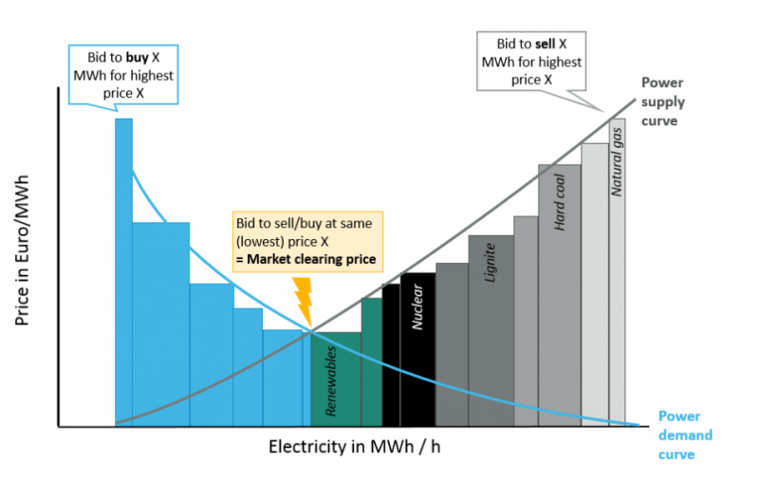
Balancing - Day Ahead market
Key: supplier portfolio is planned in balance
Balance responsible party (BRP)
  Production estimate
  Consumption estimate
  Market offers to sell or buy blocks of energy for every hour/quarter of the next day
EpexSpot DA Market:
  Order book closing at 12:00
  Auction between supply and demand
  Results at 3:00 PM: price per hour/quarter
  Suppliers (BRPs) must submit their portfolio (in balance) for the following day to Elia: hourly/quarterly production, consumption, use of interconnections
https://www.cleanenergywire.org/factsheets/why-power-prices-turn-negative

Slide 20
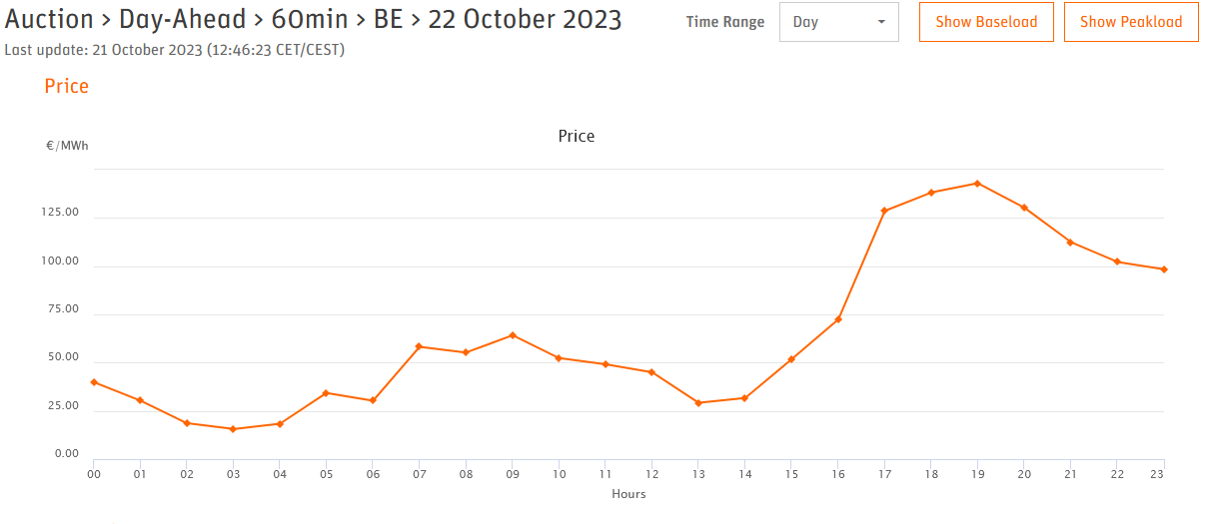
20-140€/MW means 0,02-0,14€/kW
Day Ahead
        https://www.epexspot.com/en /market-data
        https://www.epexspot.com/en /market-data
        https://www.cleanenergywire.org/factsheets/why-power-prices-turn-negative
From 20 to 140 €/MW
on a Sunday

Slide 21
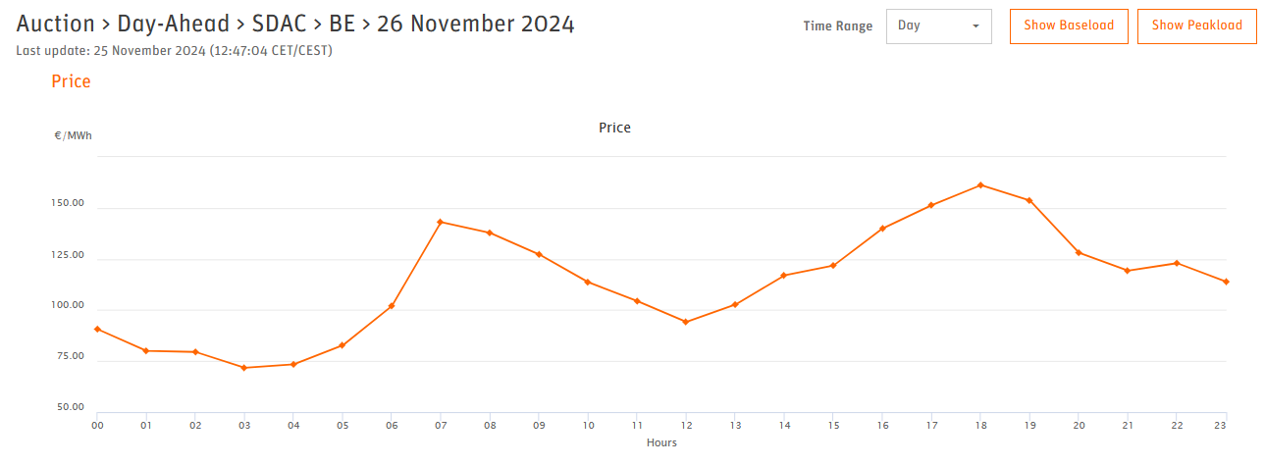
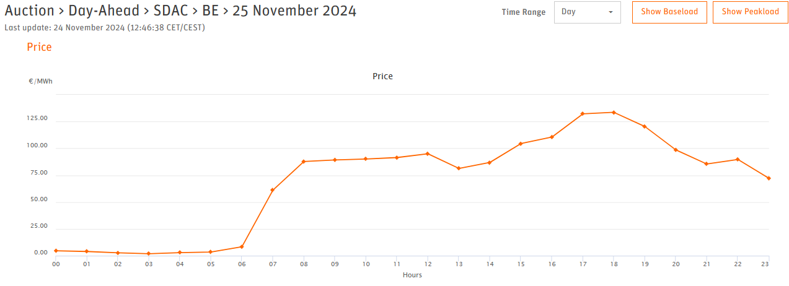
Balancing - Day Ahead price examples 2024
From 75 to 170 €/MW
On Tuesday
From 5 to 135 €/MW
On Monday

Slide 22
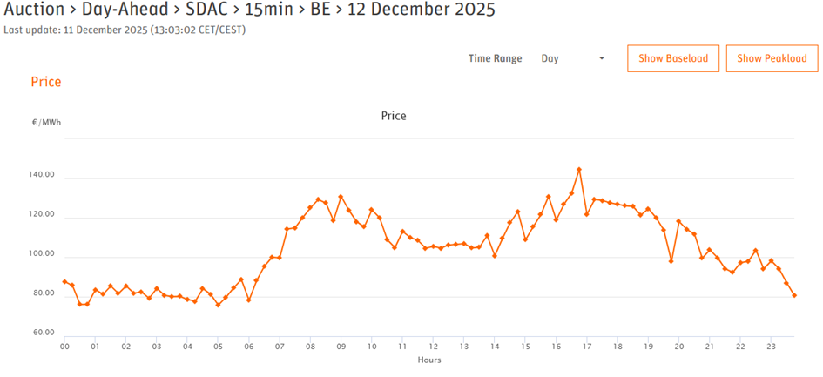
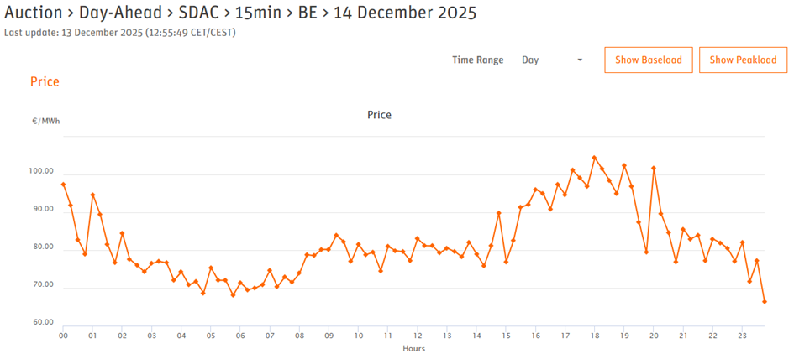
Balancing - Day Ahead price examples 2025
From 75 to 145 €/MW
On Friday
From 68 to 105 €/MW
On Sunday (cloudy)

Slide 23
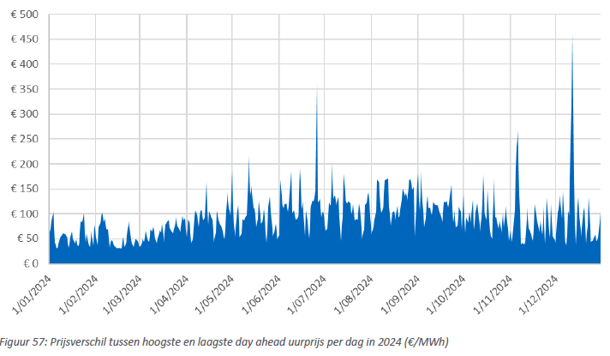
Balancing - Day Ahead – Side note Price Spread
  Price differences between the highest and lowest day-ahead hourly prices per day in 2024.
  It gives an idea of daily savings potential by shifting consumption from the most expensive to the cheapest hour of the day.
  Largest €458.11
  Smallest €30.57
  Average €92.63
  Spread
    75% of the days >€60
    50% of the days > €88.5
    25% of the days > €115
Prijzenrapport 2024 VREG
https://www.vlaamsenutsregulator.be/publicaties/rapp-2025-08

Slide 24

Balancing - Day Ahead – Side note
“Terugdraaiende teller” with PV in Belgium
“Salderingsregeling” with PV in the Netherlands
Basic mechanism
  You sell energy to the net when prices are low (PV production); ex 0,03 €/kWh
  You buy electricity from the net when prices are high (no PV production like evening): ex €/kWh
  The meter registers the net in/out
  Your supplier pays the difference
    all other customers pay your PV, via fixed or variable contracts
    Not sustainable in the long term?
How to solve?
  fixed yearly fee from supplier to PV-owner
  Change system to digital meter and separate invoicing of offtake and injection

Slide 25
Agenda
Project Every1
Introduction
The changing electricity system
Balancing and Day ahead market
Dynamic prices and how to reduce your costs
Imbalance in real time and how to contribute/gain
Flexibility in your processes
Your energy buffers
EMS and maakjemeterslim.be
Conclusions

Slide 26
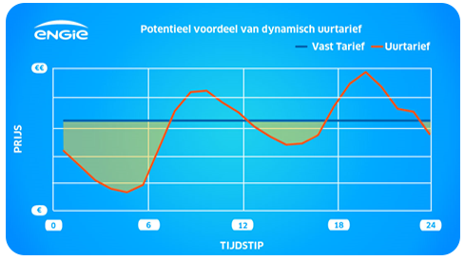

Day Ahead market leads to Dynamic pricing
Result of DA: Dynamic price contracts
  as a pricing formula for consumers
  every hour/quarter a different price
Allows to optimise energy cost!
= implicit flexibility
  Arbitrage between cheap and expensive hours
    Remember: energy cost is 42 to 57% of the electricity invoice
  Planning consumption for the next day:
    Household: EV-charging, hot water boiler, …
    Industrial process control: oven, sterilization, pumping, batch process, …
    See later in this presentation
        https://www.engie.be/nl/dynamic-tariff/

Slide 27
Agenda
Project Every1
Introduction
The changing electricity system
Balancing and Day ahead market
Dynamic prices and how to reduce your costs
Imbalance in real time and how to contribute/gain
Flexibility in your processes
Your energy buffers
EMS and maakjemeterslim.be
Conclusions

Slide 28
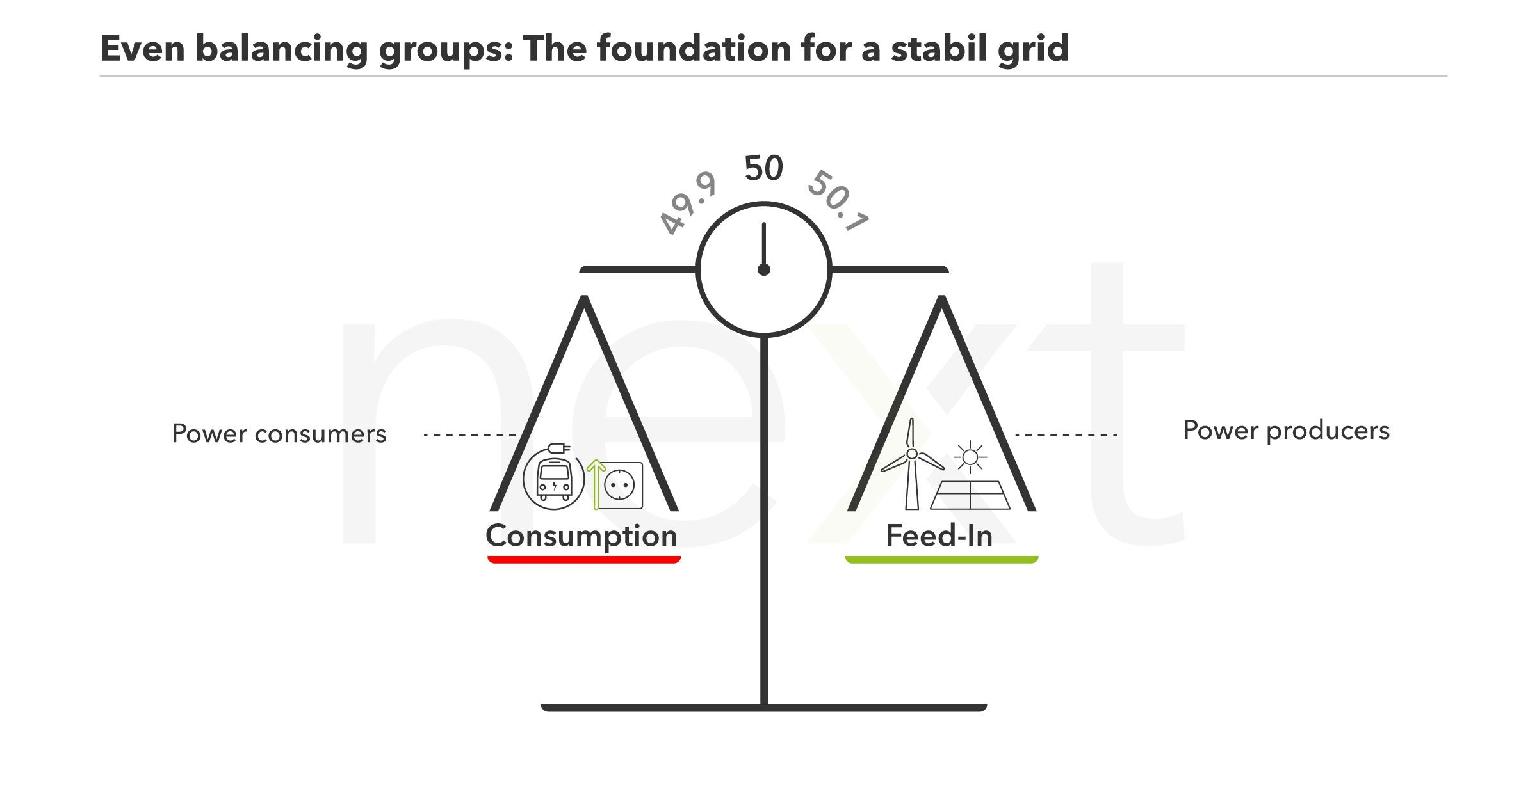
The day itself
Reality is constantly different from prediction
Production: wind a little earlier, cloud lingers a little longer, power station failures, grid or interconnection problems , …
Consumption: less consumption due to production downtime, heavy industrial process incident, …
EPEXspot intraday market:
  extra trading up to 5 min before T0
But even then: continuous deviations
  Residual balance
  Must be compensated in real time by Elia TSO (50Hz)
        https://www.next-kraftwerke.com/knowledge/balancing-group

Slide 29
The day itself
The BRP supplier who causes residual imbalance in his portfolio will be charged by TSO Elia
Flex service providers (FSP) compensate this imbalance and are compensated for this
  e.g. batteries, gas-fired power stations,..
  e.g. electrolysis plants (demand response)
So: the charge/fine paid by BRPs goes via Elia (minus margin) to the FSPs, who can use it to pay their CAPEX and OPEX.
Explicit Flex and explicit flexibility markets

Slide 30
The day itself - details explicit flexibility
TSO: frequency control and restoration
The TSO is responsible for balancing the grid (supply versus demand) and to control the net frequency at 50Hz.
Imbalance happens continuously because of inaccurate forecasting, intermittent RES generation or technical incidents.
  Generation > demand: frequency goes up
  Generation < demand: frequency goes down
  Both deviations have to be countered by parties that have the flexibility to increase/decrease demand or generation: they provide balancing services
Restoring frequency deviations is a 3 stages control process

Slide 31
The day itself - details explicit flexibility
TSO: frequency control and reserve markets
Primary Control: Frequency Containment Reserves (FCR):
  Fast, decentralized, full automatic control
  Response times: 0-30 seconds
  Market size (2023): Continental Europe 3000MW; Belgium 93W
  Opportunity for battery storage
Secondary Control: Automatic Frequency Restoration/Replacement (aFRR):
  Fast, central automatic control
  Response times: 30 seconds – 15 minutes
  Market size (2023): Belgium 117MW
  Opportunity for battery storage
Tertiary Control: Manual Frequency Restoration/Replacement (mFRR):
  Slow, central manual control
  Response times: > 15 minutes
  Market size (2023): Belgium 638MW
  Provided by power plants, industrial loads (demand response)

Slide 32

The day itself - details explicit flexibility
TSO: flexibility markets and actors
Flex assets: TSOs or DSOs are not allowed to own generation assets or storage assets. A market consultation is needed.
Balancing services markets: The TSO organizes a market for each control (FCR, AFRR, MFRR), where flexibility service providers offer their services.
The market is complex , risky and has thresholds (min 1MW)
Balance Responsible parties (BRP’s):
  Handling imbalance on the own portfolio is cheaper than relying on Elia Imbalance market services.
  So BRP's are eager to contract flex directly: a new form of explicit flexibility.
  Today part of the 'imbalance market' is shifting party to a more active Intraday market.
Aggregators as FSPs:
  Gather flexibility from different consumers, producers and storage systems and pool this flex
  Mediator between flexibility service providers and flexibility requesting parties, like Elia
  Manage risks, maximize value of flex
  Ex: Centrica, Flexcity, Next Kraftwerke ,…
New Flexibility Service Providers (FSPs):
  Other FSPs use EMS functionality to gather flexibility by controlling home batteries or home EV-chargers
  Ex: LifePwr, Powernaut, …
  Value creation on FCR or Imbalance market

Slide 33
The day itself - details explicit flexibility – side note
Security of supply – Capacity Remuneration Mechanism (CRM):
  Compensate generation capacity with regards to the nuclear phase-out (starting in 2025).
  Compensate electrical capacity holders for that portion of their relevant costs that are not compensated by their revenues, otherwise known as 'missing money', because of limited running hours.
  Enable current and new capacities to be available on the market in order to avoid security of supply issues.
  Auction based, in multiple phases
  Technology neutral; opportunity for new Energy Storage systems
  → used for f.e. gas-fired power stations and large battery systems

Slide 34
Agenda
Project Every1
Introduction
The changing electricity system
Balancing and Day ahead market
Dynamic prices and how to reduce your costs
Imbalance in real time and how to contribute/gain
Flexibility in your processes
Your energy buffers
EMS and maakjemeterslim.be
Conclusions

Slide 35
Flexibility: in processes
Get Flexible
  The more flexible your processes (electricity consumption) are, the more aligned with the current and future energy system
    Strategy: design your process for flexibility
  Plan consumption based on Day Ahead / dynamic pricing
  Switch to supply contract with dynamic pricing
  Production curtailed when there’s too much energy the market (negative prices on sunny Sundays)
  Use an Energy Management System to control consumption (and production)
There is quite some flexibility in households and companies

Slide 36
Flexibility: in processes
Get Flexible in residential context
  EV charging
    Based on clock in car
    Manually start/stop charging via app
    Optimise for self consumption
    Smart charging on low dynamic tariffs
    via EMS
  Domestic hot water (direct or via heat pump)
    Based on clock
    Optimise for self consumption
    Based on low dynamic tariffs
  …

Slide 37
Flexibility: in processes
Get Flexible in an SME context
  EV charging at the SME for multiple cars
    Smart charging strategies
    Load balancing between cars
    Priority versus flex
    Utilise grid connection size better (physical and agreed power)
    Optimise for self consumption
    Smart charging on low dynamic tariffs or via EMS
  Processes: oven, sterilization, pumping, hot water, steam, batch processes, …
    Smart control on low dynamic tariffs or via EMS
  Also consider personnel (cost) when changing processes to be more flexible
  Dynamic energy contracts have no fixed monthly energy budgets → discuss with financial manager

Slide 38
Agenda
Project Every1
Introduction
The changing electricity system
Balancing and Day ahead market
Dynamic prices and how to reduce your costs
Imbalance in real time and how to contribute/gain
Flexibility in your processes
Your energy buffers
EMS and maakjemeterslim.be
Conclusions

Slide 39
Flexibility: energy buffers
Some consumption can not be moved to another time:
  If you want to prepare dinner, you need the appliances to cook
  If you want to watch TV you will not align with PV production
Some processes are difficult or costly to change
In those cases you can use energy buffers
  as temporary storage between the moment of PV production or offtake and the moment of effective consumption

Slide 40

Energy buffers: Thermal storage
Sanitary hot water tank
  Comfort = enough hot water when you want to take a shower;
  Share of electricity consumption in a household: 25% if electrically heated
Underfloor heating (accumulation – inertia)
Steering
  based on sun (self-consumption)
  based on cheap prices (dynamic prices)
  clock controlled (basic)
  EMS
Thermal storage is much cheaper than electrical storage
https://www.zonneboileradvies.be/zonneboiler-places/groot-stockvat-zonneboiler/

Slide 41
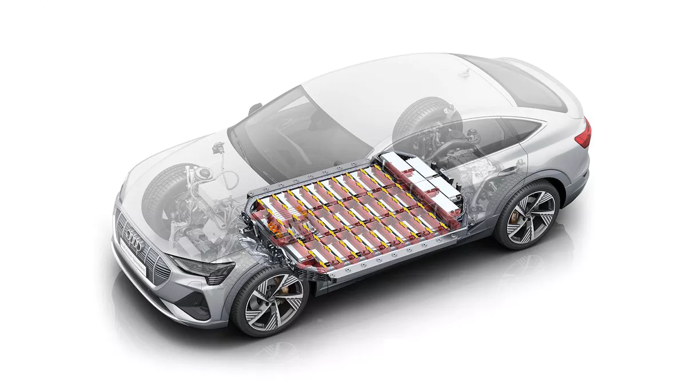
Energy buffers: Storage in kilometres
Electric vehicle
Battery on wheels
  Comfort = enough range to complete the following trips (until next charging session)
  Share of electricity consumption in a household: 25-30%
Steering
  based on sun (self-consumption)
  based on cheap prices (dynamic prices)
  clock controlled (basic)
  EMS
https://gocar.be/nl/autonieuws/auto-industrie/hoeveel-kost-een-battery-van-een-elektrijke-auto

Slide 42
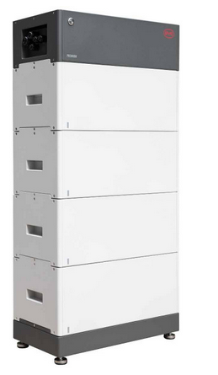
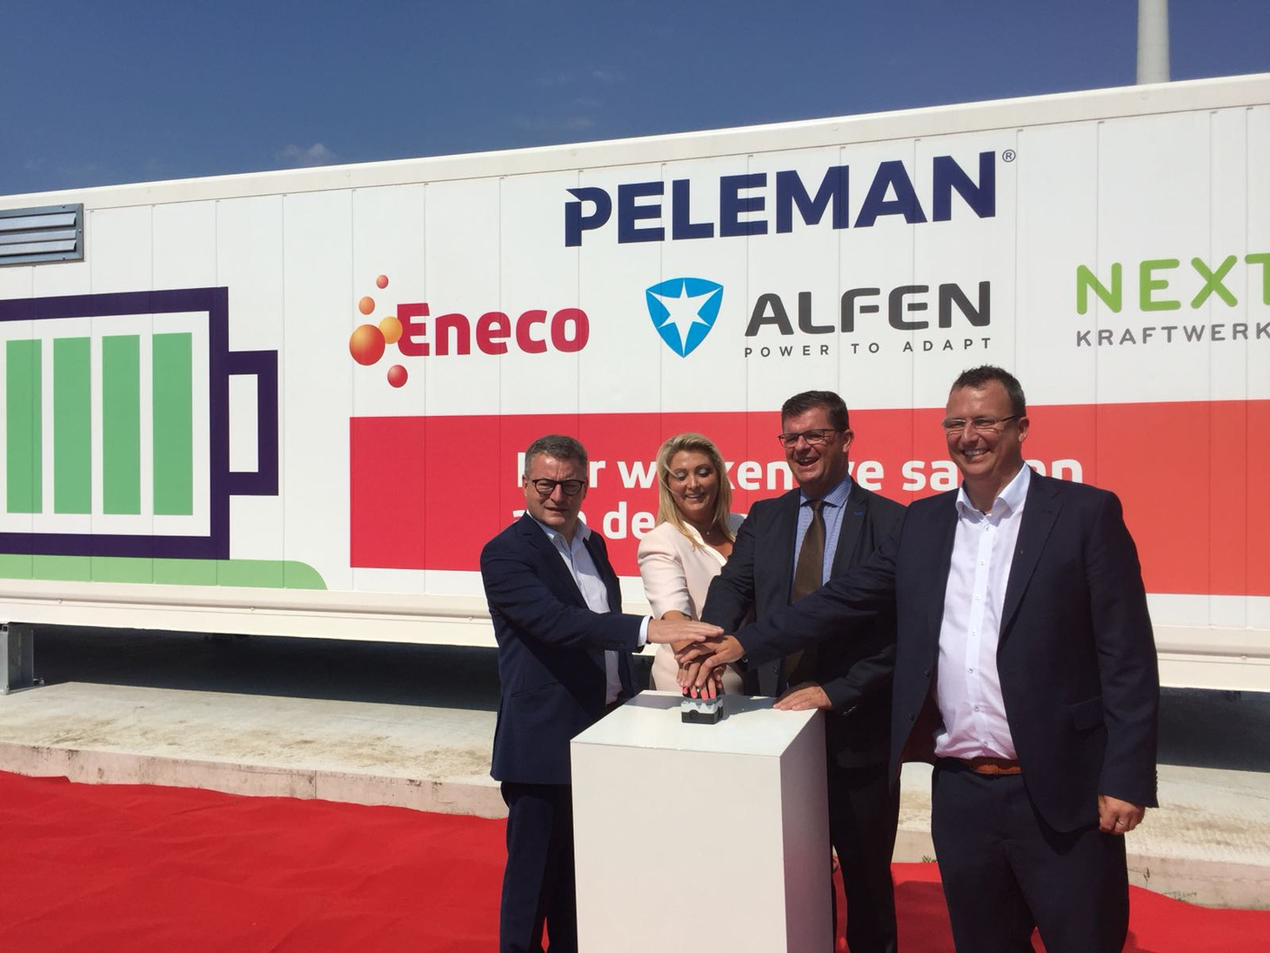
Energy buffers: Electrical storage
Batteries
  Home batteries
  Industrial batteries
Functionality
  Charging the sun during the day to feed evening peak consumption
  Self-consumption optimization
  Arbitrage is also possible (buy at low prices, use at high prices)
Steering
  via EMS
  based on injection measurement
  Business case: multiple revenue streams needed
https://online-accu.nl/solar-accessiores/byd/9885700/
https://news.eneco.be/industriele-battery-verhoogt-lokaal-consumption-van-windenergie#

Slide 43
Agenda
Introduction
The changing electricity system
Balancing and Day ahead market
Dynamic prices and how to reduce your costs
Imbalance in real time and how to contribute/gain
Flexibility in your processes
Your energy buffers
EMS and maakjemeterslim.be
Conclusions

Slide 44
Energy Management Systems
You can manually do basic controls:
  Use timer, apps with start/stop functionality, …
To control energy consumption in a smart way, you need an Energy Management System (EMS)
  Understand your consumption: monitoring
    Data measurement
    Visualisation
    Analysis
  Control devices
    Smart charging of EV or EV parking
    Self consumption optimisation (functionality mostly included in hybrid inverters)
    Smart charging of battery
    Smart heating of Domestic Hot Water
    Curtail PV injection when injection prices on the market are negative

Slide 45
Energy Management Systems
Energy management systems come in different flavours
  Monitoring and visualisation
    Ex: MyFluvius (free for all digital meter users), with quarterly data activated
    Apps of the solar inverter
  Single device control
    Smart charging of EV or EV parking:
    Self consumption optimisation (functionality mostly included in hybrid inverters)
    Smart charging of battery
  EMS systems to control different devices
    Ex: Home Wizard is a simple cheap system
    Other EMS: maakjemeterslim.be

Slide 46
Energy Management Systems
Energy management systems can deliver real value in Euros:
  Efficient energy management
    Insight in (unneeded) consumption
  Manage peak: reduce capacity tariff on distribution cost
  Self consumption optimisation
    Use EV, boilers and heat pump when your PV system produce energy
  Smart charging of EV and battery
  Optimise with dynamic tariffs
  Use FSP services:
    to provide services to TSO (FCR market)
    To provide services to BRP (imbalance)
    To do arbitrage between cheap and expensive hours

Slide 47
Agenda
Introduction
The changing electricity system
Balancing and Day ahead market
Dynamic prices and how to reduce your costs
Imbalance in real time and how to contribute/gain
Flexibility in your processes
Your energy buffers
EMS and maakjemeterslim.be
Conclusions

Slide 48
Conclusion
Flexibility is needed in the system to cope with more and more renewables
  There will always be an incentive to adapt consumption to production or to use energy buffers
There is quite some flexibility in companies and households
  Use it!
Control consumption via (semi-) automatic control → EMS
The more flexible consumption the better:
  strategic advice to design processes with as much flexibility as possible
Always maintain comfort or the function in processes
In addition to flexibility in processes, there is also flexibility in energy buffers

Slide 49
Extra: SmartEn – video: summary
smartEn is the European business association integrating the consumer-driven solutions of the clean energy transition.
They aim to create opportunities for every company, building and car to support an increasingly renewable energy system.
Excellent video to show what flexibility is, why it is needed:
  Introducing Demand -Side Flexibility (5 minutes video)

Slide 50
Extra: Podcast series Pioniers in de energietransitie
Een serie van podcast, gerealiseerd door Flux50
Kadert in project “Opleidingen van de toekomst – thema energie”, een project van Europa Werk en Sociale Economie
Pioniers in de energietransitie (spotify)
  Podcast 13: Elektriciteitssysteem, door Johan Driesen van KUL
  Podcast 14: Flexibiliteit, door Dries Bols van Lifepwr

Slide 51
Questions? Concerns?
Email: marc.vermeeren@flux50.com

Slide 52
Wat vind jij?
Laat ons je feedback weten!
Evaluatie
Dit helpt ons de Every1 materialen verder te verbeteren. Dankjewel!
Link to the short 3-5 min survey:
https://ec.europa.eu/eusurvey/runner/Every1WebinarDutch

