Slide 1

Do renewables make the grid unstable?
2026
Separating the myth from how the grid actually stays up
Notes:
A recurring worry in public debate is that solar and wind, because they are weather-dependent and connect through power electronics instead of spinning machines, must make the electricity grid less stable. This deck unpacks that worry. We will look at why people think this, at what grid stability actually means in technical terms, and at how grids dominated by renewables stay stable in practice. The short answer: high-renewables grids are stable — they just rely on a different mix of tools (grid-forming inverters, batteries, demand response, interconnections) than the old fossil-and-nuclear grid did.

Slide 2
How to use this slide deck
This Slide deck is meant as a guide and easy starting point for a person that will explain the topic to an audience that isn't familiar with the topic yet.
Feel free to adapt and expand to your own need.
  The material is licensed under CC4.0 SA BY
You can find guidance text in the notes of each slide

Slide 3
Agenda
The worry
The three pillars
Solar and wind are intermittent and have no spinning mass — so the grid must be fragile, right?
Frequency stability, voltage stability and adequacy of supply over time.
And renewables too
Smart inverters, batteries, flexibility and interconnections do what thermal plants used to.
Notes:
We will go through three questions. First, where the worry comes from — what people mean when they say 'renewables make the grid unstable'. Second, what 'grid stability' actually means in engineering terms: the three pillars are frequency stability (50 Hz), voltage stability, and adequacy of generation over time. Third, how a grid full of renewables delivers those three pillars in practice, with examples and with an honest look at the 28 April 2025 Iberian blackout.

Slide 4
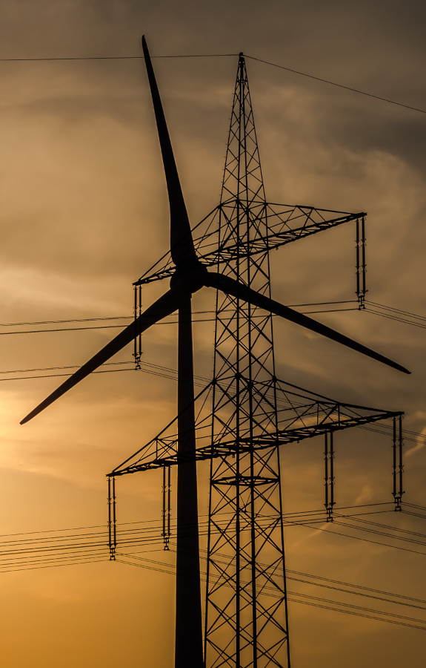
The worry
Variable output: solar and wind follow the weather
No spinning mass — no natural inertia from inverters
Inertia used to come free from thermal plants
Notes:
The worry has three legs. First, output is variable: solar drops at sunset and on cloudy days, wind drops when the air is still, and forecasting is imperfect. Second, solar and wind connect to the grid through power electronics — an inverter — instead of through a spinning synchronous machine. They therefore do not naturally store rotational energy that would resist frequency changes. That stored kinetic energy is called inertia. Third, traditional thermal and nuclear plants used to deliver a long list of ancillary services (inertia, primary frequency response, reactive power, short-circuit current) for free, as a side-effect of running. As they are retired, all those services have to be procured explicitly from new sources. That last point is the real engineering challenge — not the renewables themselves.

Slide 5
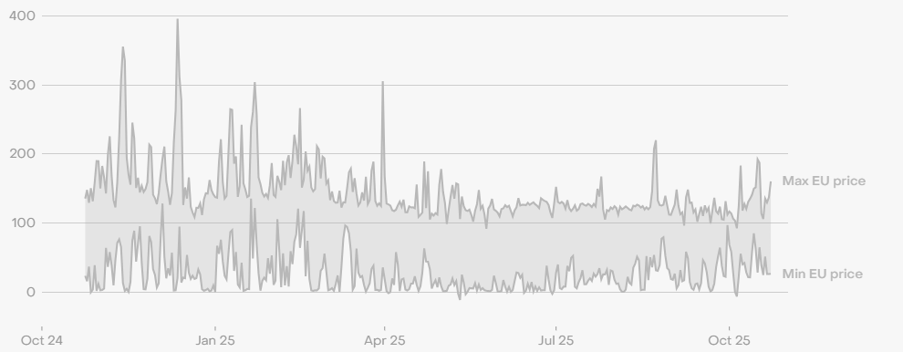
How does the grid actually stay stable?
Notes:
'Grid stability' is not a single property. Engineers split it into three categories, each addressed by a different set of tools and markets. Confusing the three is one of the main reasons the debate gets stuck. On the next three slides we walk through frequency stability, voltage stability, and adequacy in turn, and then look at how each is delivered in a high-renewables system.

Slide 6
Three pillars of grid stability
1. Frequency stability
Across the European grid, supply and demand must match to within a fraction of a percent at every moment — any imbalance shows up as 50 Hz drifting up or down. Operators correct it within seconds using primary, secondary and tertiary reserves (FCR, aFRR, mFRR).
Notes:
The first pillar is frequency stability. The European synchronous grid runs at 50 Hz, and that frequency is a real-time signal of the balance between supply and demand. If demand exceeds supply, the frequency falls; if supply exceeds demand, it rises. Both deviations have to be corrected quickly. The TSOs do this with three layers of reserves: Frequency Containment Reserves (FCR) act within seconds, automatic Frequency Restoration Reserves (aFRR) take over within minutes, and manual Frequency Restoration Reserves (mFRR) deliver the longer-duration response. In a renewables-rich grid, batteries, demand response and increasingly the renewables themselves provide all three layers.

Slide 7
Three pillars of grid stability
1. Frequency stability
Supply and demand must match at every moment — 50 Hz is the live indicator. Operators correct deviations within seconds with FCR, aFRR and mFRR reserves.
2. Voltage stability
Voltage at every node must stay inside tight bands. Generators absorb or inject reactive power; modern inverters in PV and wind farms can do exactly the same.
Notes:
The second pillar is voltage stability. Voltage at every node in the network has to stay inside a tight band — typically within a few percent of nominal — otherwise sensitive equipment trips or insulation starts to fail. Voltage is controlled by injecting or absorbing reactive power locally. Traditionally, synchronous generators in fossil and nuclear plants did this. Today, the inverters in solar farms and wind turbines can provide exactly the same service, and the EU grid code already requires them to. In fact, distributed PV inverters across thousands of rooftops can provide finer-grained voltage support than a handful of large machines ever could.

Slide 8
Three pillars of grid stability
1. Frequency stability
50 Hz is the live indicator of balance. Three layers of reserves (FCR, aFRR, mFRR) correct deviations from seconds to hours.
2. Voltage stability
Voltage at every node must stay inside tight bands. Inverters in PV and wind farms can absorb or inject reactive power, just like spinning machines.
3. Adequacy of supply
Enough generation must be available when demand peaks. Solved with a mix of dispatchable generation, storage, flexibility, and cross-border interconnections.
Notes:
The third pillar is adequacy — making sure there is enough generation available at the moments when demand peaks, including the worst-case combinations of low wind, low solar and high load (the 'dark doldrums' or 'Dunkelflaute'). Adequacy is delivered by a combination of dispatchable generation (gas, hydro, biomass), long- and short-duration storage (pumped hydro, batteries, hydrogen), demand-side flexibility (large industrial loads, EV charging, heat pumps), and cross-border interconnections that let a region import from a neighbour when its own resources are short. The Capacity Remuneration Mechanism is one of the regulatory tools used to ensure adequacy explicitly.

Slide 9
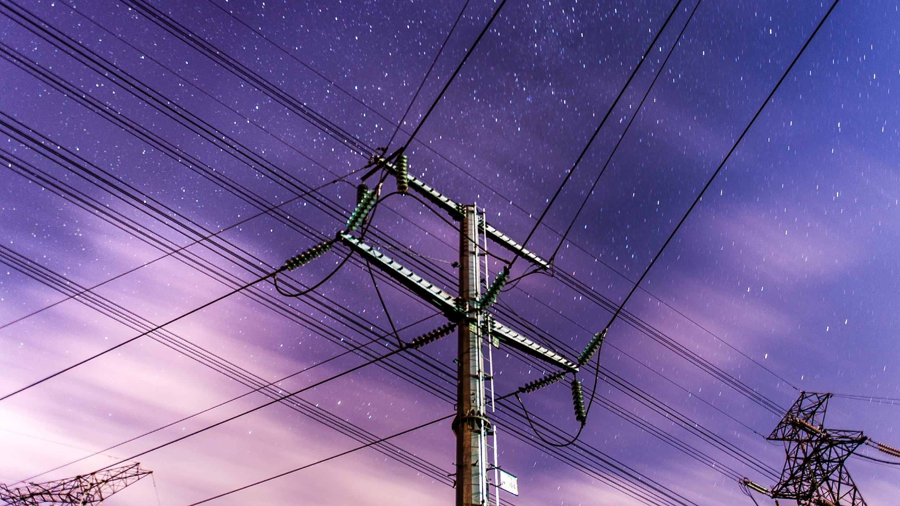
Renewables can deliver stability too
Stable
by design
Inverters can be 'grid-forming', not just 'grid-following'.
Storage and flexibility plug the gaps left by retired thermal plants.
Notes:
If the three pillars are frequency, voltage and adequacy, then the question becomes: can a grid full of solar, wind and batteries deliver all three? The answer is yes — provided the system is operated and regulated to procure those services explicitly. The next three slides walk through exactly how that is done in practice.

Slide 10
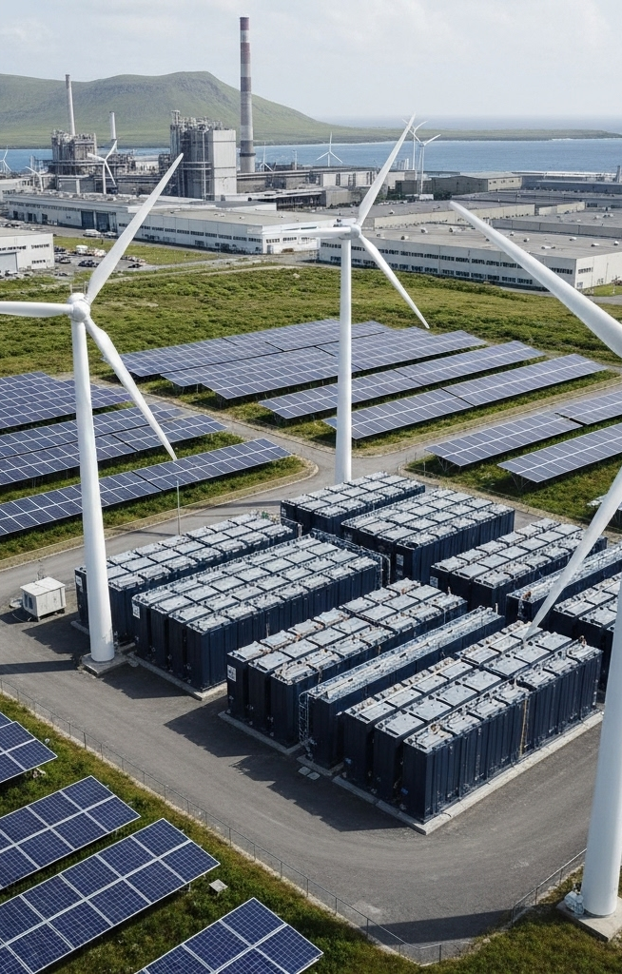
Smart inverters do more than make AC
Modern inverters deliver real grid services:
Reactive power for voltage support
Fast frequency response in milliseconds
Grid-forming control creates synthetic inertia
Notes:
The first lever is the inverter itself. The inverters in today's solar and wind farms are no longer just AC sources — they are programmable power-electronics platforms. They can provide reactive power on demand for voltage support, they can deliver fast frequency response (often in milliseconds, much faster than a thermal plant), and the newest 'grid-forming' inverters can even create synthetic inertia, behaving electrically like a synchronous machine to the rest of the network. The UK's E.ON Drax pumped-hydro plant was replaced by a Tesla battery operating in grid-forming mode in 2024 — the same service, from a renewables-compatible asset. EU and national grid codes are progressively requiring these capabilities from all new connections.

Slide 11
Flexibility plugs the gaps
What used to come free now gets procured explicitly:
Batteries supply FCR and aFRR within seconds
Demand response shifts loads, EVs, heat pumps
Interconnections trade across borders in real time
Notes:
The second lever is flexibility — and crucially, flexibility from many sources. Battery storage is already the dominant provider of Frequency Containment Reserves in Belgium, Germany and the UK; a 100 MWh battery can respond in milliseconds and deliver minutes to hours of energy. Demand response uses the inherent flexibility of industrial processes, EV charging and heat pumps to follow grid signals rather than fixed schedules. Interconnections — the high-voltage links between countries — let a region with surplus wind export to a neighbour with a still day, smoothing out variability geographically. Together these three sources of flexibility plug the gap left when a thermal plant retires.

Slide 12
What about the Iberian blackout?
28 April 2025 — Spain and Portugal lost power for hours. The story is more nuanced:
Triggered by voltage oscillations and protection trips, not 'too much solar'
Insufficient inertia and reactive-power reserves at that moment made the system fragile
Lesson: high-renewables grids need ancillary services designed for them, not against them
Notes:
The 28 April 2025 blackout across Spain, Portugal and parts of southern France is the headline event people point to. The honest version: it was not caused by 'too much solar'. The chain of events involved a low-frequency oscillation in the transmission system, voltage swings on a sunny Monday afternoon when Spain was exporting several gigawatts, and the cascading trip of PV and wind plants whose protection settings reacted to the voltage drop. The underlying weakness was that not enough inertia or reactive-power reserve was available at that moment — an operational and procurement problem, not a 'renewables don't work' problem. Spain has since accelerated mandates for grid-forming inverters and reactive-power reserves. The lesson is general: high-renewables grids need their ancillary services designed and procured explicitly, not assumed to come for free.

Slide 13

The takeaway
Renewables don't make the grid unstable — but they change how stability is delivered:
Frequency, voltage and adequacy still have to be procured — just from new sources
Inverters, batteries, demand response and interconnections do the job today
Build the markets and grid codes for the system we have, not the one we used to have
Notes:
To close: 'renewables make the grid unstable' is a misdiagnosis. What is true is that as fossil and nuclear plants retire, the services they delivered for free — inertia, primary frequency response, reactive power, short-circuit current — have to be procured deliberately from new sources. That is an engineering and market-design problem, and Europe is solving it: grid-forming inverter requirements, battery participation in FCR and aFRR, demand-response markets, capacity remuneration mechanisms, and expanded cross-border interconnections. The grid of 2035 will be majority-renewable, and it will be as stable as the grid of 2005 — through a different mix of tools.

Slide 14
acknowledgements
“Do renewables make the grid unstable?” was produced by Th!nk E for the Every1 project, licensed CC BY-SA 4.0. Every1 has received funding from the EU Horizon Europe programme under grant agreement No. 101075596.
Slide 3 — K.H. Reichert, “Billions of pounds of green infrastructure…”, CC BY-NC 2.0.
Slide 4 — ember.com, “Wholesale electricity prices in Europe”, CC BY 4.0.
Slides 8 & 11 — rawpixel.com, “Electric pole” and “Black transmission towers”, CC0.
Slide 9 — easy-peasy.AI, “High-Tech Microgrid Setup with Renewable Energy Resources”, CC BY 4.0.
Slide 10 — pensionpolicyinternational.com, “Inflation, war, rising interest rates…”, CC BY-ND 4.0.
Slide 12 — pxels.com, “European Commission Flags on Poles”, CC0.

Slide 15
Thank you!
Notes:
Questions? Related Every1 materials on the knowledge hub: 'How does flexibility help the grid', 'What is a digital twin of the grid', 'What can we learn from the Spanish and Portuguese Black-out?', and 'Why is my solar suddenly worth nothing?' for the citizen-level economic side.

