Slide 1

Bidirectional
Charging

Slide 2
How to use this slide deck
This Slide deck is meant as a guide and easy starting point for a person that will explain the topic to an audience that isn't familiar with the topic yet.
Feel free to adapt and expand to your own need.
  The material is licensed under CC4.0 SA BY
You can find guidance text in the notes of each slide

Slide 3
Opportunities and benefits
Agenda
The context
Barriers to technology
adoption
The actors
Policies
Opportunities and
benefits
Examples of pilot projects
Notes:
This presentation will focus on following topics:
The context of bidirectional charging
The main actors participating in bidirectional charging
Opportunities and benefits of the technology
Barriers to this technology’s adoption
Policy considerations that could alleviate the barriers
And pilot project examples.

Slide 4
The context

Slide 5
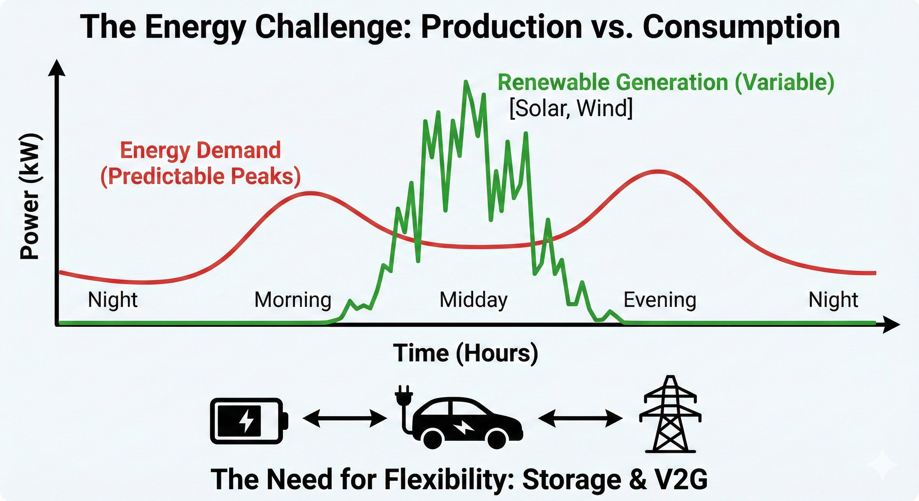
The energy challenge: why do we need storage?
Notes:
Most renewable energy generation is intermittent (you need sun, you
need wind, etc.).
For example, there is not much solar power generation in the morning
and evening, precisely when there are peaks in energy demand linked to
household activity.
Therefore, the challenge is to improve the way we use of renewable
energy generation by storing this energy for later use. We need storage and flexibility to store the surplus of renewable energy generated and use it
when peaks occur. This is a major challenge in increasing the penetration of
renewables.
One technology that can support this is bidirectional charging.

Slide 6
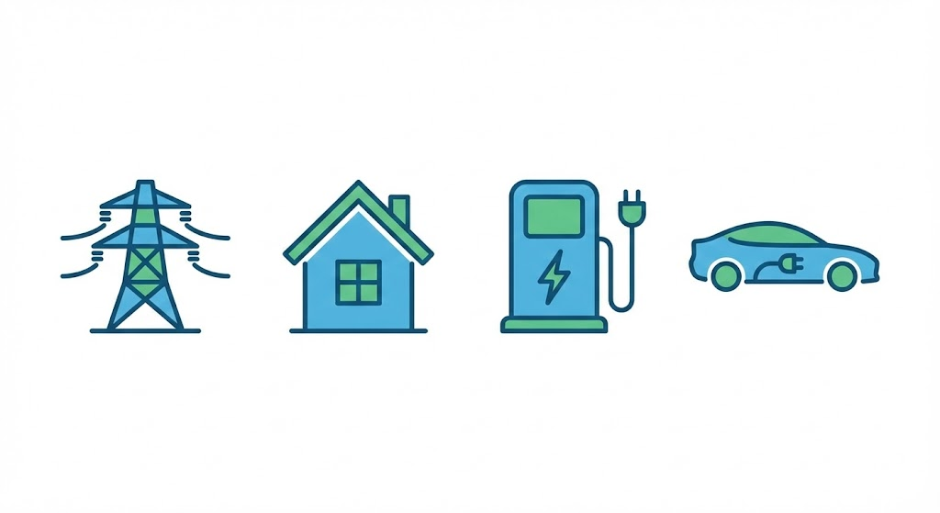
What is bidirectional charging?
Unidirectional charging (Normal charging or smart charging)
Bidirectional charging
Notes:
What is bidirectional charging?
Unidirectional charging from grid to home to charger to car
Bidirectional charging can also do the reverse and discharge electricity to
the grid
Difference between bidirectional charging and smart charging
Smart charging → use of software that allows charging to be delayed or
stopped.
Bidirectional charging → a more advanced step: it allows the same functions as smart charging, but also enables energy to be fed back into the grid.

Slide 7
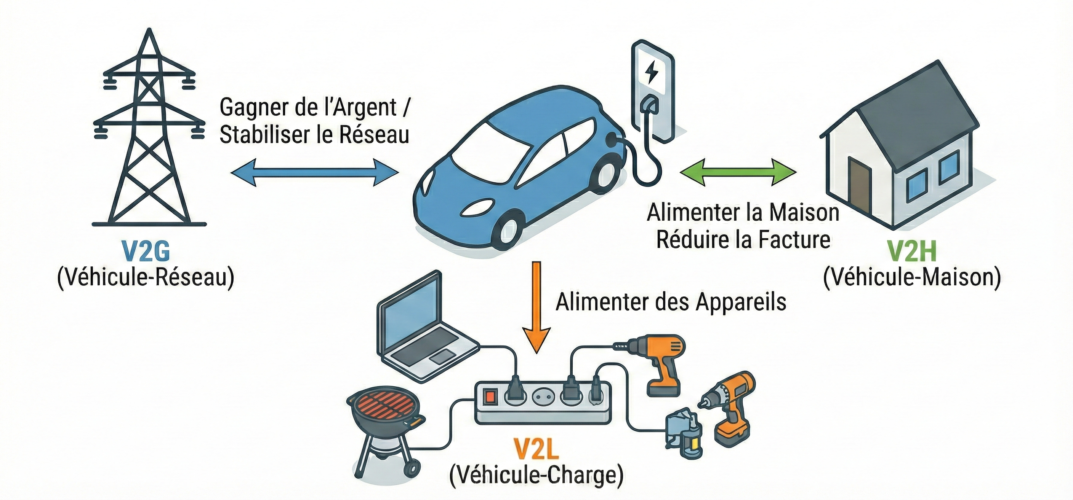

V2X: The multiple applications of bidirectional charging
Earn money /
Stabilse grid
Power house
and reduce bills
Power appliances
Notes:
There are several possible applications for bidirectional charging, also known as V2X (vehicle to everything):
V2G: Vehicle-to-Grid allowing to provide electricity to the grid— aims to help stabilize the grid and can generate
revenue.
V2H: Vehicle-to-Home allowing to provide electricity to a home — helps power the home and reduce energy bills.
V2L: Vehicle-to-Load allowing to provide electricity to a device — can
power equipment by plugging it directly into the vehicle.

Slide 8
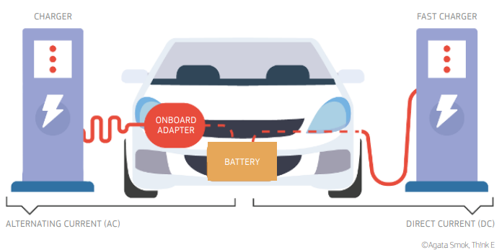
Required hardware
Notes:
What equipment is required for bidirectional charging?
There are two types of charging modes, each requiring a different equipment setup:
Direct current (DC) → This is the most common for bidirectional charging. The adapter (inverter) is located in the charging station, which converts
alternating current (AC) from the electrical grid into direct current (DC).
The battery stores electricity in DC, so no additional adapter is required in the vehicle.
Alternating current (AC) → Less commonly used for bidirectional
charging. In this case, an onboard inverter is required to convert the current
into DC for the battery.

Slide 9
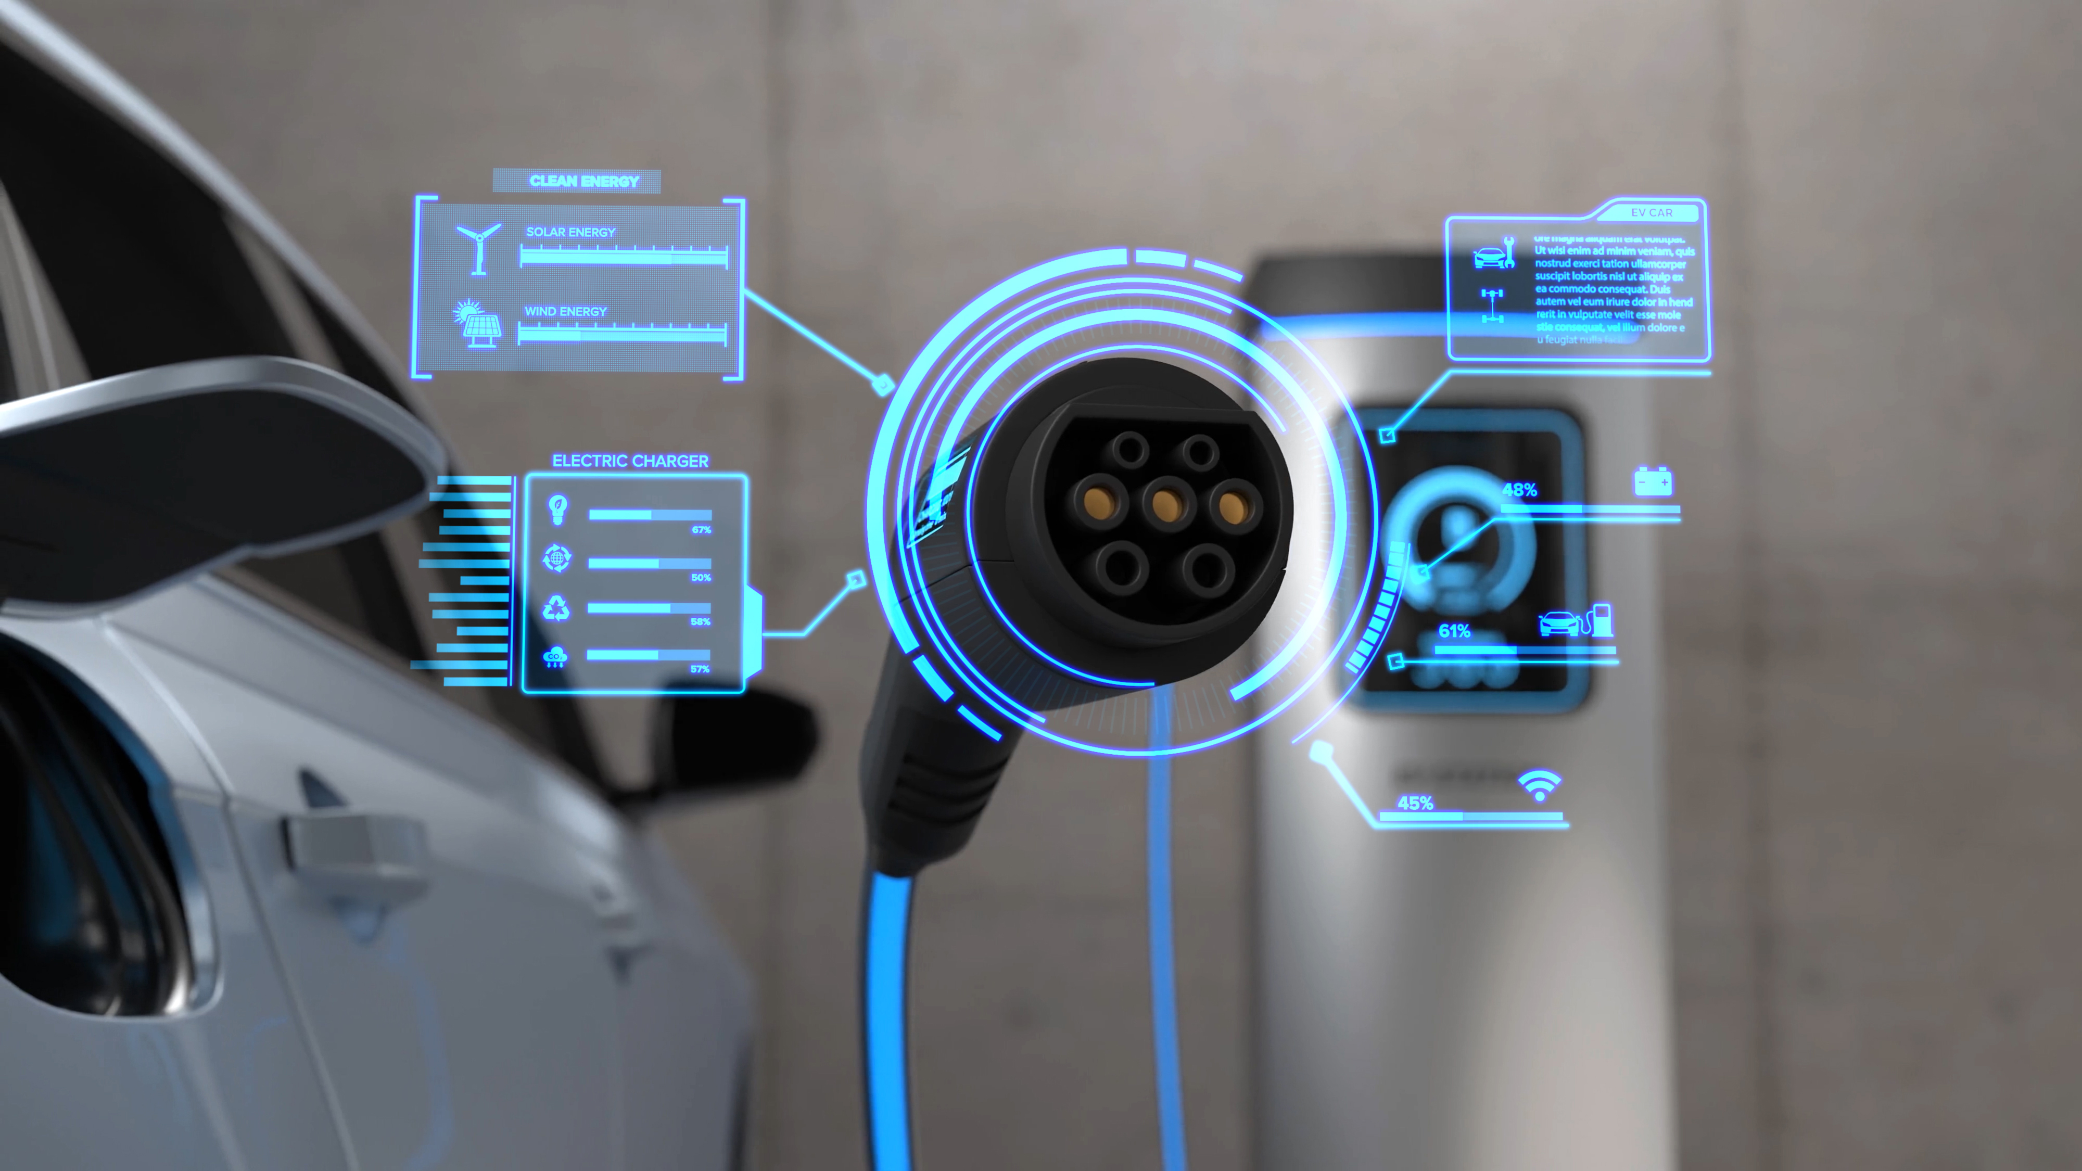
Required software
@user6702303 on Freepik
Notes:
Appropriate software is also required.
The software must be able to optimize the use of vehicles participating in the system.
It must optimise when to delay, increase, or decrease charging or discharging by taking renewable energy availability or the needs of the electrical grid into
Account.
Also, communication protocols between all the equipment involved are also
necessary.
This adds another layer of complexity to the system, as existing
protocols must support the data required for bidirectional charging.

Slide 10
The actors

Slide 11
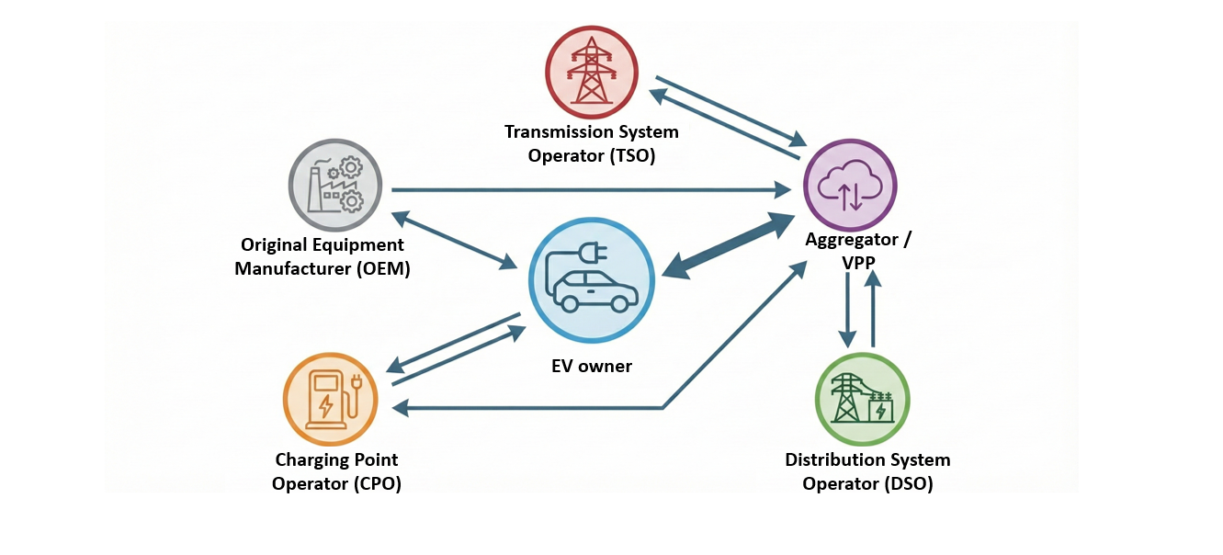
The main actors involved in the V2G system
Notes:
The main actors involved in V2G are presented on following picture with their interactions.
Other stakeholders are also involved, such as local authorities, for example.
This is a simplified version, but it works more or less like this.

Slide 12
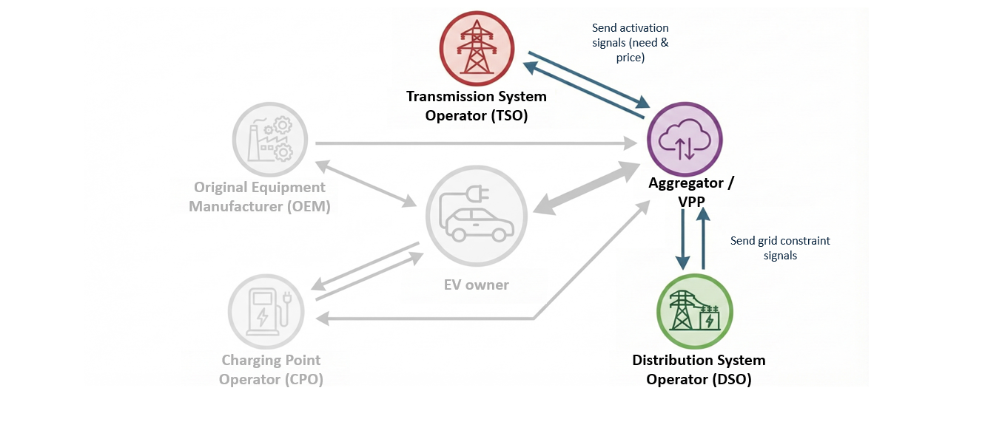
Grid operators: The actors who have a need
Notes:
Grid operators are the actors who have a need.
The TSO (Transmission System Operator): High level → needs support to
ensure grid stability and communicates these needs along with the
associated remuneration.
The DSO (Distribution System Operator): Lower level → aims to avoid demand peaks and communicates the constraints of the electrical grid.

Slide 13
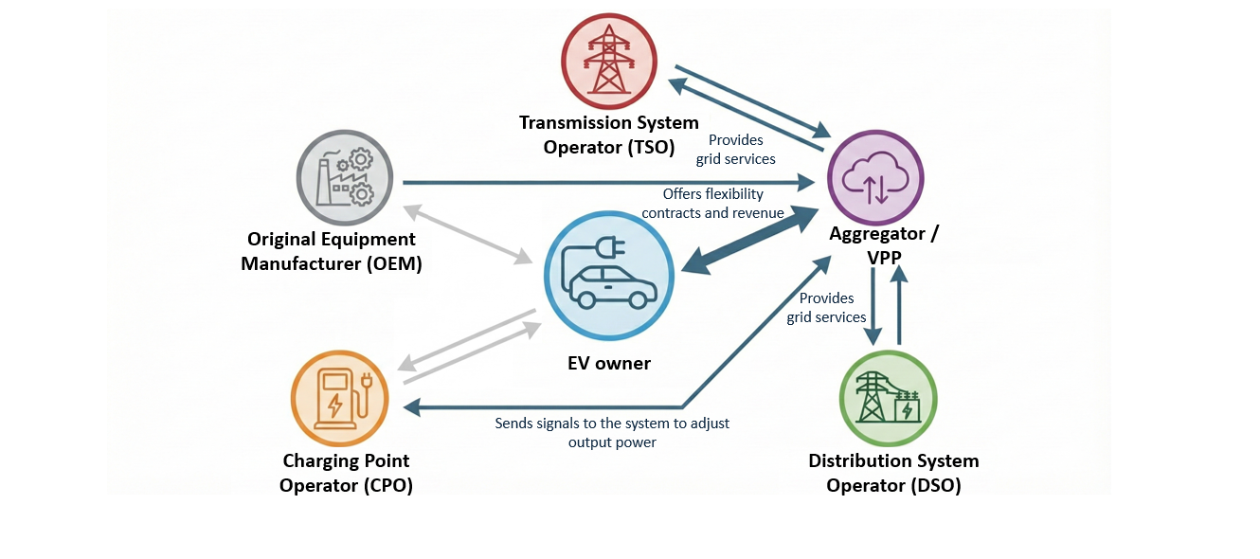
The aggregator: The actor with the main role
Notes:
The aggregator plays a central role. It manages a portfolio of vehicles,
which gives it access to a large flexibility capacity that can be made available to meet the needs of the electrical grid.
It receives requests from grid operators and offers its services in return for remuneration.
It sends signals to charging points, which then adjust their power levels
accordingly.
It is also in contact with electric vehicle owners, providing them with a
flexibility contract and sharing the revenues associated with the services delivered.

Slide 14
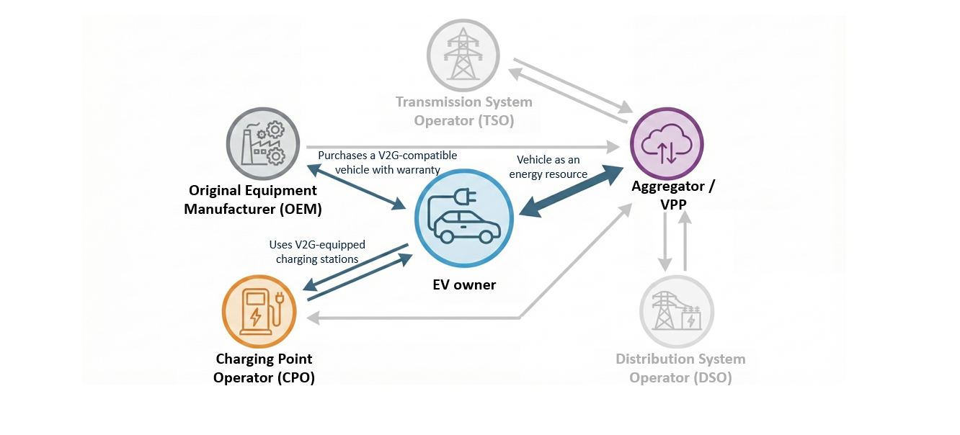
The EV owner: The actor who owns the valuable resource
Notes:
The electric vehicle owner is the actor that owns the resource.
He purchased a vehicle with bidirectional charging capability from a manufacturer and makes the vehicle available to an
aggregator in exchange for remuneration.
To do so, they use charging points that support bidirectional charging,
either public charging points or a unit installed at home.

Slide 15
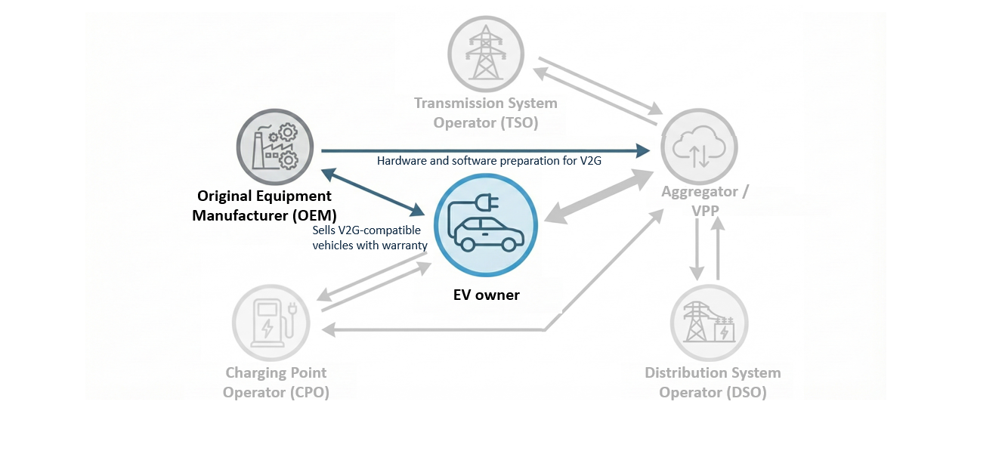
The car manufacturer: The actor who produces the resource
Notes:
The car manufacturer is the actor that produces vehicles supporting
bidirectional charging, thanks to the hardware and software integrated into the car.

Slide 16
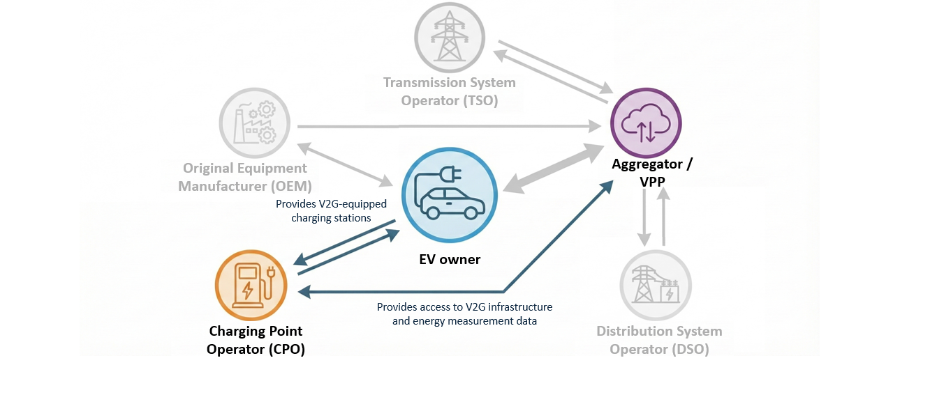
The charging point operator (CPO): The actor who connects the resource
Notes:
The charging point operator or manufacturer is the actor that connects
vehicles to the grid through charging points that support bidirectional
charging.
They provide the aggregator with access to adjust charging parameters and they provide the charging-related data, which is then used to determine
the remuneration of each party (the aggregator, the charging point operator, and the vehicle owner).

Slide 17
Opportunities and Benefits
Notes:
Let’s now discuss the opportunities and benefits linked to bidirectional charging

Slide 18
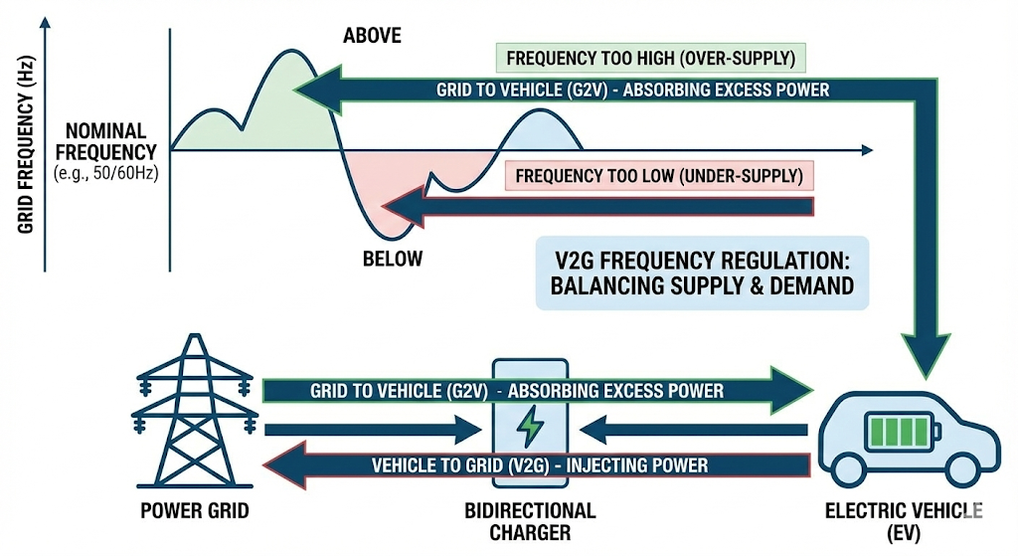

Supports grid stability
Notes:
An important benefit is helping to stabilize the grid when needed.
Essentially, it is about balancing supply and demand:
It helps absorb surplus energy by charging vehicles.
It injects energy back into the grid by discharging vehicles when needed.

Slide 19
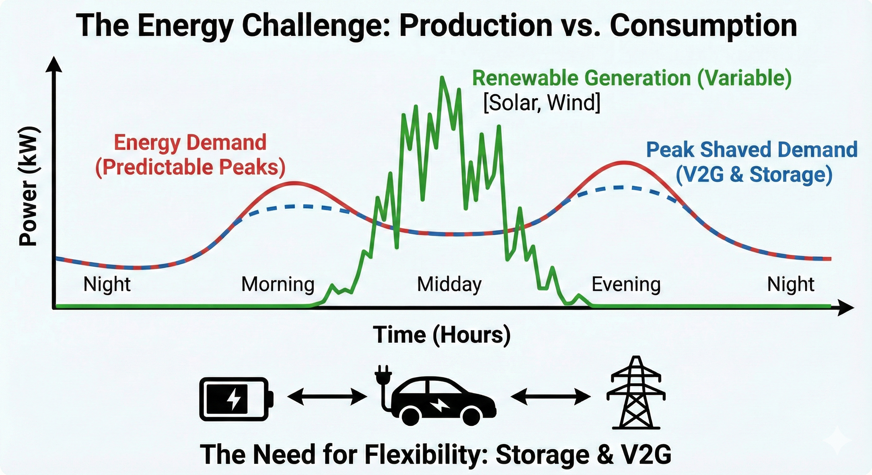
Enables optimization of renewable energy and the grid
Notes:
Another important benefit is optimizing renewable energy and the use of the grid.
Optimizing renewable energy means there will be less need to curtail
renewables during the day, leading to greater penetration of renewable
energy in the energy mix.
Steering the discharging of the batteries also allows renewable energy to
be made available during periods when renewables are not naturally
available, thereby reducing the use of thermal energy generation.
It also supports the grid by helping to absorb demand peaks, which
reduces the need for investment in strengthening the electrical network.

Slide 20
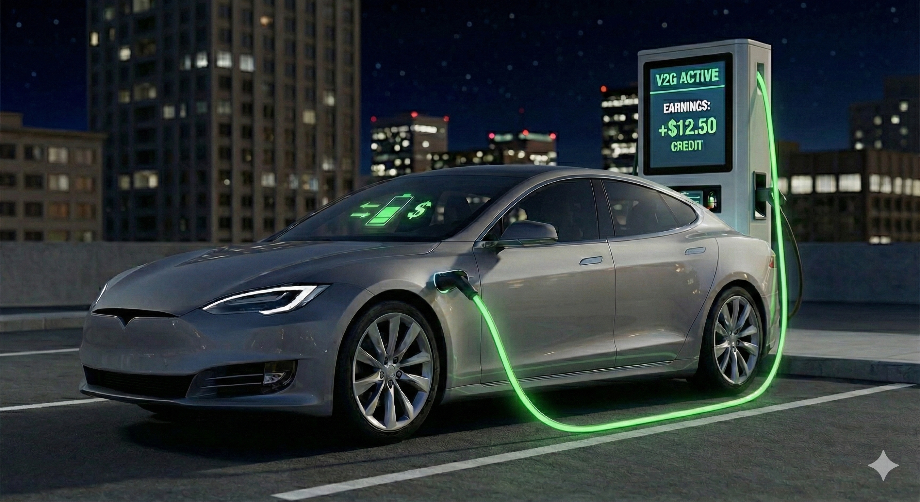
Monetization of idle assets
Notes:
As mentioned previously, it is also an opportunity for electric vehicle owners
to reduce their charging costs.
95% of the time, vehicles are parked and immobile. The vehicles can
therefore be seen as an asset that generates revenue.
This is an important benefit for the vehicle owner — without revenues, it
would not be possible to convince people to participate in bidirectional charging to support the electrical grid.

Slide 21

Grid resilience and V2H
Notes:
Another benefits for the owner include, for example, the ability to use the
vehicle as a backup power source in the event of a power outage
through vehicle-to-home (V2H).

Slide 22

V2G in fleet operations
Fleet demand and usage are highly predictable
  Fixed routes
  Predictable downtime
  Vehicle rotation
Reduces the fleet’s Total Cost of Ownership (TCO)
@ thing2196 on Unsplash
Notes:
There are also benefits for other stakeholders, such as professional fleets.
It can improve their business case since these fleets are predictable with sometimes fixed routes or downtime for example.
V2G can therefore be used in a fleet to optimise and reduce the Total Cost of Ownership of the fleet’s vehicles.

Slide 23
Barriers to Technology
Adoption
Notes:
Since access to the batteries of privately owned vehicles is important, it
is also crucial to overcome the barriers to adoption.

Slide 24
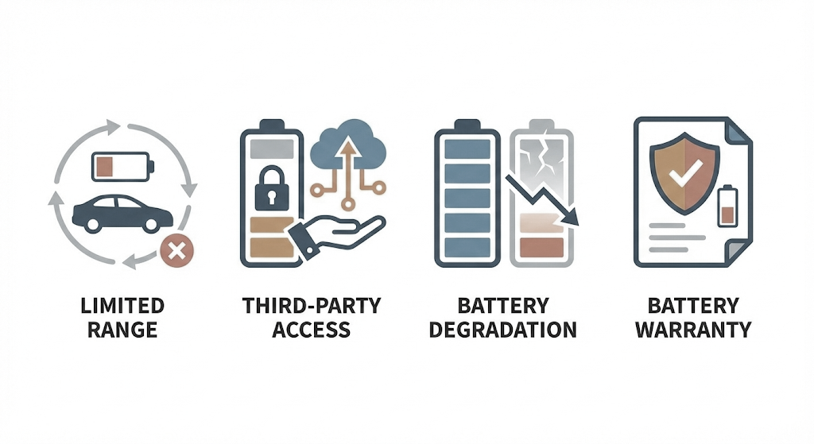
Increased anxiety related to third-party battery use
Anxiety
Impact on the vehicle’s range
Privacy
Battery warranty
Battery
degradation
Notes:
An important barrier is uncertainty and anxiety related to third-party use
of the battery.
What impact does this usage have on the battery?
Will there be enough range if the vehicle is needed immediately?
Privacy concerns regarding what information can the aggregator see about the vehicle usage?
Does this charging and discharging affect the lifespan of the battery and the vehicle?
And if so, does the warranty cover this impact?
All of these questions contribute to the concerns and anxiety that owners
have about this issue.

Slide 25
Additional cost of V2G infrastructure
Up to 5 to 10 times higher cost
Notes:
There is also an additional cost for the infrastructure, which can be up to 5 to 10 times the cost of a standard charging station.
The equipment is more expensive because it requires specific components, such as an inverter that converts alternating current (AC) into direct current
(DC), etc.
All this additional electrical equipment also increases installation costs, as the system becomes more complex.
It is therefore important to reduce these installation costs as well.

Slide 26
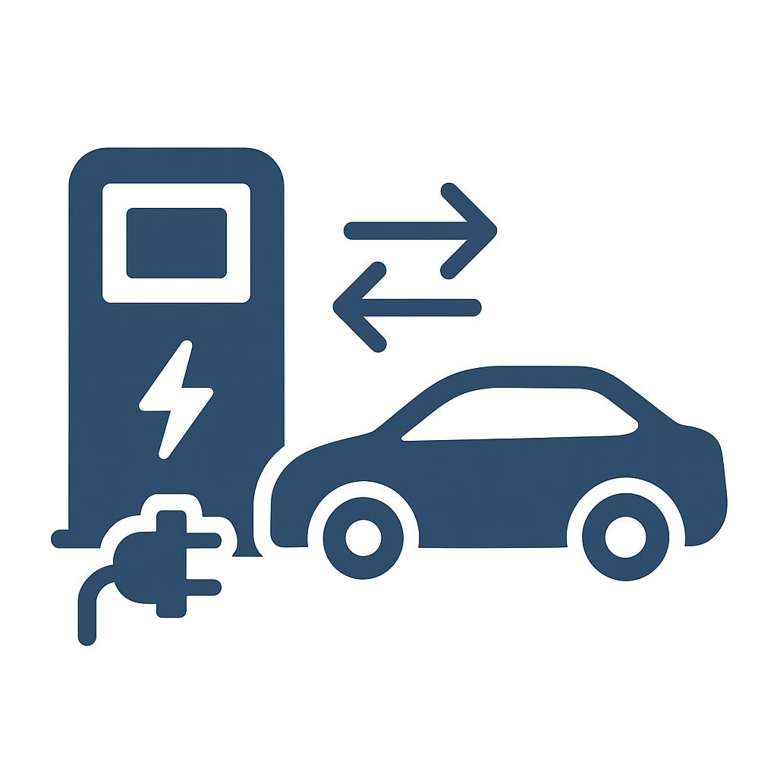
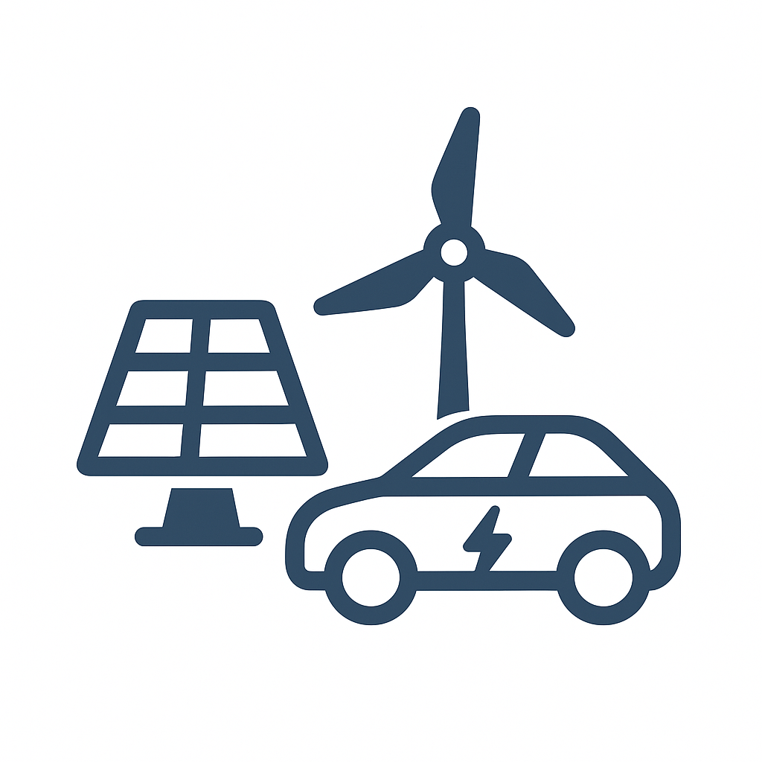
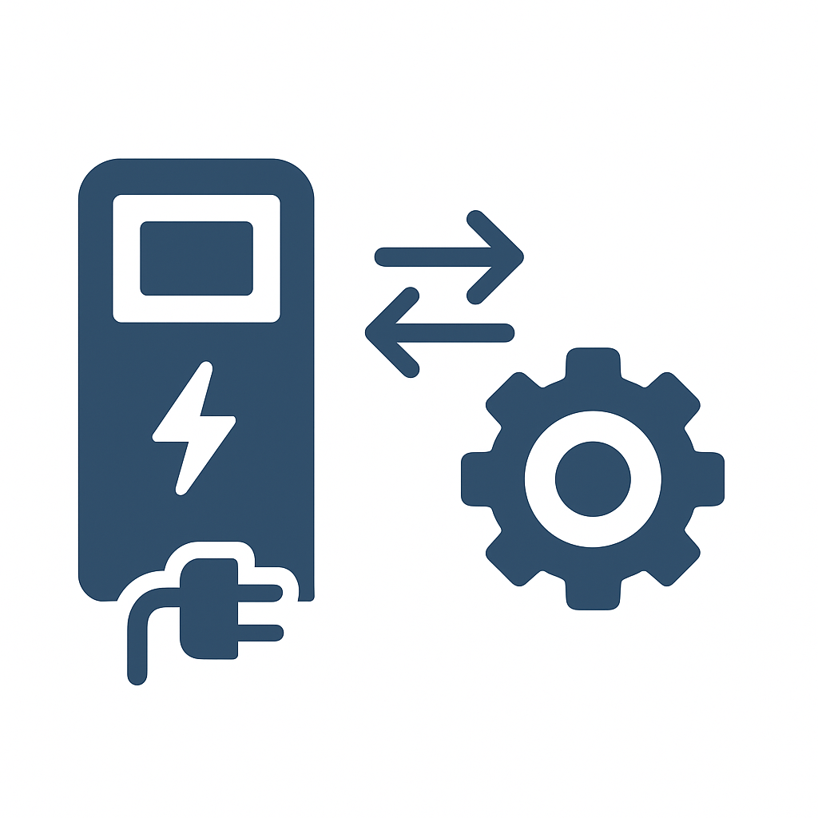

Standardization of the technology and market access
Communication
standardization
Significant barriers to
energy market access
for aggregators
Communication and
coordination between actors
Between charging
stations and vehicles
Charging station control
Notes:
Another barrier is the lack of standardization in software communication.
There are different standards for communication between charging
points and vehicles, as well as for controlling the charging station itself.
Ideally, a single standard should be adopted to make the technology easier
to implement and to avoid incompatibilities.
It is also necessary to simplify communication and coordination between stakeholders. This can be technological in nature, such as harmonizing
standards, but also administrative, ensuring that processes are not
fragmented.
Finally, access to the energy market is very complex for aggregators.
Many requirements must be met before gaining access, an example is that
aggregators need in some countries to have a large number of participating vehicles before getting access to the market.

Slide 27
Tax system adaptation is necessary
Bidirectional charging is currently considered a simple energy flow
The consumer pays taxes for both charging and discharging
They are therefore taxed twice
The tax system should take into account the flexibility service provided to the electricity grid and be adapted accordingly
€
€
Notes:
A final barrier that I’ll be mentioning is the necessity to adapt the tax system for charging and discharging electricity.
Bidirectional charging is currently considered a simple energy flow and the consumer pays taxes for both charging and discharging and are therefore taxed twice
The tax system should take into account the flexibility service provided to the electricity grid and be adapted accordingly

Slide 28
Policies
Notes:
Now, how can policies facilitate the development of V2G?

Slide 29
How can policies facilitate the development of V2G?
Policy recommendation 1: Regulatory sandbox | Discuss the role of pilot programmes and regulatory environments that allow V2G technologies to be tested without the full regulatory burden
Policy recommendation 2: Standardisation of Interconnection | Harmonising standards and simplifying the ‘connect and notify’ process for certified equipment is essential to reducing costs and accelerating the mass deployment of V2G technology
Example of political success: The German tariff exemption | This policy eliminates double taxation related to V2G, allowing the market to operate based on the actual value of the energy flexibility provided
Notes:
A first policy recommendation would be to test V2G technologies
extensively in real-world conditions without full regulatory burdens, to
stimulate accelerated learning and market readiness.
A second policy recommendation would be to harmonising connection
standards and simplify the connection process for certified equipment
To reduce costs and to speed up large-scale V2G deployment.
Finally, removing the double taxation is imperative. For example, Germany’s tariff exemption removes double taxation on V2G, allowing the market to
reflect the true value of the flexibility services provided.

Slide 30
Examples of Pilot Projects
Notes:
I will now conclude with two examples.

Slide 31

Utrecht and the Energized Project
Goal: Become the first city with a large-scale V2G project
Participants:
  Municipality of Utrecht (NL)
  Renault – Car manufacturer
  We Drive Solar – Charging infrastructure company
  MyWheels – Car-sharing company
Since the vehicles are shared, they have a different energy demand curve
and greater potential for bidirectional charging.
Currently, 50 Renault 5 E-Tech vehicles as shared cars
Planned expansion to 500 vehicles, corresponding to a flexibility potential
of 5 MW to support the grid during peak demand.
@sp_k_ on Unsplash
Notes:
The first pilot project is Energized in Utrecht. The goal is to make Utrecht
the first city to deploy a large-scale V2G project.
The initiative brings together the Municipality of Utrecht, Renault, We Drive
Solar, and car-sharing company MyWheels.
Because the vehicles are shared, they follow a different energy demand
pattern and offer greater potential for bidirectional charging.
The project currently includes 50 Renault 5 E-Tech cars, with plans to expand to 500 vehicles, unlocking up to 5 MW of grid flexibility during peak demand

Slide 32
V2G Açores
The Azores, located in the middle of the Atlantic, consist of independent microgrids, disconnected from the
mainland and not interconnected with each other.
They have a high share of renewable energy (solar, wind, geothermal), combined with storage solutions to
optimize its use.
Goal: Demonstrate that EVs can stabilize island grid frequency by feeding energy back during peak demand
or drops in renewable production.
Project participants:
  Electricidade dos Açores (EDA) – Grid operator
  Nissan – Car manufacturer
  Galp – Aggregator
  Nuvve – Software provider
  Magnum Cap – Charging point operator
Deployment of 10 Nissan Leaf vehicles and 10 bidirectional charging stations at EDA site in São Miguel.
The project successfully demonstrated that the fleet could provide frequency regulation services.
Notes:
The second project is V2G Açores.
The Azores are composed islands with isolated microgrids in the Atlantic ocean with a high share of renewable energy, making grid stability a key
challenge.
This pilot project deployed 10 Nissan Leaf vehicles and 10 bidirectional
chargers to demonstrate that EVs can support frequency regulation
by feeding energy back during peak demand or renewable shortfalls.
Led by EDA with partners including Nissan, Galp, Nuvve, and Magnum Cap,
the project successfully proved the fleet’s ability to deliver grid stabilization
services.

